Slide 1
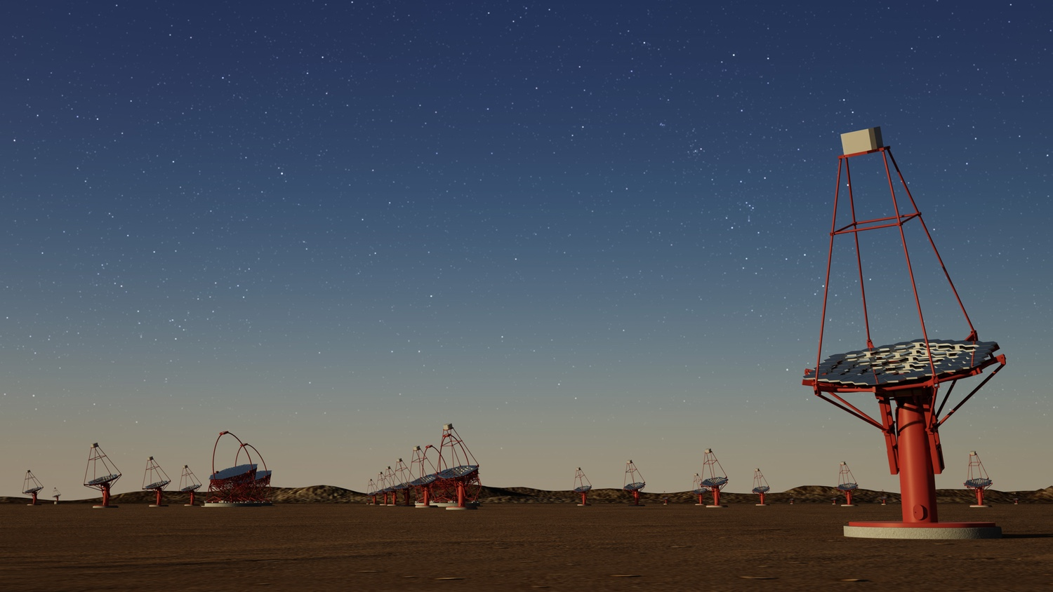
CTA-N Operations Building Definiation meeting
George Pruteanu
PO RAM

Slide 2
Warehouse
Size to be determined (based on the minimum number and volume of spare parts needed to system level. This could be done by rolling up the proposed spare parts list from work packages and following an analysis and considering all constrains and factor to minimize the number needed and to meet availability requirements.
If the size is a constrain for the CTA-N we should adjust our spare parts list keeping a certain Confidence Level (CL - Usually CL=90% to 95%) the availability to system level will still be met.
For the before and during ‘integration stage’ and few months following the acceptance, we should consider using containers or whatever space available will be at RQM and adjust our minimum needs!
In any case, Controlled Environment shall be considered so we will not affect the reliability of our spares.
Temperature (Heat-pump installed)
Humidity,
Proper Ventilation
Proper light system
Automatic fire extinguisher system (more details and other stuff Karl can provide)

Slide 3
Warehouse cont.
The final choice for the warehouse, should have proper in/out access (ramp or platform to load unload heavy parts into and off vehicles)
Must have enough large alleys and space to manipulate and safely use forklifts or any manual mechanical help devices needed to manipulate heavy or fragile parts.
Outdoor (preferable covered parking) or indoor/garage closed-by the warehouse space (maybe?), for all needed transportation vehicle, lift load-unload parts tools or personnel etc. Proper illuminated for safety access.
Maintenance vehicle(s) equipped with minimum set of tools electrical mechanical to be able to do minimum removal/replace LRU.
Dedicated transportation vehicles (Parts and Personnel)
Floor powered cleaning devices/vehicles to maintain warehouse and space to store them.
Electrical/Hydraulic mobile lift platforms and storage space for it.

Slide 4
Other Facilitues
‘Shipping Receiving Room’ (~ 30 to 40 m2) - an extra room for holding, packing and all necessary conditions to temporarily store defective removed parts from the telescope and make them ready for shipping to TLCM.
Could be nearby warehouse or separate the followings:
‘Maintenance Manager and/ or Maintenance Engineer Office’ (~20 to 30 m2) for two offices (Laptops, Maintenance GUI) – ‘Social/Relaxing Room’ (~ 15 m2)
‘Dressing/Changing Room’ (~ 15 to 20 m2)
‘PPE Room’ (~ 10 m2)
‘Washroom/Shower Room?’ (obviously!!!)
‘Meeting Room’ (10-12 people capacity – maybe less… max 6?) to be used for ‘hand-over’ between shifts (Night/Day and Day/Night exchange info meeting)

