Slide 1


ACE RAM Workshop
George Pruteanu
CTAO – PO - RAM
Barcelona July 8-9 2019

Slide 2
Agenda:
RAM Prediction (Lambda Predict)
FMEA
Maintenance Concept philosophy
  Preventive Maintenance (PM)
  Predictive Maintenance (PdM)
    Condition Monitoring System (CMS)
  Corrective Maintenance (CM)
    FLCM (BIT – BITE)
    SLCM
    TLCM
  Design for Maintenance - Concept

Slide 3
RAM Prediction (Lambda Predict)
Build ‘System Tree’ (more on function than physical location).
Where can be obtain, use supplier information (MTBF, FR, Sales vs. Returns in specific time etc.).
Use Part Library available with ‘Reliasoft’.
Reliability prediction (FIDES, Telcordia, Mil 217, NSWC-07/11)
  ‘Part count’ and ‘Part stress’ Analyses - Mil 217 (friendly user)
Consider environmental and other stress factors
Using BlockSim to represent the reliability model (RBD – Reliability Block Diagram) of system.
Lambda Predict software and Block-Sim and how to connect them.

Slide 4
RAM Prediction – Assumption for correction
Use "Ground, benign" as Environment Factor for components inside the camera body (assuming the camera is isolated from external conditions and it has offered a controlled temperature and humidity environment),
Use "Ground, fixed" for components outside the camera body,
Use 30°C as reference temperature inside the camera, when more specific values are not available,
Use a Quality Factor of "M" by default (corresponding to a multiplicative factor x1.0 in the failure rate). At least for passive parts as SMD Capacitors and Resistors, it produces failure rates much closer to those predicted by Fides and Telcordia for similar parts,
It is allowed to use the failures rates from the parts manufacturers when they are referred to 55°C and 60% CL (most common case),
It is allowed to use reliability models from different Standards to predict the failure rate of given parts. For example, FIDES to predict failure rate of connectors and fans (more updated properties such as L10 supported). FIDES to use PI factor of 1 instead of 4.

Slide 5
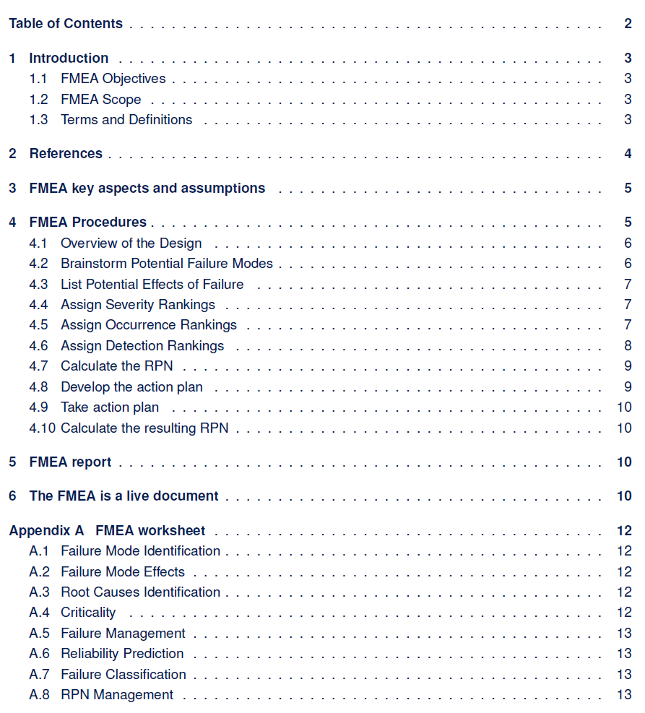
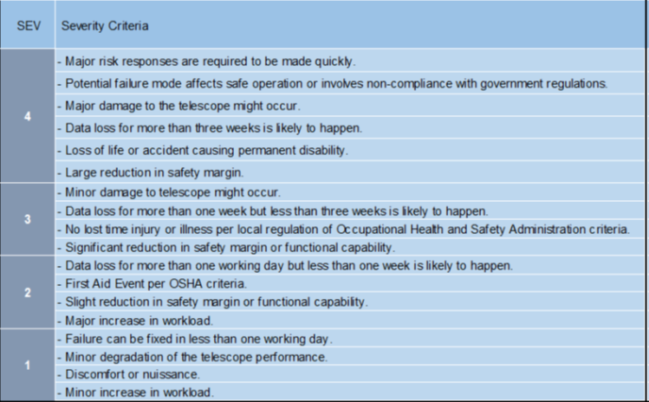
FMEA

Slide 6
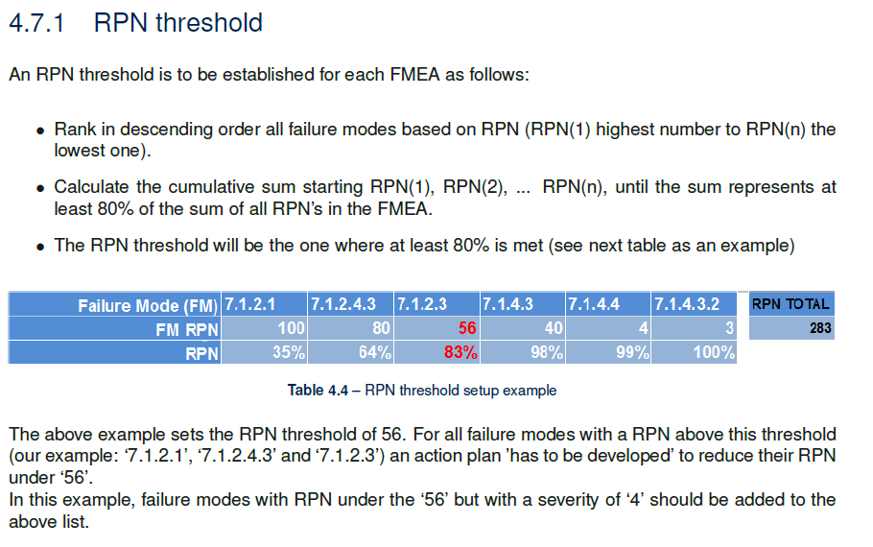
RPN threshold

Slide 7
Maintenance Concept philosophy
CTAO basic philosophy is to have a system that requires minimum maintenance, consistent with safety and a low cost of operation.
CTAO to implement Maintenance Process based on:
regular activities (i.e preventive maintenance),
condition monitoring of all major components and a
quick on-site remove/replace (R&R) of failed component.
CTAO Maintenance activities:
Preventive Maintenance (PM)
Predictive Maintenance (PdM) and Condition Monitoring System (CMS)
Corrective Maintenance (CM)

Slide 8
Preventive Maintenance (PM)
A preventive maintenance program will be determined by economics or safety would result in much less ‘emergency work’ and costly repairs.
PM consists of ‘check point periodic, scheduled activities’ on equipment:
  visual inspection,
  cabinets thermography
  adjustments, cleaning,
  lubrication (use automated process particularly in difficult to reach spots)
  scheduled replacements of:
    consumable parts (air filters, oil filters),
    limited life items (camera sensors??),
    Items subject to restoration to "as new" condition (overhaul),
  minor repair and maintenance of equipment and systems (cleaning mirrors, checking oil etc.).
  Replacement of obsolete items.

Slide 9
Predictive maintenance (PdM) and Condition Monitoring System (CMS)
Goal of PdM is the ability to:
  collect data (essential parameters),
  analyze data and
  predict when equipment failure could occur, and, case by case followed by preventing the potential failure through regularly schedule or schedule replacement before failure.
Predictive maintenance cannot exist without Condition Monitoring System (CMS),
CMS correctly implemented will:
Reduce:
  cost of asset failures and
  potential collateral damages to the system.
Improve:
  equipment reliability and safety
Minimize:
  unscheduled downtime due to catastrophic failure.
  maintenance time
  requirement for ‘emergency spare’ parts
Optimizes:
  maintenance intervals (better than manufacturer recommendations)

Slide 10
Corrective Maintenance (CM)
Corrective Maintenance is based on the principle that the equipment downtime must be minimized at the first level of maintenance (FLCM) >>> minimize the time to repair /restore system functionality.
Minimization is achieved by limiting fault isolation and the in-situ exchange of LRUs to fast and easy replacement.
The FMEA forms the basis of the identification of the Corrective Maintenance requirement.
CTAO Corrective Maintenance Activities can be done on 3 identified levels:
First Level Corrective Maintenance (FLCM)
Second Level Corrective Maintenance (SLCM)
Third Level Corrective Maintenance (TLCM)

Slide 11
First Level Corrective Maintenance (FLCM) & BITE (BIT)
Two type of actions identified at FLCM:
the repair/restoration at the location of the failure (i.e. connections and connectors fixes on site, resetting of the defective units of equipment performed on-site).
or by the removal and replacement of the identified defective LRU/LLRU, and subsequent functional verification of the spare used).
CTAO requires a ‘design for maintenance’ approach and a Build in Test (BIT) would automatically flag the defective LRU (see next slide).
BIT is a fault management and diagnosis equipment or software routine, which will automatically flag and pinpoint the defective LRU.
BITE - Built in Test Equipment it’s the extra hardware needed to eventually generate signals!
BIT uses internal system hardware and software to test the system or its subsystems. CTAO requirement the BIT will be automatically triggered at the beginning and at the end of the observing cycle:
BIT-ON – as a condition to complete the ‘standby’ state of the instrument,
BIT-OFF - at the end of any observation cycle before gets in the parking position.

Slide 12
BITE – Built in Test Equipment
BIT is a fault management and diagnosis equipment or software routine, which will automatically flag and pinpoint the defective LRU.
BIT uses internal system hardware and software to test the system or its subsystems.
CTAO goals for BIT:
BIT should detect 90% of all failures of the instrument and camera.
BIT must have less than 0.1% false alarms (high BIT- Equipment reliability).
BIT must be design for fault detection to the LRU.
CTAO requirement the BIT will be automatically triggered at the beginning and at the end of the observing cycle
BIT-ON – as a condition to complete the ‘standby’ state of the instrument,
BIT-OFF - at the end of any observation cycle before gets in the parking position.

Slide 13
Second Level Corrective Maintenance (SLCM)
LRUs identified as defective at the FLCM are returned to a Central Maintenance Facility.
Maintenance personnel use standard sets of second level maintenance tests and diagnostic equipment or automatic test and diagnostic equipment, to isolate and identify the defective subcomponents or parts within the defective LRU.
SLCM repair action consists of the removal and replacement of the defective assemblies or parts (LLRU), with the subsequent functional verification of the replacement(s).

Slide 14
Third Level Corrective Maintenance (TLCM)
TLCM is defined as repair and restoration of the LRU at a remote site,
  Supplier/manufacturer responsible in agreement with CTAO to repair with-in a defined time line (turnaround time -TAT)
RCCA training! Information needed generate repair shop report are vital information for the Failure Reporting Analysis and Corrective Action System (FRACAS)- a failure tracking system to be implemented.
All TLCM activities are recommended to be undertaken by the supplier or original manufacturer or their authorized repair and overhaul agencies.

Slide 15
Design for Maintenance
  Maintainability is created during the design process. It cannot be added later.
  Adopt maintenance philosophy in terms of ‘repair versus disposal’ of the product or components. This should be done before starting any design work.
  Consider where maintenance will take place (FLCM, SLCM, TLCM)
  Keep it simple. Complex arrangements are usually harder to maintain.
  Make it testable. Reactive (fault finding) tests often reveal latent problems that will become faults in the near future.
  Include diagnostic test points in electrical circuits.
  Design reliability into items that are difficult to maintain to reduce the need for maintenance access.
  Provide warning labels where a maintenance engineer may be exposed to danger. For example on hot or heavy items or where there is stored mechanical or electrical energy.
  Provide maintenance instructions and information panels if the routine is difficult to remember, and fix them as close to the point of maintenance as possible.
  Design equipment to fail-safe so that risk of injury to maintenance personnel is reduced.
  Avoid the requirement for special tools.
  Modularity design.
  Remove/replace with-out the need of removing other than belongings of the defective unit
  BIT is essential to ease the troubleshooting and to identify exactly the defective component

Slide 16
Thank You!
Questions?

