Slide 1
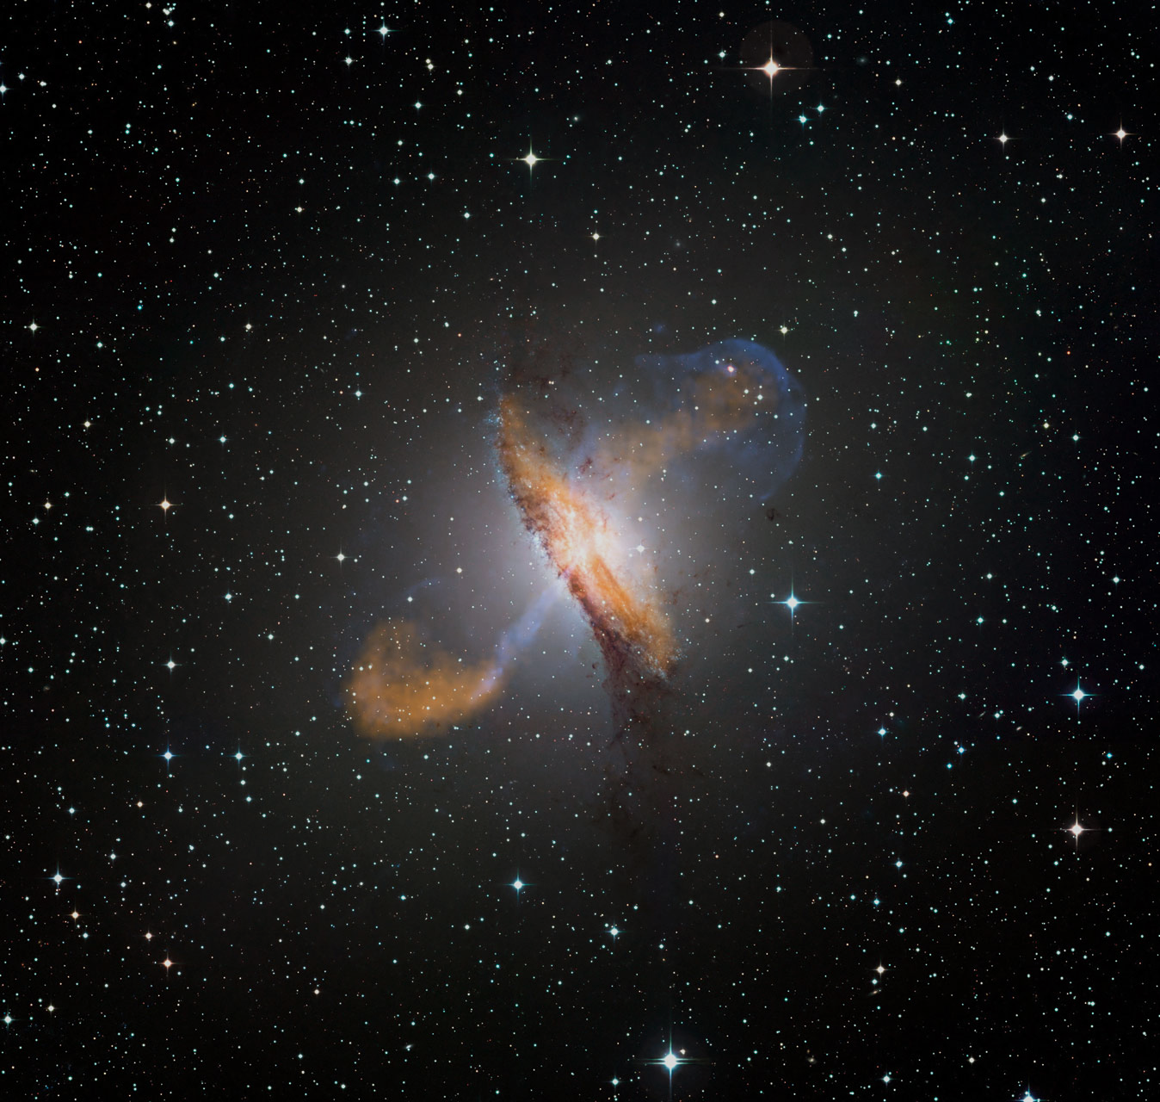



The Multi-Messenger View of AGN
Markus Böttcher
North-West University
Potchefstroom
South Africa
Supported by the South African Research Chairs Initiative (SARChI) of the Department of Science and Innovation and the National Research Foundation of South Africa.

Slide 2
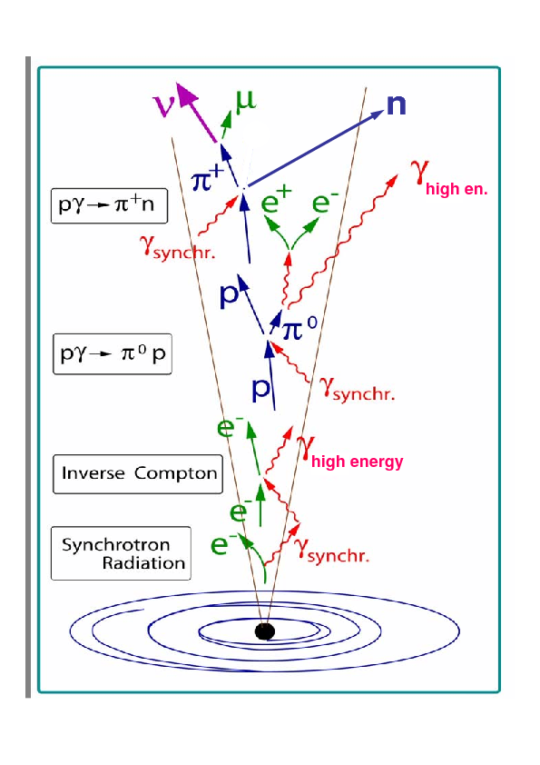
Multi-Messenger Signals from AGN
(hadronic / lepto-hadronic models)
Cosmic Rays (p)
Neutrinos
→ p + e⁺ + ν_{e}
Gravitational Waves
Illustrations: Katz et al. (2012)

Slide 3
Neutrino Production in Blazars
IceCube-170922A
TXS 0506+056
(IceCube et al. 2018)

Slide 4
Basics of Neutrino Production
p + γ → p + π⁰
or n + π⁺
π⁰ → 2γ
π⁺ → μ⁺ + ν_{μ} τ = 2.55×10⁻⁸ s
π⁻ → μ⁻ + ν_{μ}
μ⁺ → e⁺ + ν_{μ} + ν_{e} τ = 2.2×10⁻⁶ s
μ⁻ → e⁻ + ν_{μ} + ν_{e}
pγ likely strongly dominant over pp in AGN jet environments.

Slide 5
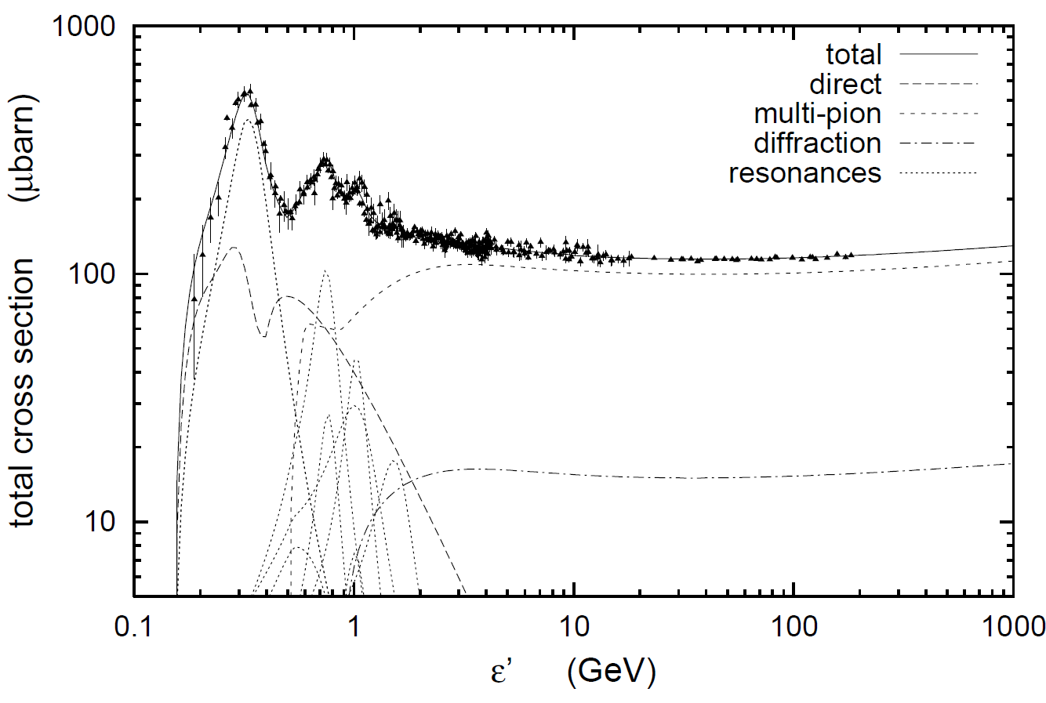
Photo-Pion Production
Δ⁺ resonance
1232 MeV
= m_{p}c² + 294 MeV
σ(pγ→pπ⁰) : σ(pγ→nπ⁺) = 2:1
(Baldini et al. 1998; Mücke et al. 2000)

Slide 6
Photo-Pion Production
Spectral index (n[ε] ~ ε^{−α}) of target photon field
Interaction Probability
(Mücke et al. 1999)
Center-of-Momentum energy
For realistic target photon fields,
most interactions occur near Δ⁺ resonance.

Slide 7
Photo-pion production - Energetics
At Δ⁺ resonance:
s = E’_{p} E’_{t} (1 – β_{p}’ μ) ~ E’_{p} E’_{t} ~ E_{Δ+}² = (1232 MeV)²
and E’_{ν} ~ 0.05 E’_{p}
To produce IceCube neutrinos (~ 100 TeV → E_{ν} = 10¹⁴ E₁₄ eV):
(i.e., E’_{ν} = 10 E₁₄ δ₁⁻¹ TeV)
Need protons with E’_{p} ~ 200 E₁₄ δ₁⁻¹ TeV
and target photons with E’_{t} ~ 1.6 E₁₄⁻¹ δ₁ keV
=> PeV CRs
=> X-rays

Slide 8
Photo-Pion Models for TXS 0506+056
neutrinos
pion-induced cascades
(Cerruti et al. 2019: MNRAS, 483, L12)
Proton-synchrotron
Bethe-Heitler-induced
cascades
Models producing neutrinos and gamma-rays through the same proton population, predict too high neutrino energies!

Slide 9
Photo-Pion Models for TXS 0506+056
(Gao et al. 2018, Nature Astron., 3, 88)
Models with p-γ induced γ-ray emission over-produce X-rays due to cascades!

Slide 10
Photo-Pion Models for TXS 0506+056
Need u_{t}’ >> u_{B}’
= 4 B₁² erg / cm³
Proton-synchrotron
(Reimer et al. 2019: ApJ, 881, 46)
From cascading constraints:
pγ neutrino production in TXS 0506+056 possible with strong external UV/X-ray radiation field, but under-predicts Fermi γ-rays.
=> No neutrino – γ-ray correlation expected!

Slide 11
Photo-Pion Models for TXS 0506+056
(Gao et al. 2018, Nature Astron., 3, 88)
(Keivani et al. 2018, ApJ, 864, 84)
Models producing neutrinos and gamma-rays require leptonically dominated gamma-ray production!

Slide 12
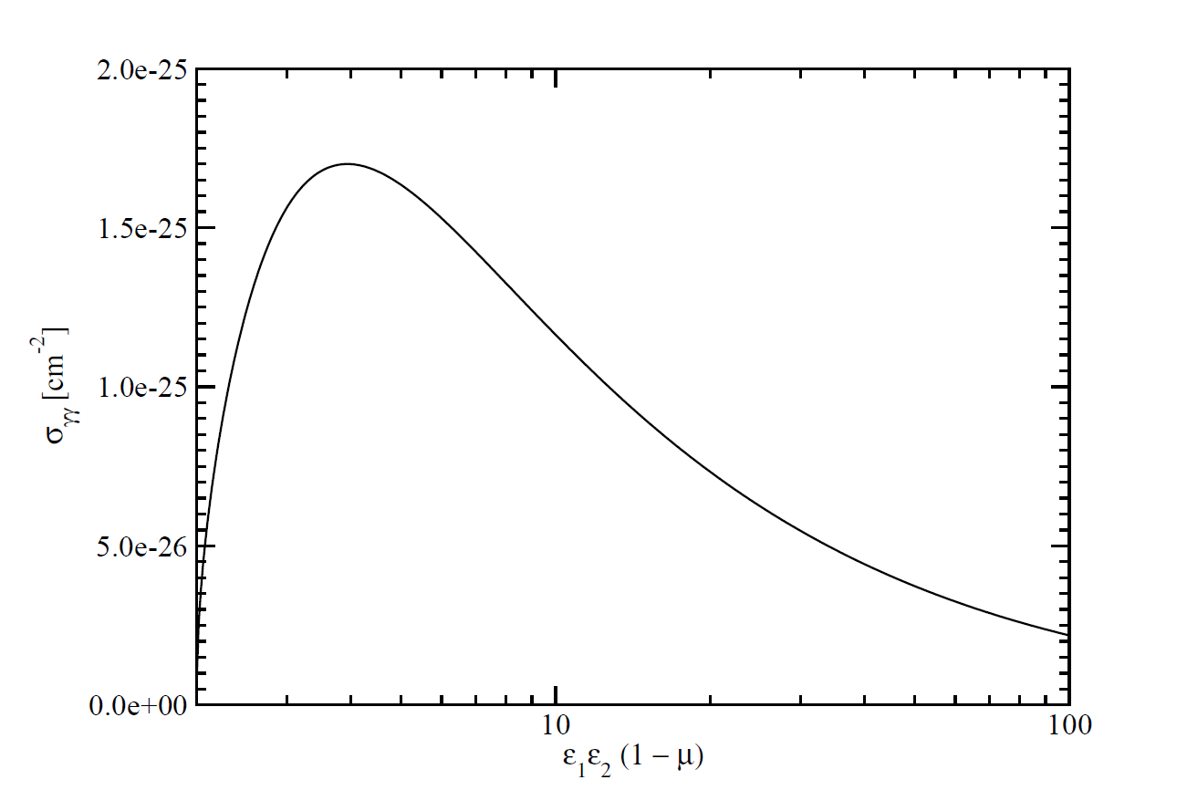
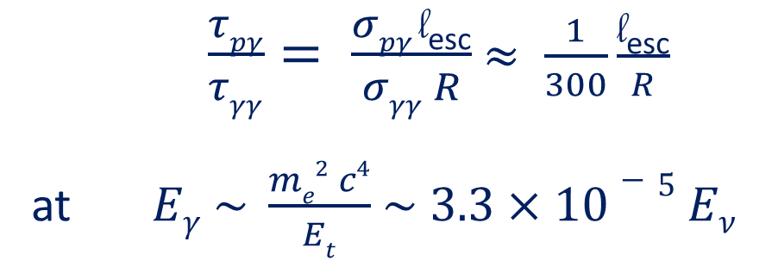
The pγ Efficiency Problem
Efficiency for protons to undergo pγ interaction ~ τ_{pγ} = l_{esc} σ_{pγ} n_{ph}
Likelihood of γ-ray photons to be absorbed ~ τ_{γγ} = R σ_{γγ} n_{ph}
σ_{pγ}
σ_{γγ}
$\frac{τpγ}{τγγ}= \frac{σpγ \text{l}\text{esc}}{σγγ R}$ $≈ \frac{1}{300}\frac{\text{l}\text{esc}}{R}$
at $Eγ \sim \frac{me2 c4}{Et}$ $\sim 3.3×10−5 Eν$
l_{esc} = average length travelled by protons until escape
~ GeV – TeV γ-rays

Slide 13

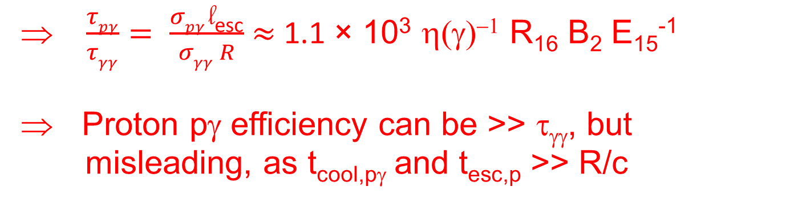
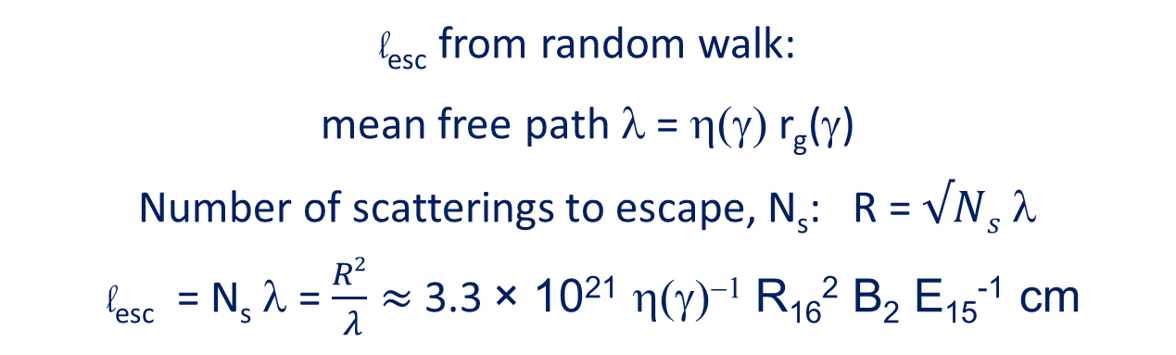
The pγ Efficiency Problem
$\frac{τpγ}{τγγ}= \frac{σpγ \text{l}\text{esc}}{σγγ R}$ $≈ \frac{1}{300}\frac{\text{l}\text{esc}}{R}$
l_{esc} = average length travelled by protons until escape
l_{esc} from random walk:
mean free path λ = η(γ) r_{g}(γ)
Number of scatterings to escape, N_{s}: R = $√Ns$ λ
l_{esc} = N_{s} λ = $\frac{R2}{ λ}≈$3.3 × 10²¹ η(γ)⁻¹ R₁₆² B₂ E₁₅⁻¹ cm
$\frac{τpγ}{τγγ}= \frac{σpγ \text{l}\text{esc}}{σγγ R}$ $≈$ 1.1 × 10³ η(γ)⁻¹ R₁₆ B₂ E₁₅⁻¹
Proton pγ efficiency can be >> τ_{γγ}, but
misleading, as t_{cool,pγ} and t_{esc,p} >> R/c

Slide 14
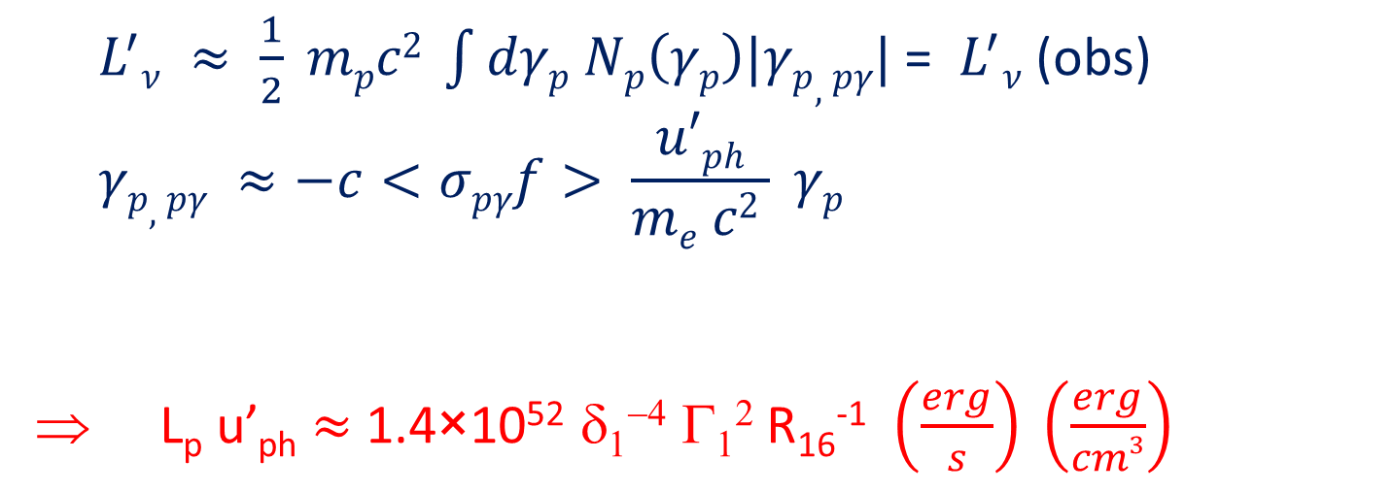
The pγ Efficiency Problem
Relevant constraint for proton bulk kinetic luminosity:
.
${ L}^{′}ν ≈ \frac{1}{2} mpc2 \int{dγp Np\left(γp\right)|γp,pγ|}$ = ${ L}^{′}ν$(obs)
$$γp,pγ ≈−c<σpγf> \frac{u′ph}{me c2 } γp$$
L_{p} u’_{ph} $≈$ 1.4×10⁵² δ₁⁻⁴ Γ₁² R₁₆⁻¹ $\left(\frac{erg}{s}\right) \left(\frac{erg}{cm3}\right)$
.
(Reimer et al. 2019: ApJ, 881, 46)

Slide 15

Cosmic-Ray Acceleration in Blazars
No conclusive correlation between AGN and UHECR arrival directions observed.
To produce > 100 TeV neutrinos → Need PeV protons
Simplest constraint: Confinement (Hillas Criterion):
E_{n} < Z e B R = 3 × 10¹⁸ B₂ R₁₆ eV
(Z = 1 for protons)
for hadronic blazar models with B = 100 B₂ G
R = 10¹⁶ R₁₆ cm
  Protons for IceCube neutrino production:
  UHECRs (E > 10¹⁹ eV): Plausible for heavy elements
  (Z >> 1)
(e.g., Rodrigues et al., 2018: ApJ, 854, 54)

Slide 16
Cosmic-Ray Acceleration in Blazars
Acceleration of Fe and subsequent spallation may produce UHECR spectra and composition similar to the observed ones.
(Rodrigues et al., 2018: ApJ, 854, 54)

Slide 17
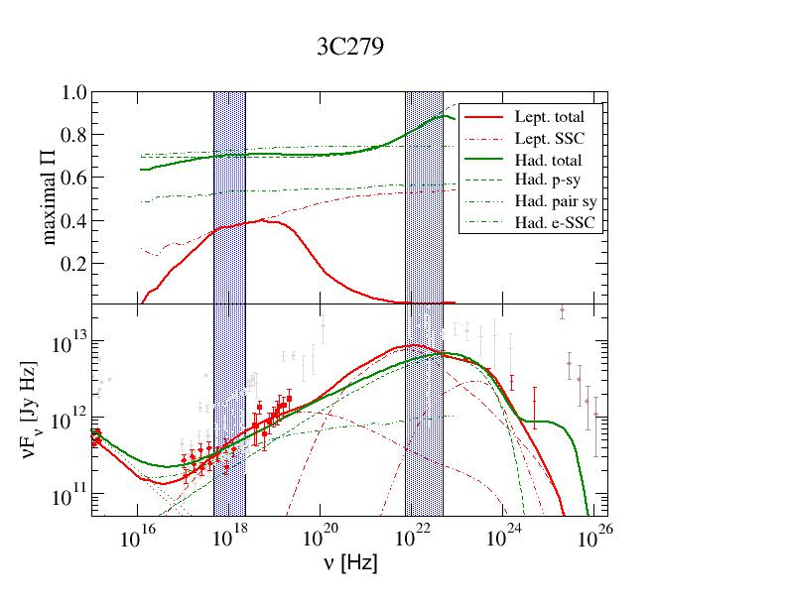
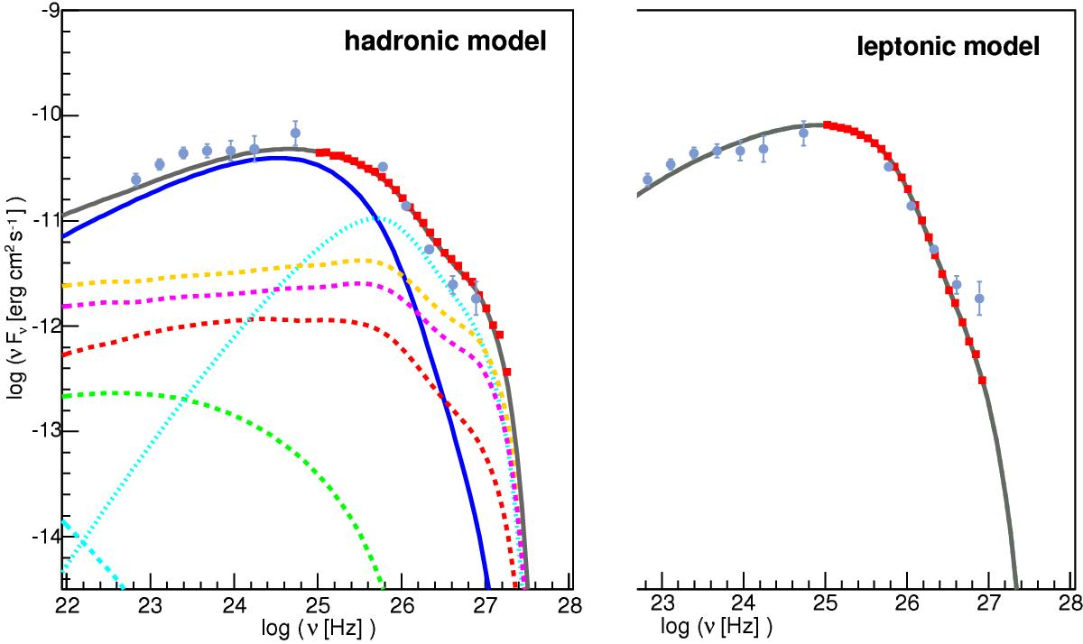
Observable signatures of proton / CR acceleration in blazars
X-ray / γ-ray polarization
(Zhang & Böttcher 2013: ApJ, 744, 18)
Spectral signatures of pγ induced cascades
→ IXPE / AMEGO
Requires simultaneous optical polarimetry for comparison.
→ CTA
Requires simultaneous MWL
(OIR-UV-X-ray) coverage.
(Zech et al. 2017: A&A, 602, A25)

Slide 18
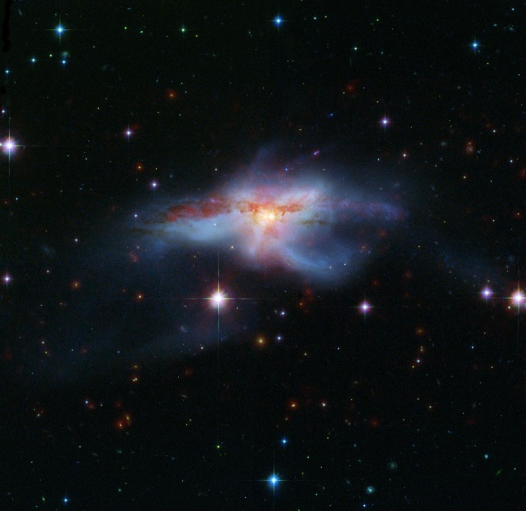
Binary Super-Massive Black Holes – Gravitational Waves
Evidence for periodicity in some AGN, e.g., OJ 287, PG 1553+113
Possible signature
of binary super-
Massive black holes
(Tavani et al., 2018, ApJ, 851, 11)

Slide 19
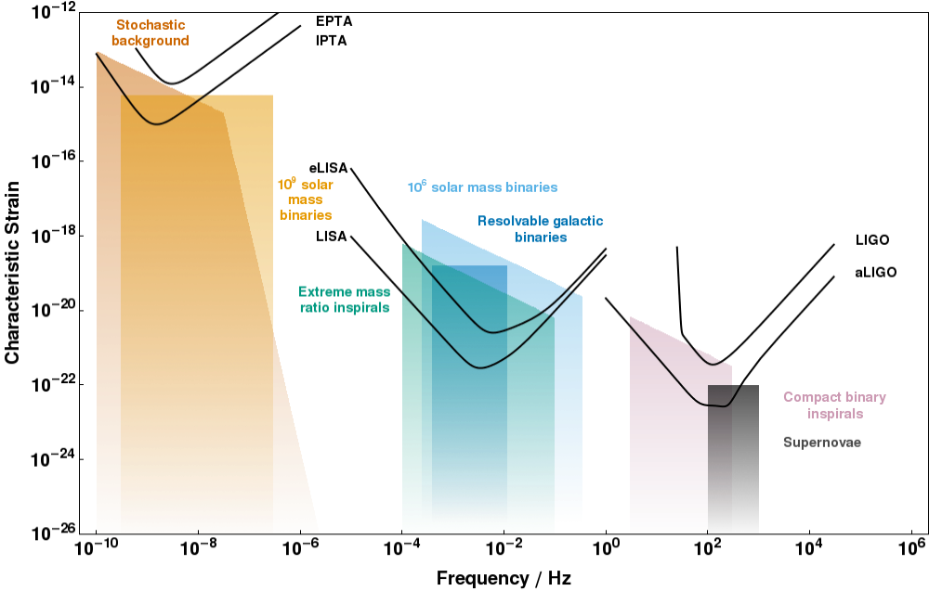
Gravitational Waves from supermassive black hole binaries
GW frequencies: f ~ 30 P_{y}⁻¹ nHz

Slide 20
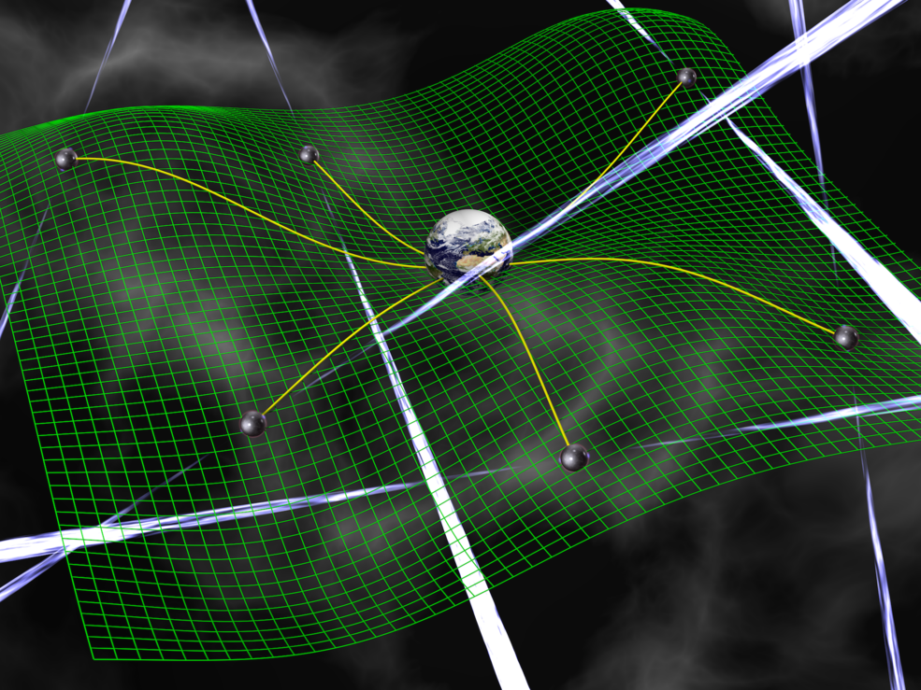
Pulsar Timing Arrays
Search for relative distortions of pulsar timing signals in various directions

Slide 21
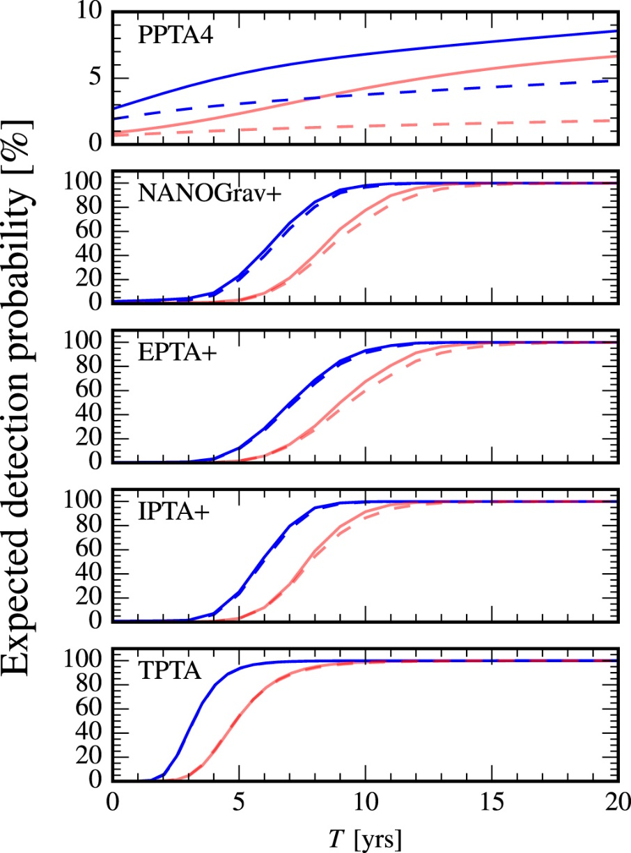
Gravitational Waves from supermassive black hole binaries
Prospects for detection with Pulsar Timing Arrays (PTAs):
Large Pulsar Timing Ararys
(incl. Parkes PTA) may detect
SMBH binary GW background
within the next ~ 5 – 10 years.
(Taylor et al. 2016, ApJ, 819, L6)

Slide 22
Supermassive black hole binaries
No detection of individual binaries, but estimates of total number of binary SMBHs.
→ disk/jet precession
→ feasibility of precessing-
jet models for blazar
variability
SMBH binaries: Possible site of jet-jet interaction → VHE neutrino production (?)
(Britzen et al., 2019: A&A, 630, 103)

Slide 23
Summary
Production of IceCube neutrinos in AGN / blazars plausible, but no correlation between γ-ray and neutrino activity necessarily expected.
Blazar jets are plausible accelerators of PeV – EeV CRs; UHECR acceleration plausible for primary acceleration of heavier nuclei (Fe).
Binary Supermassive black holes (Periodicity / precessing / interacting jets) produce nHz gravitational-wave background, which may be detectable by PTAs within the next decade.
Supported by the South African Research Chairs Initiative (SARChI) of the Department of Science and Innovation and the National Research Foundation of South Africa.

Slide 24
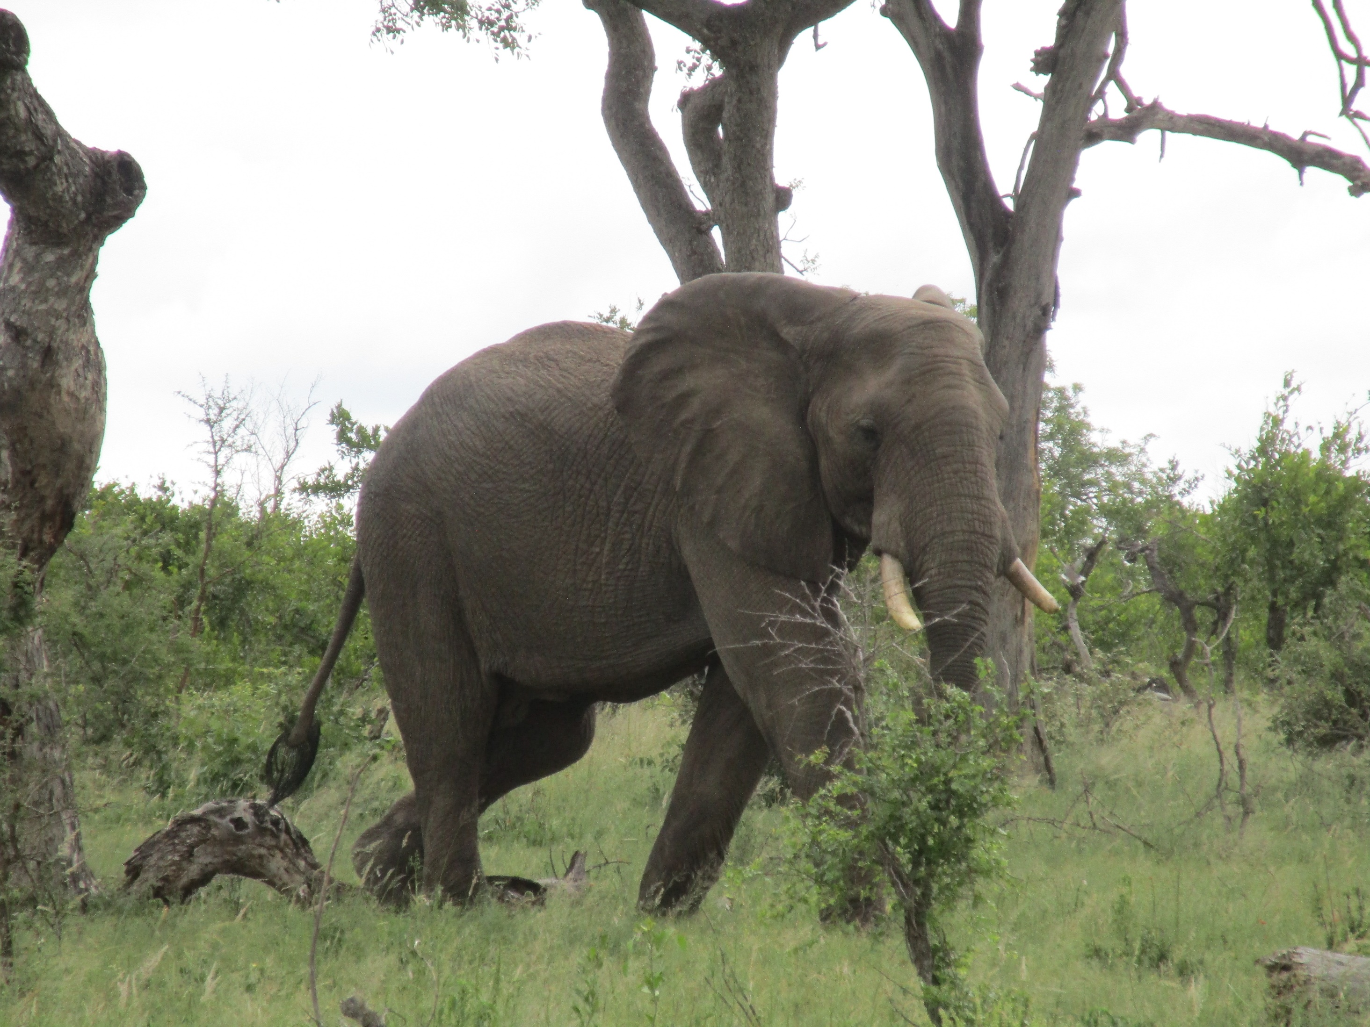
Thank you!
Any opinion, finding and conclusion or recommendation expressed in this material is that of the authors and the NRF does not accept any liability in this regard.

