Slide 1
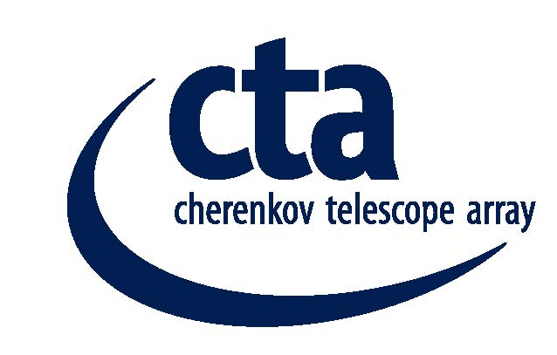
Study for Electrical Power Distribution CTA North Array
Final presentation
Heidelberg
February 23rd 2018

Slide 2
Electrical Power Distribution Concept CTA North Array
Sarweystrasse 3 70191 Stuttgart
P.O.Box 10 14 54 70013 Stuttgart
Phone: +49 (0) 711 8995-0
Fax: +49 (0) 711 8995-459
www.fichtner.de
Please contact: Manfred Engelmann
Extension: 519
E-mail: Manfred.Engelmann@fichtner.de
Rev. No. | Rev-date | Contents / amendments | Prepared / revised | Checked /released
0 | 20.02.2018 | First Issue | Engelmann | Bußmann
1
2

Slide 3
Disclaimer
The content of this document is intended for the exclusive use of Fichtner’s client and other contractually agreed recipients. It may only be made available in whole or in part to third parties with the client’s consent and on a non-reliance basis. Fichtner is not liable to third parties for the completeness and accuracy of the information provided therein.

Slide 4
Study Content
Introduction
Site Conditions
Connection Conditions
Load Conditions
Implementation of Telescope Array
Power Supply Concept
Data Cabling Concept
Cable Routing
Protection Concept
Cost Estimation
Recommendation

Slide 5
Introduction
Task description
  CTA intends to implement a Cherenkow Telescope Array Observatory for the Northern hemisphere at the Roque de las Muchachos, La Palma, Spain
  Developing a concept for safe power supply to all consumers
    4 Large scale telescopes (LST)
    Up to 15 Medium scale telescopes (MST)
    Operation building
    Data center
    Instruments such as Lidar, Ceilometer, Weather station, All sky camera
  including data cable concept

Slide 6
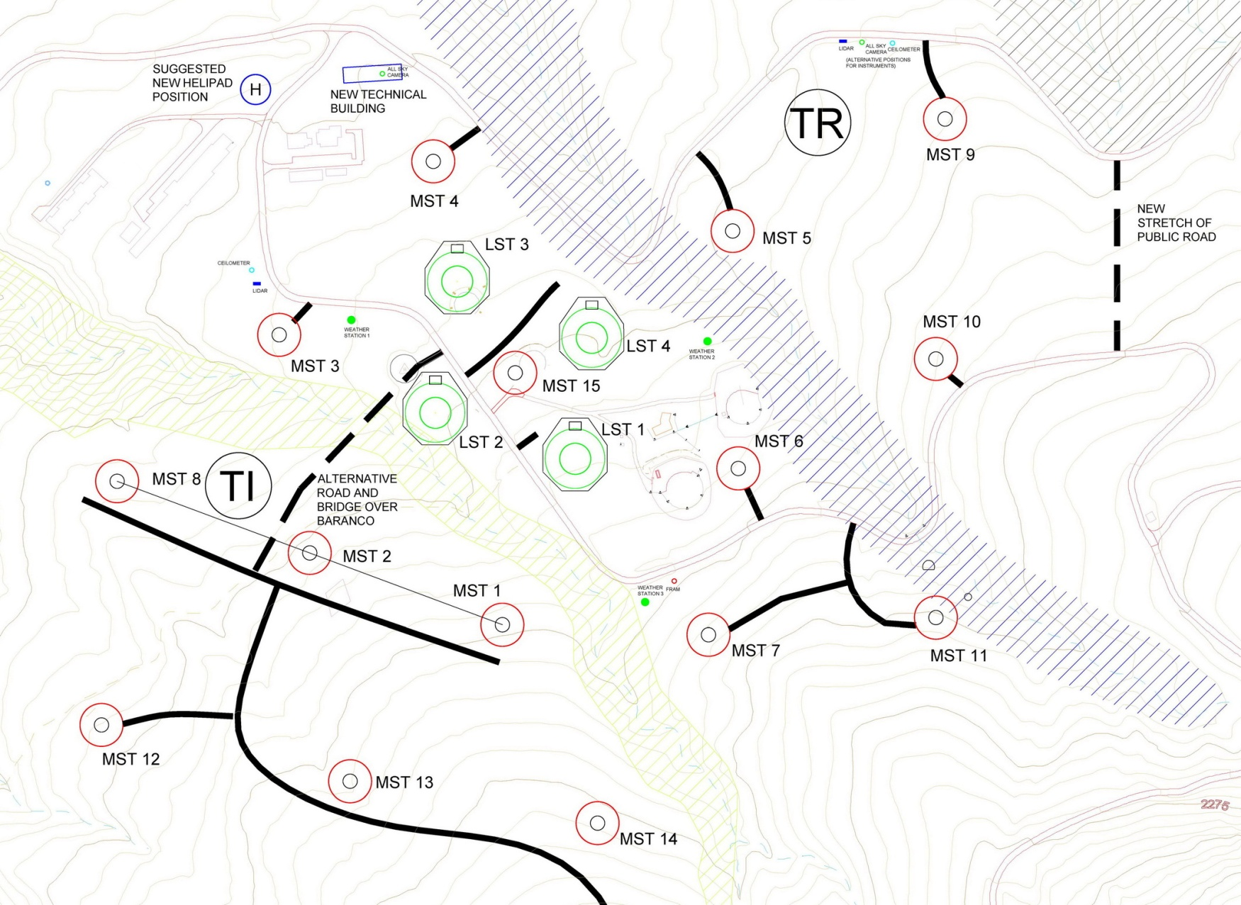
Array Layout

Slide 7
Site Conditions
Local Power Supply
    The public electrical distribution grid (20 kV and 0.4 kV) is provided by ENDESA
    20 kV connection point nearest to Observatories area is at Hoya Grande (cable 8 km)
    In near future new 20 kV substation at the Visitors Center in front of the Astrophysics Park
    20 kV distribution within the Astrophysics Park by Instituto de Astrofísica de Canarias (IAC)
    Radial structure of the 20 kV feeders within IAC area shall be extended to ring structure in future

Slide 8
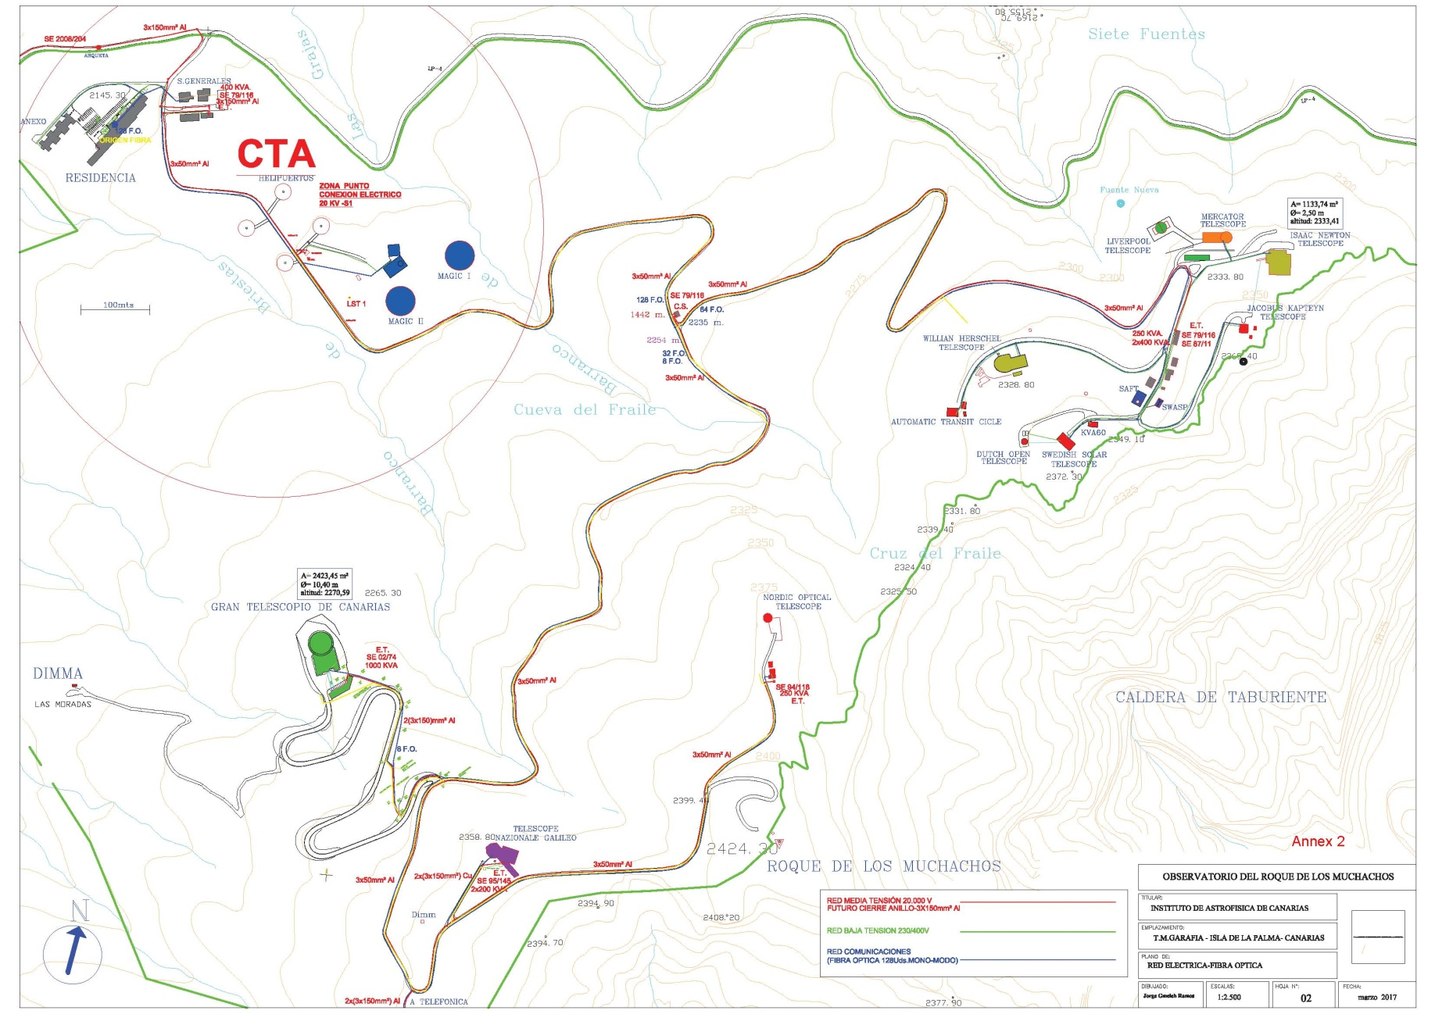
Site Conditions

Slide 9
Connection Conditions
ENDESA
    ENDESA has no specific connection conditions
    International standards are used
    Short circuit power at the connection point in Hoya Grande 30 to 40 MVA
    The diesel engine power plant near Santa Cruz is running during day time with a power of about 45 MW and during night with about 30 MW
  IAC
    IAC design standards are considered in this concept

Slide 10
Load Conditions
Load list
  The study is based on the following load assumptions

Slide 11
Load Conditions
Mean Power
  Under normal observation conditions the telescopes are running with mean power
    22 kW per LST
    15.5 kW per MST
Peak Power
  In case of a gamma reburst the telescopes
  are fast repositioned with peak power
    Up to 350 kW per LST
    32.5 kW per MST
  Peak power of the LST is supported by an
  energy storage system
  Peak power demand from grid is restricted
  to 60 MW per LST

Slide 12
Load Conditions
Emergency Power
  In case of failure of the public grid the diesel generator(s) will supply the mean power demand of the whole telescope array
  Time during start-up of the generator is buffered by UPS systems
    LST – Energy storage system
    MST – Central or local UPS
    Data Center – Integrated UPS

Slide 13
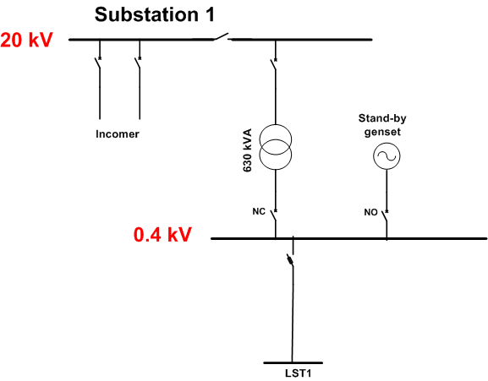
Implementation of telescope array
Base
  Installation of
    LST 1
    20 kV substation 1
    630 kVA transformer 1
    0.4 kV switchboard 1
    Emergency diesel generator 1
    Data Center (IT container)
Expansion stage 1
  Installation of
    LST 2, LST 3, LST 4, MST 3

Slide 14
Implementation of telescope array
Expansion stage 2
  Installation of
    14 MST
    20 kV substation 2
    630 kVA transformer 2
    0.4 kV switchboard 2
    Emergency diesel generator 2
    Operation building
  Relocation of IT-Container to the Operation Building

Slide 15
Power Supply Concept
Investigated variants
    Variant 1 with single feeders

Slide 16
Power Supply Concept
Investigated variants
    Variant 2 with double feeders

Slide 17
Power Supply Concept
Investigated variants
    Variant 3 with double feeders and no LV interconnection

Slide 18
Power Supply Concept
Investigated variants
    Variant 4 with single feeders and no LV interconnection

Slide 19
Power Supply Concept
Concept Evaluation
    Voltage profile
    Load flow calculations show that the cable sizing in all variants fulfills the requirements
    Power quality
    Power quality is independent from public grid As all essential equipment is fed via frequency converter (UPS)
    Reliability
    Substations and cable cabinets
      Statistically one outage within 50 years
    Cables
      Variant 1 and 4
        One failure of a single cable within 2.5 years
      Variant 2 and 3
        One outage of a single cable within 1 year
      Outage of one cable will cause no damage to the telescope equipment

Slide 20
Data Cabling Concept
  General
    Each telescope needs a dedicated fiber optic cable with 24 fibres
    Minimized splice points
  Expansion Stage 1
    LST1 to LST4 and MST3 directly connected to the IT-Container near LST1
  Expansion Stage 2
    All cables from Expansion Stage 1 extended via splice box to the Operation Building
    All other MSTs connected by dedicated cable to the Operation Building

Slide 21
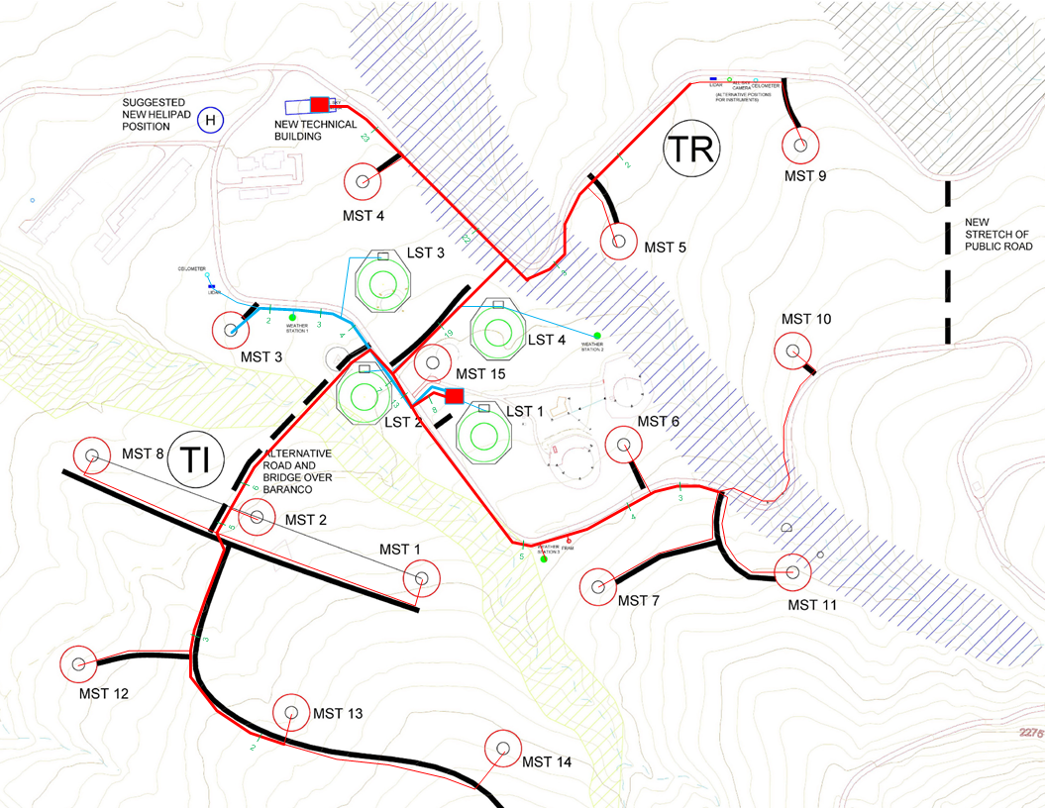
Power and Data Cable Routing

Slide 22
Protection Concept
    Variant 2 and 3 with central UPS
      Short circuit current behind UPS limited
      2 to 8 times rated current of UPS
  Short circuit currents
Ik“max (kA) | 1 | 2 | 3 | 4
LV substation | 31.7 | 31.7 | 25.5 | 25.5
Operation Building | 27.3 | 27.3 | 22.6 | 22.6
MST 15 | 19.0 | 19.0 | 17.8 | 17.8
Ik“min (kA) | 1 | 2 | 3 | 4
MST 9 | 1.2 | 1.2 | 1.2 | 1.2

Slide 23
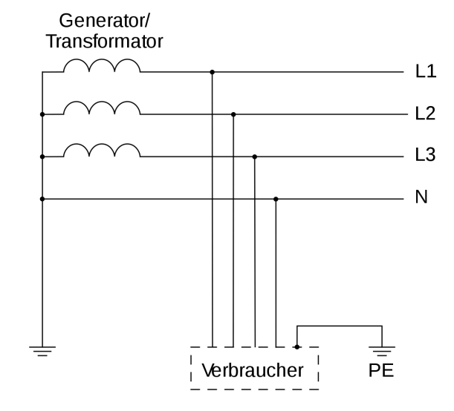
Protection Concept
        All 0.4 kV feeders with RCDs of 500 mA or less
        All 20 kV and 0.4 kV incoming cables with appropriate surge devices
  Earthing considerations
      LV network is designed as TT type
      No special earthing requirements
      Earthing resistance of 100 Ohm is sufficient
        together with 500 mA RCDs
      Compensation conductors connecting all foundation
        earth electrodes of the telescopes are recommended
  Protection devices
    Variant 1 and 4
      All 0.4 kV feeders with fused load break switches
    Variant 2 and 3
      All 0.4 kV feeders with MCCBs with adjustable current setting

Slide 24
Cost estimation
  Assumptions
  Cost estimation is made for the following main components
      20 kV substations (including transformer)
      0.4 kV substations (incl. cable cabinets and diesel generator)
      power cabling
      data cabling
      UPS systems
  Sources
      Budget offers
      Fichtners experience

Slide 25
Cost estimation
  Investment and Maintenance cost

Slide 26
Recommendation
  Technical Point of View
    Variant 1 and 4
      Standard equipment can be used – higher reliability +
      Safe position of telescopes under all circumstances possible +
      Single telescope out of service after cable failure o
    Variant 2 and 3
      Special equipment (ATS, special tailored UPS, MCCBs) necessary o
      Safe position of telescopes under all circumstances not guaranted -
      Higher reliability in the observing mode +
  Economical Point of View
    Variant 3 and 4
      Investment cost 30% to 40% lower than Variant 1 and 2 +
      Lowest maintenance cost in Variant 3 (40% of cost of Variant 4) +
      In total Variant 4 marginable less than Variant 3
  Regarding technical and economical point of view
  it is recommended to realize Variant 4

