Slide 1
Infrastructure Interfaces
Hardware
(Software)
External
Internal
Tools
30. 1. 2017 mp

Slide 2
Ill defined interfaces create
Extra costs
Extra work
!No adapters!
Up to now mainly paperwork,
but nothing finished
„undefined“
„pending“
„preliminary“

Slide 3
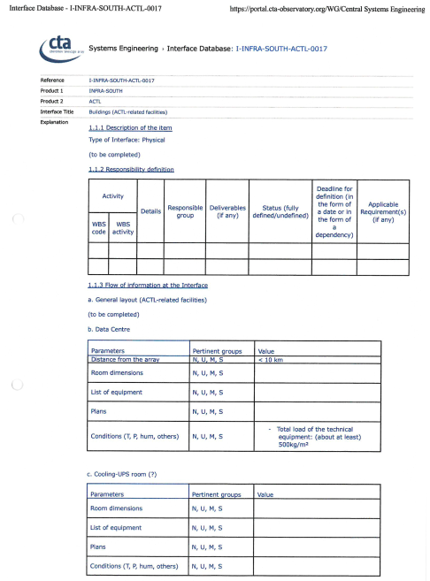
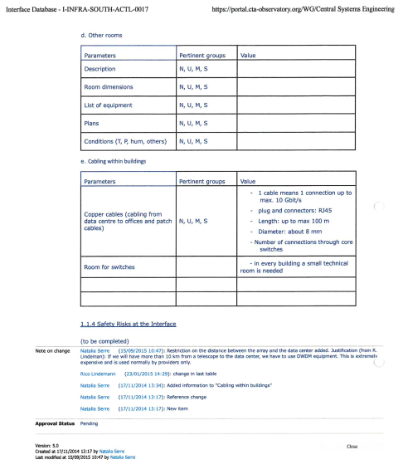
Interface database
525 entries
Last modification
2014 90
2015 414
2016 20
2017 1
Mainly templates of different kinds
No responsable persons
None really complete, often outdated
None approved

Slide 4
CTA needs this database!
Adapt or slightly improve the structure
One template for all
Fill completely! With responsable person!
The whole set of documents
has to be worked through.
In most cases right from the beginning

Slide 5
Where is the interface?
This is not clear in many cases!
For example: Emergency power for a telescope
in order to obey the requirement
„park safely in case of powercut“
Second independent power supplied for the whole array
Local UPS under the supervision of CTAO
Local UPS as part of a telescope
under the responsibility of the telescope group

Slide 6
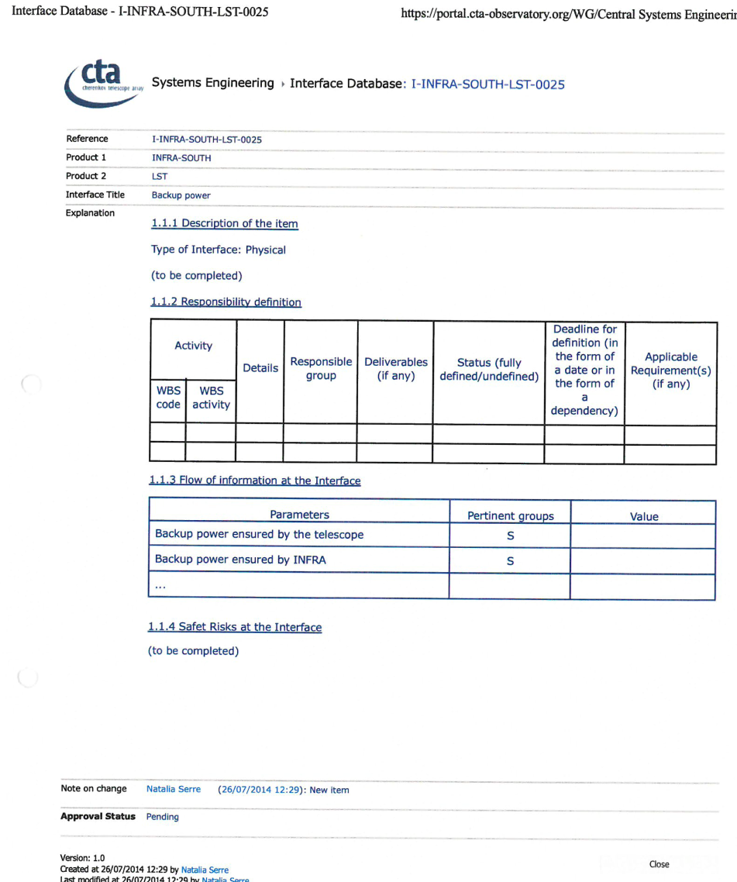
SST is the same

Slide 7
Interfaces to the external world
Specifications for local suppliers
Access road
Border of leased land (fence?)
Electricity
Internet
Water
Sewerage
Waste

Slide 8
Interfaces internally
(next to each telescope)
Access to road
Foundation (concrete, anchors or bolts, outer ring)
Supply point (Man hole)
Electricity
Data lines
Water
Compressed air

Slide 9
Around a telescope
N
Safety zone, no road!
SP?
foundation
SP?
SP?

Slide 10
Tools are like interfaces.
They have to fit for several applications.
!Avoid adapters!
Storage places for parts of telescopes
Adjustment system for telescope axes
(marking, total station, level)
Cranes
Hooks
Lifting gear
Fork lift
Lifting platform
Mirror attachment (mirror installation, mirror coating)
Jigs of any kind

Slide 11
CONCLUSION
Documentation is only a structure
and serves mainly as a place holder.
Content can hopefully to some extend
be found within the work packages.
A tremendous amount of work ahead

Slide 13
