Slide 1

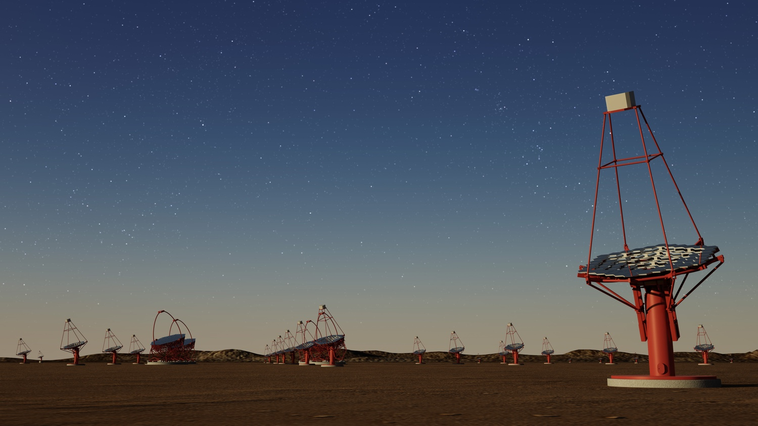
On-Site South
Infra Workshop
On-Site Facilities for
Pre-production deployment
David Bristow
Bologna 30 – 31.01.2017

Slide 2
Workshop Agenda
Global Site Schedule
2. On-Site Facilities for Pre-production
3. SST Pre production Telescopes
4. SST Common Foundation
5. Infra Interfaces
MST – Proposal for and INFRA to xST Electrical Interface

Slide 3
Pre-production Workshop
Objective: This is gathering information workshop.
Why?: To define the concept for which initial contracts will be placed for the pre-production deployment.
Initial Deployment of Pre-production Telescopes
Deployment Facilities

Slide 4
General Arrangement - Concept
What are the initial contracts?
Enabling Works
Foundations
U/G Services
Roads
Control Building
Technical Building

Slide 5
Initial Construction Diagram
Questions?

Slide 6
Site General Arrangement

Slide 7
Phase 1 Foundations

Slide 8
Underground Services

Slide 9
U/G Services - Details

Slide 10
On-Site Data Centre
Questions?

Slide 11
Data Centre - Control Room
Questions?

Slide 12
On-Site Equipment Storage
Questions

Slide 13
Data control building

Slide 14
CTA – NORTH GA

Slide 15
CTA – North Control Building

Slide 16
And the facility……

Slide 17
The End…..!
Thanks.

