Slide 1

On-Site South
SST
Common Foundation
David Bristow
Infrastructure Design Coordinator
Bologna 30 – 31 January2017
The Study was commissioned by ASTRI on behalf of the SST Teams

Slide 2
SST Common Foundation – the Concept
The Study is a detailed foundation ‘Feasibility Study’ based on the concept of designing a Common Foundation for the SST Telescopes.

Slide 3
SST Common Foundation – Standardisation
The Base interface
ASTRI - 24 Anchor bolts M30 arranged on a 167cm diameter circumference
SST-1M and SST 2m GCT – 24 Anchor bolts M30 arranged on a 100cm diameter circumference.

Slide 4
SST Common Foundation – Geology
The Geotechnical Aspects.
The Study is based on the Arcadis desktop study of the site.
The are report assumes that bedrock will bed located at a depth between 0.6m and 2.60m

Slide 5
SST Common Foundation – the design
The designed foundation:
Diameter 4 metres
Depth 1.5 metres
With 8 Micropiles
And 8 Strand Anchors

Slide 6
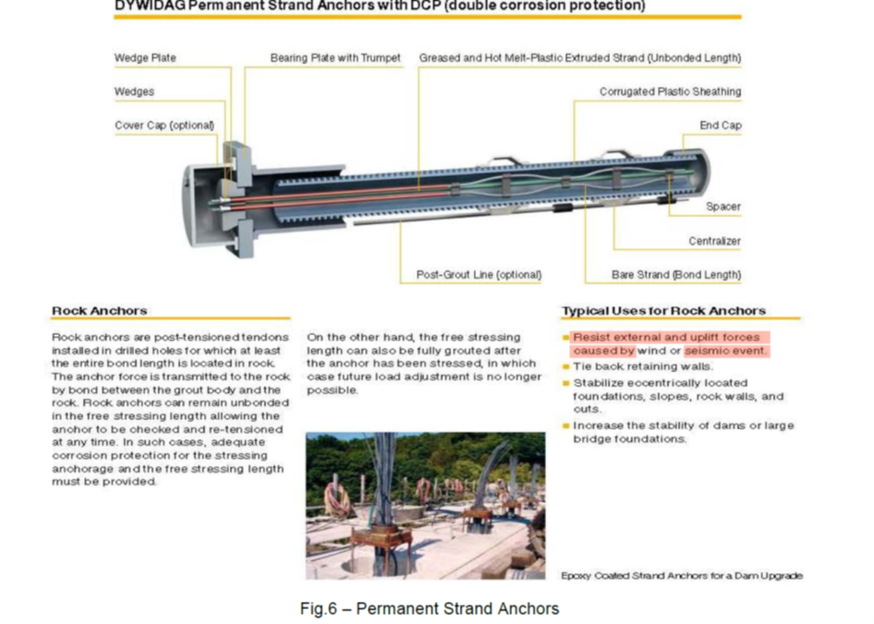
SST Common Foundation – the design
Strand Anchors
Characteristics:
Length 8 metres

Slide 7
SST Common Foundation – drawings

Slide 8
SST Common Foundation – further inputs
Conclusions from the Geotechnical Site Investigation Study to determine the final design for the SST common foundation.
There maybe more than 1 foundation design depending on the ground conditions identified
Teams to provide drawings and specification of latest designs
Commission detailed design of SST foundations based on the results from the Geotechnical Site Investigation Study

Slide 9
ASTRI Foundation - Sections

Slide 10
ASTRI Foundation – Plan View

Slide 11
ASTRI Foundation - Details

Slide 12
The End…..!
Thanks.

