Slide 1



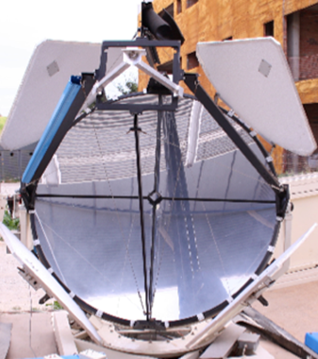
Status of IFAE/UAB Raman LIDAR
Lluís Font and Markus Gaug
UAB & CERES-IEEC
Central Calibration Facilities meeting
Barcelona 20-23 June 2016

Slide 2



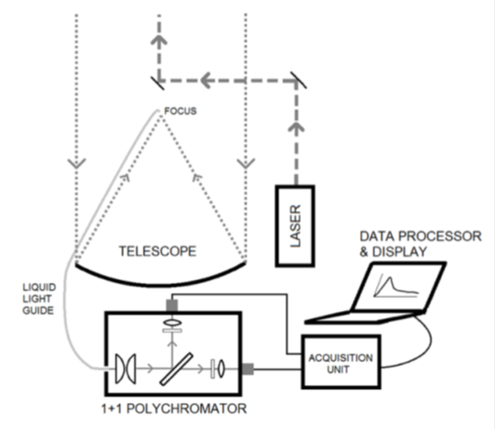
Overview
The concept
Recycle a former CLUE telescope and container to build and advanced Raman LIDAR optimized for CTA
2 + 2 configuration:
  355 nm + 532 nm elastic channels
  387 nm + 607 nm N₂ Raman lines
Atmospheric molecular and aerosol transparency as a function of range and wavelength.
Laser: Brilliant Compact Q-Switched Nd:YAG 1064nm + frequency tripler head Rate:10 Hz Pulse:5 ns Beam divergence:0.5 mrad
Parabolic mirror f = 180 cm => f/D = 1
Dichroic guiding mirrors → coaxial
Polychromator home made
Acquisition: standard LICEL units

Slide 3
Overview
The strategy
IFAE/UAB prototype
LUPM prototype
Long-term testing @ La Palma
(1 year of robotic operation)
Final Raman LIDAR design
(based on former CLUE experiment)

Slide 4

Overview
The funding situation
  Funding for LIDAR prototype still is insufficient this year (as all Spanish funding proposals in 2016).
  Funds for final LIDAR will come from FEDER funds
  in 2017-2018.
The team
+ Markus Gaug (UAB)
+ Oscar Martínez (IFAE) (Eng)
+ Oscar Blanch (IFAE)
+ Oriol Calpe (UAB) (Undergraduate)
+ Michele Doro (INFN Padova)
+ Lluís Font (UAB)
+ Merve Colak (IFAE) (PhD student)
+ Scott Griffiths (IFAE) (Postdoc)
+ Manel Martínez (IFAE)

Slide 5
Status prototype
Hardware
Mirror characterized
Liquid light guide characterized
Guiding mirrors (dichroic) + alignment in zenit. Monochromator used
Driving system not robotic yet
✓
Polychromator finished. Characterization studies on-going
Laser being repaired. Near range solution and fine-alignment postponed. Back on track soon (within 2 weeks)

Slide 6
Status prototype
Software
Library to read Licel files ready
Internal communication translated from Labview to C (in process)
Documentation
Finished one bachelor thesis on pre-alignment (Eudald Font)
Another bachelor thesis on polychromator characte-rization is on-going (Oriol Calpe)
Constantly update a LIDAR TDR
ICDs created (except for the one with ACTL)

Slide 7
LIDAR alignment

Slide 8
LIDAR alignment
23/07: “calima”

Slide 9
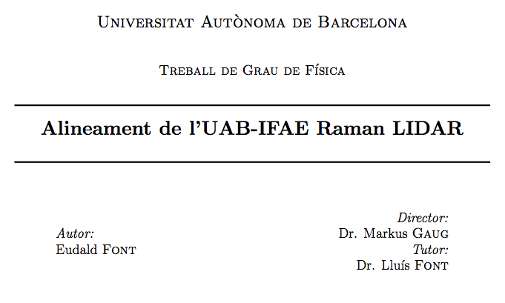
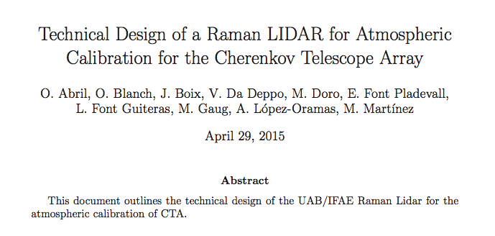
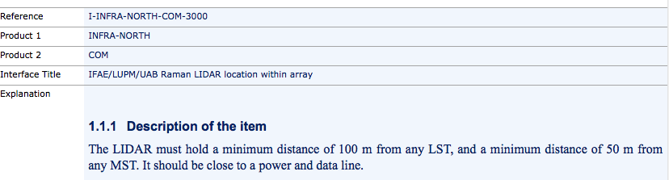
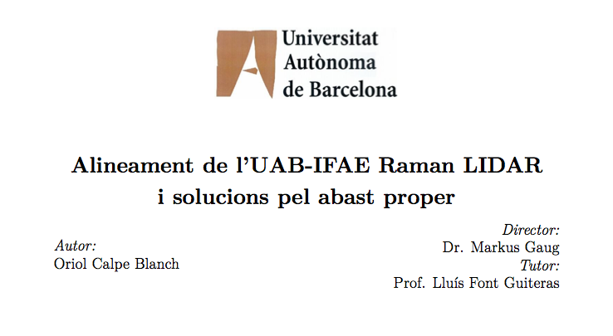
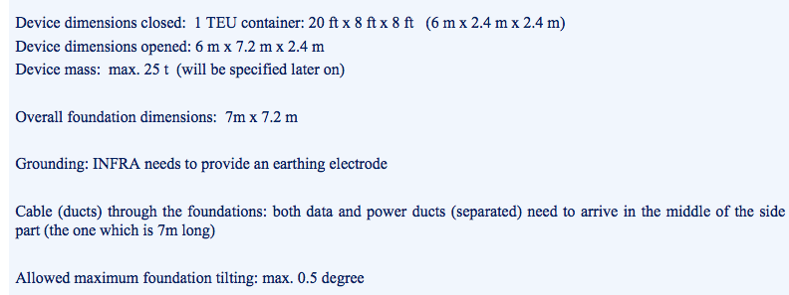
Documentation

Slide 10
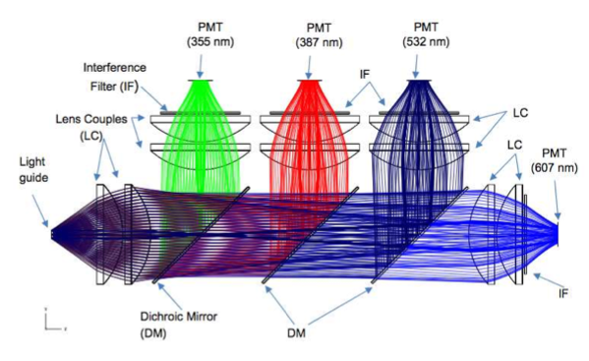
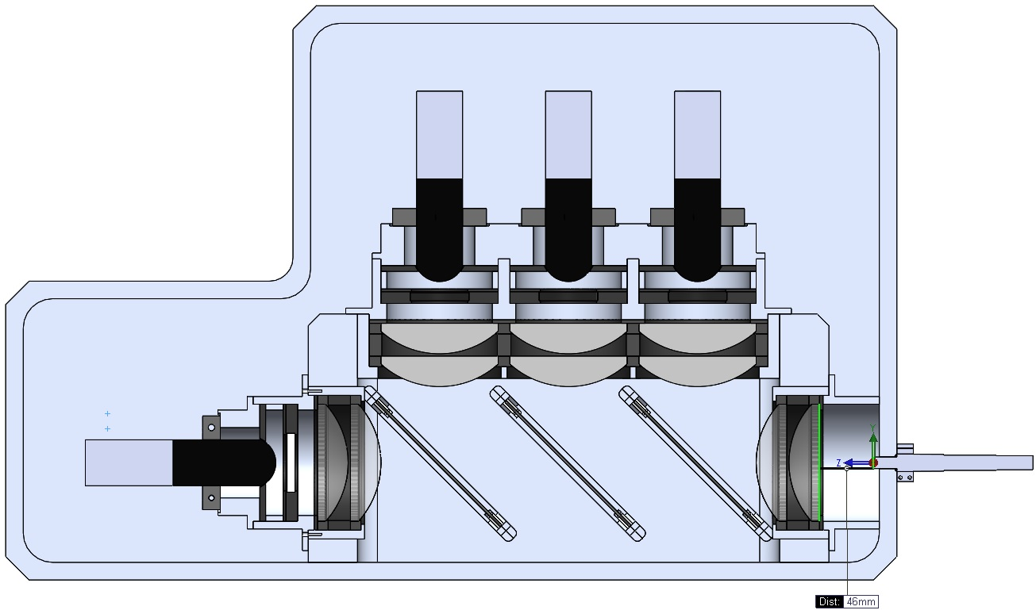
Polychromator

Slide 11
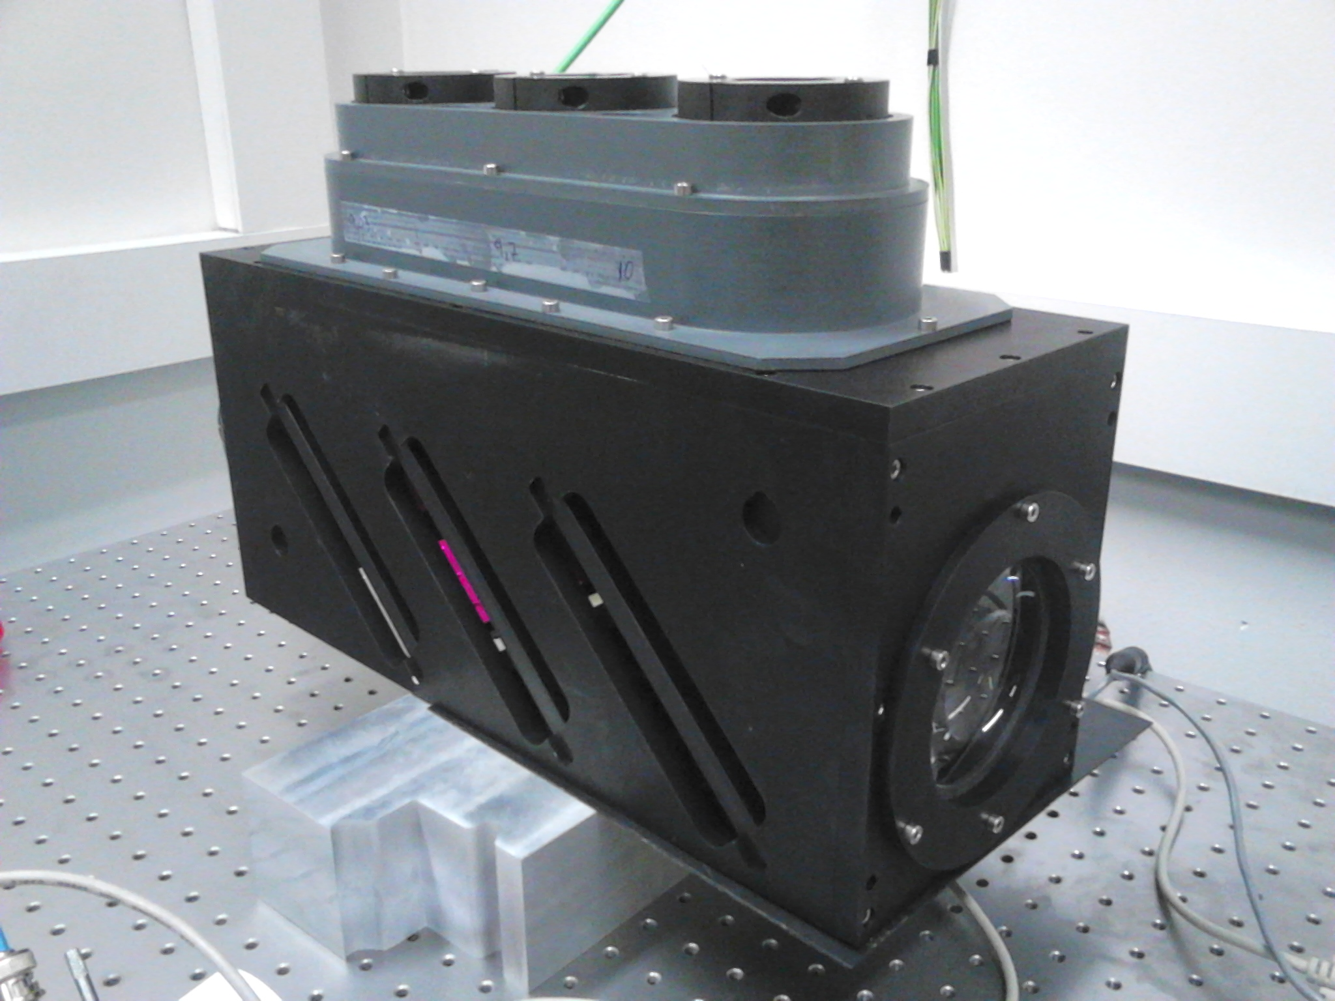
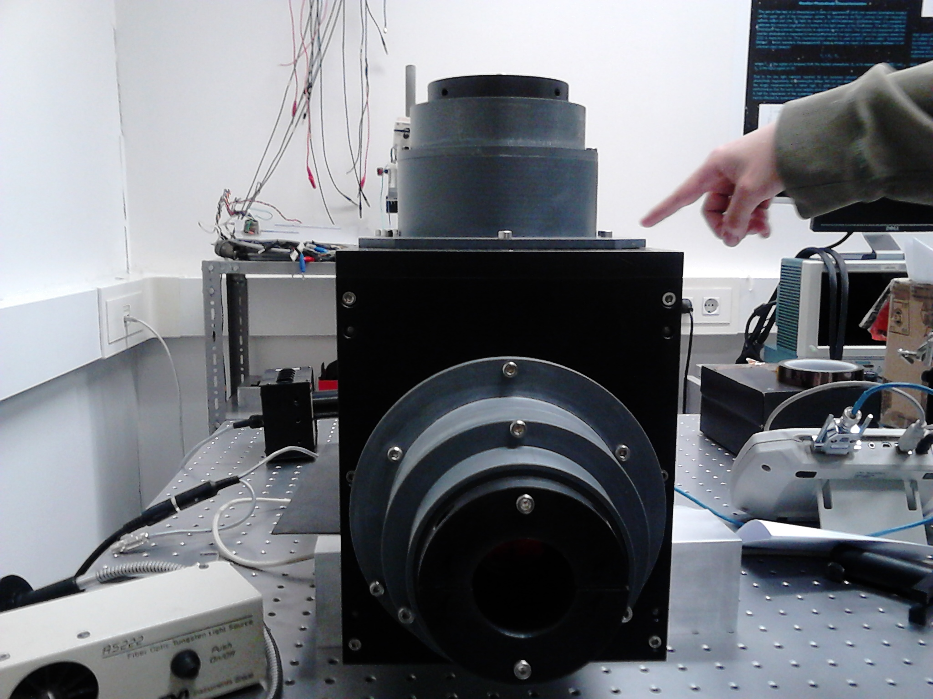
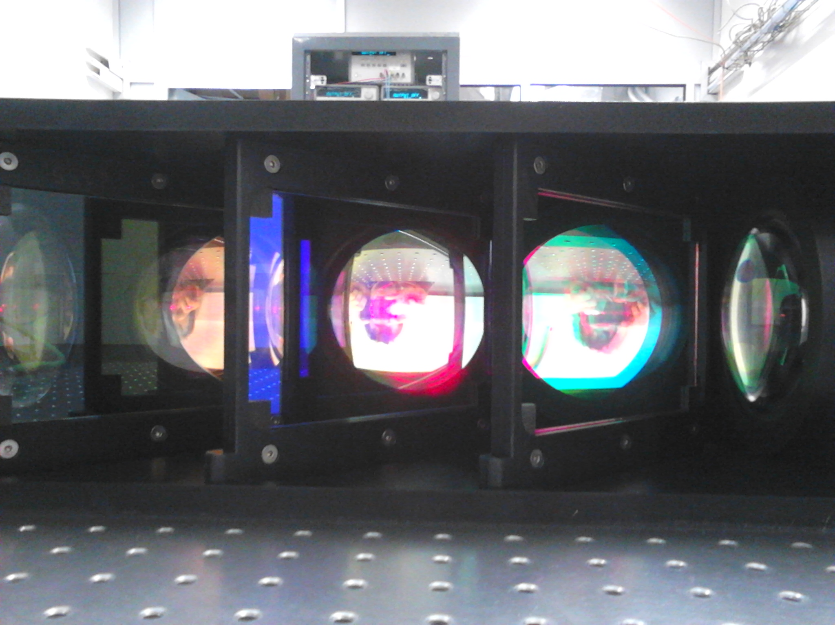
Polychromator

Slide 12
Polychromator
Characterization test set up
PIN diode
Xe source
Monochromator
Colimator
Filter wheel
Shutter
Liquid light guide
Polychromator

Slide 13
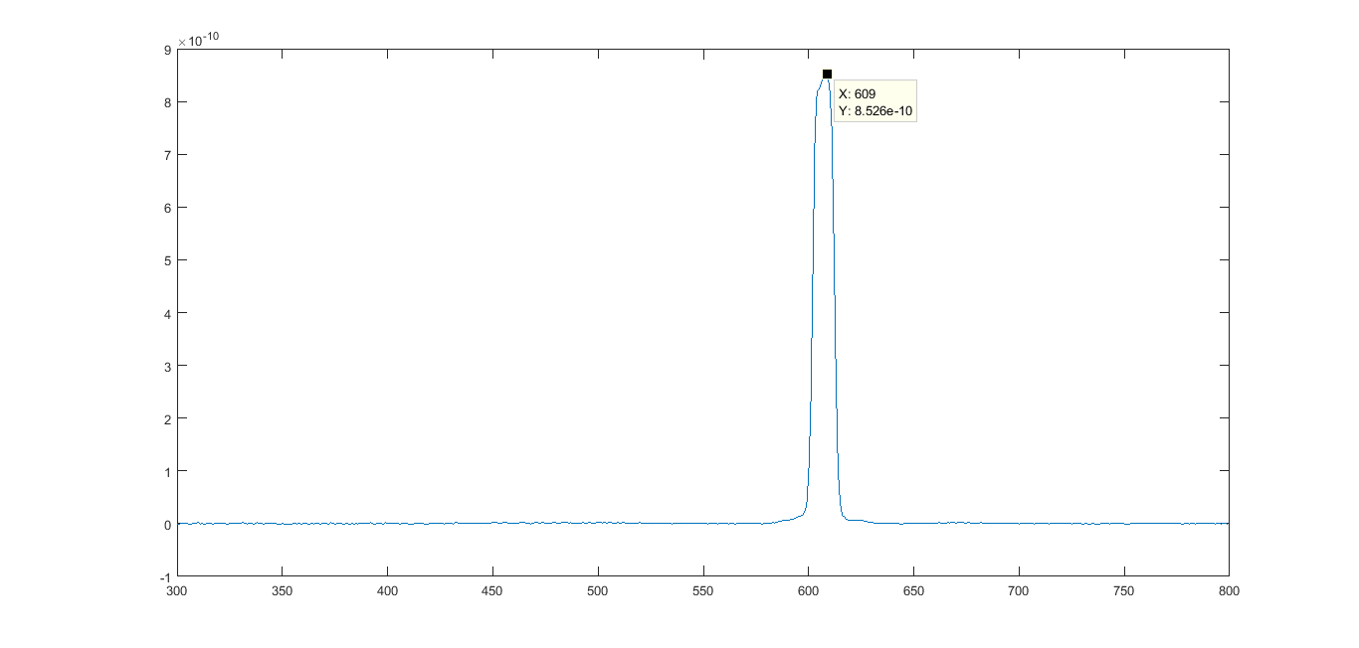
Polychromator
Preliminary results
607nm
607 nm

Slide 14
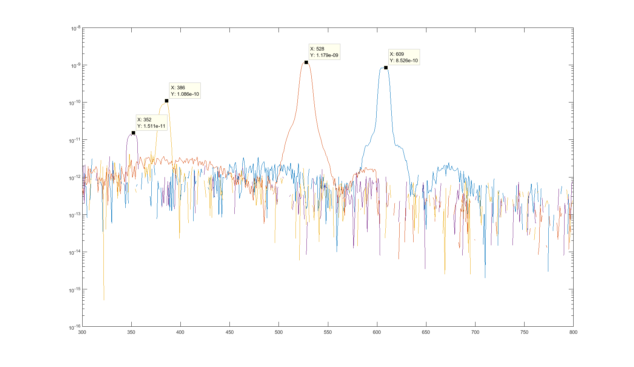
Polychromator
Preliminary results
607nm
355nm 387nm 532nm 607nm

Slide 15
Outline
Polychromator characterization will finish soon (2 weeks).
Near range solution and fine alignment will start before summer holidays.
Making it robotic.
Prototype should be ready for long term testing by mid 2017

