Slide 1
Weather monitoring status and plans @ ORM
Lluís Font and Markus Gaug
UAB & CERES-IEEC
Central Calibration Facilities meeting
Barcelona 20-23 June 2016

Slide 2
Overview
The goals
Provide the site with weather monitoring information to guarantee safety operation of the telescopes. Prevent equipment damage.
Contribute to the site climatology and full atmospheric characterization of the site.
The strategy
Acquire robust WS and weather monitoring instrumentation (24/365 with no failure for 30 years of remote operation)
Redundancy
Final selection and placement of the sensors is site-specific (Classic WS + anemometers + rain sensors + complementary instruments)
Production: all equipment and implementation for methods that are part of the final observatory .
Lluís Font and Markus Gaug
CCF meeting Barcelona 20-23 June 2016
1

Slide 3
The Northern Site: ORM
Pre-production
3.10.3.4.6 |  |  |  |  | Weather monitoring
3.10.3.4.6.7 |  |  |  |  |  | Complementary Instruments
3.10.3.4.6.7.1 |  |  |  |  |  |  | Electric field mills
3.10.3.4.6.7.1.1 |  |  |  |  |  |  |  | Establish usefulness
3.10.3.4.6.7.2 |  |  |  |  |  |  | Dust counters
3.10.3.4.6.7.2.1 |  |  |  |  |  |  |  | Establish usefulness
3.10.3.4.6.7.3 |  |  |  |  |  |  | Accelerometers
3.10.3.4.6.7.3.1 |  |  |  |  |  |  |  | Establish usefulness
3.10.3.4.6.7.4 |  |  |  |  |  |  | National Rain radars
3.10.3.4.6.7.4.1 |  |  |  |  |  |  |  | Check availability
3.10.3.4.6.7.4.2 |  |  |  |  |  |  |  | Check possibility of integration in ACTL
3.10.3.4.6.7.5 |  |  |  |  |  |  | Weather forecasts
3.10.3.4.6.7.5.1 |  |  |  |  |  |  |  | Check availability
3.10.3.4.6.7.5.2 |  |  |  |  |  |  |  | Check possibility of integration in ACTL
Useful from MAGIC experience but feedback from ACTL and PO needed
✓
✓
Useful for aerosol modelling and feedback to operators
✗
Not necessary for La Palma
✓
Available from Spanish National Meteorological service. CTA GUI (Iftach Sadeh, from DESY)
✓
IAC has an agreement with SAT24. CTA GUI (Iftach Sadeh, from DESY)
Coverage: 100% :no equipment cost; only labour (FTEs)
Next actions (to do)
Start interaction with ACTL (GUI, electric field mills) and PO, and IAC
Lluís Font and Markus Gaug
CCF meeting Barcelona 20-23 June 2016
2

Slide 4
The Northern Site: ORM
Production
ORM
Whole CTA
Whole CTA
10 COM | 4.100.030.04.06 | Weather monitoring | € 374.868,00
10 COM | 4.100.030.04.06.01 | Classic weather station | € 55.135,00
10 COM | 4.100.030.04.06.02 | Anemometers | € 98.928,00
10 COM | 4.100.030.04.06.03 | Rain sensors | € 68.051,00
10 COM | 4.100.030.04.06.04 | Complementary Instruments | € 152.754,00
€ 316.339,00
€ 52.484,00
€ 83.226,00
€ 27.876,00
€ 152.754,00
€ 154.993,00
€ 26.242,00
€ 41.613,00
€ 27.876,00
€ 59.262,00
3 classic WS + 2 spares (1 from LSTs weather monitoring)
Same model?
6 anemometers + 2 spares (3 recycled from LSTs weather monitoring)
9 rain sensors + 2 spares
Coverage
Complementary instruments:
100% (CTA-Spain, FEDER funds) in two steps:
1 Electric field mill: 35.362,00
139.302,00 – 34.350,00 (Weather monitoring for LSTs) = 104.952,00 by the end of 2016, covering:
1 dust counter: 17.900,00
Rain radars: 3.000,00
All the weather monitoring equipment but complementary instruments (or any other option)
Weather forecasts: 3.000,00
Accelerometer: Not required
The rest of Spanish contribution will come later (2017-18).
Lluís Font and Markus Gaug
CCF meeting Barcelona 20-23 June 2016
3

Slide 5
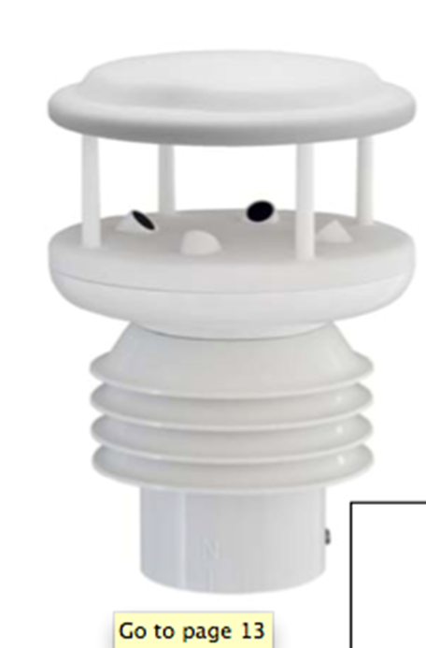
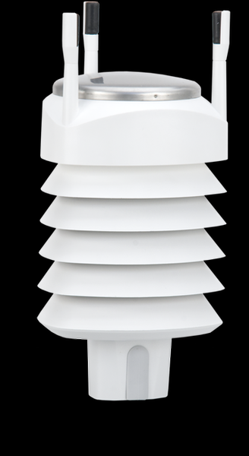
Sensors (almost) decided
Standard Weather Stations

Slide 6
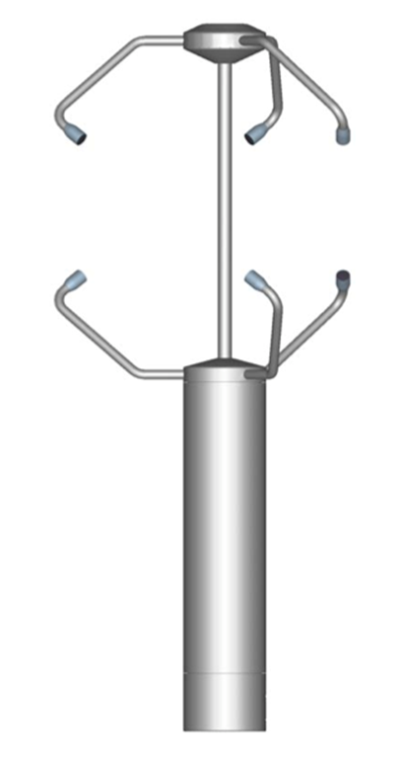
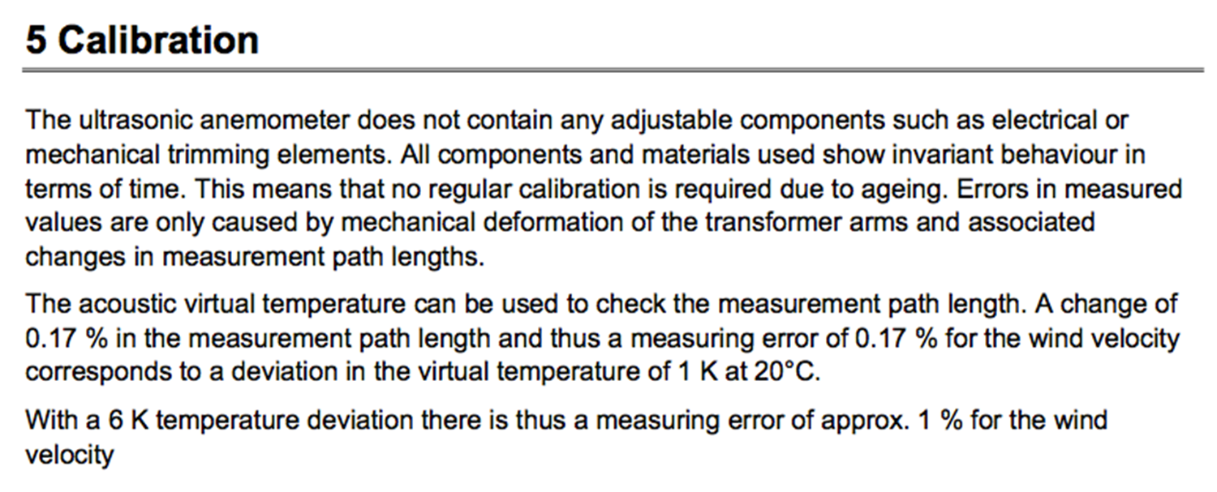
Sensors (almost) decided
Ultrasonic anemometers 3D

Slide 7
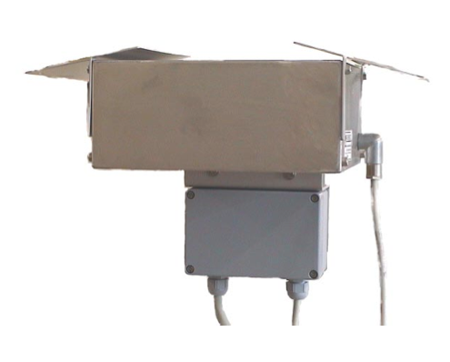
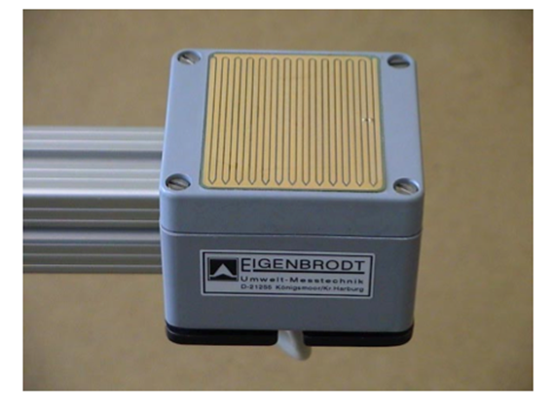
Sensors (almost) decided
Rain sensor: PRECIPITATION SENSOR – IRSS 88 from Eigenbrodt

Slide 8
The Northern Site: ORM
Next actions
Finish useful studies for complementary instrumentation
Update EoI tables and figures within
Use cases
Integration with ACTL
Purchase equipment as soon as funds are ready and procedure to spend them is established
Lluís Font and Markus Gaug
CCF meeting Barcelona 20-23 June 2016
4

Slide 9
Weather monitoring status and plans @ Armazones
Lluís Font and Markus Gaug
UAB & CERES-IEEC
Central Calibration Facilities meeting
Barcelona 20-23 June 2016

Slide 10
Overview
The goals
Provide the site with weather monitoring information to guarantee safety operation of the telescopes. Prevent equipment damage.
Contribute to the site climatology and full atmospheric characterization of the site.
The strategy
Acquire robust WS and weather monitoring instrumentation (24/365 with no failure for 30 years of remote operation)
Redundancy
Final selection and placement of the sensors is site-specific (Classic WS + anemometers + rain sensors + complementary instruments)
Production: all equipment and implementation for methods that are part of the final observatory .
Lluís Font and Markus Gaug
CCF meeting Barcelona 20-23 June 2016
1

Slide 11
The Southern Site: Armazones
Pre-production
3.10.3.4.6 |  |  |  |  | Weather monitoring
3.10.3.4.6.7 |  |  |  |  |  | Complementary Instruments
3.10.3.4.6.7.1 |  |  |  |  |  |  | Electric field mills
3.10.3.4.6.7.1.1 |  |  |  |  |  |  |  | Establish usefulness
3.10.3.4.6.7.2 |  |  |  |  |  |  | Dust counters
3.10.3.4.6.7.2.1 |  |  |  |  |  |  |  | Establish usefulness
3.10.3.4.6.7.3 |  |  |  |  |  |  | Accelerometers
3.10.3.4.6.7.3.1 |  |  |  |  |  |  |  | Establish usefulness
3.10.3.4.6.7.4 |  |  |  |  |  |  | National Rain radars
3.10.3.4.6.7.4.1 |  |  |  |  |  |  |  | Check availability
3.10.3.4.6.7.4.2 |  |  |  |  |  |  |  | Check possibility of integration in ACTL
3.10.3.4.6.7.5 |  |  |  |  |  |  | Weather forecasts
3.10.3.4.6.7.5.1 |  |  |  |  |  |  |  | Check availability
3.10.3.4.6.7.5.2 |  |  |  |  |  |  |  | Check possibility of integration in ACTL
✓
Probably not needed. Still to be studied.
✓
Useful for aerosol modelling and feedback to operators
✓
Useful, although analysis still ongoing
✗
Not available for Armazones
✓
Useful, although no studies performed yet
Coverage: 100% :no equipment cost; only labour (FTEs)
Next actions (to do)
Push for usefulness studies
Lluís Font and Markus Gaug
CCF meeting Barcelona 20-23 June 2016
2

Slide 12
The Southern Site: Armazones
Production
Armazones
Whole CTA
Whole CTA
10 COM | 4.100.030.04.06 | Weather monitoring | € 374.868,00
10 COM | 4.100.030.04.06.01 | Classic weather station | € 55.135,00
10 COM | 4.100.030.04.06.02 | Anemometers | € 98.928,00
10 COM | 4.100.030.04.06.03 | Rain sensors | € 68.051,00
10 COM | 4.100.030.04.06.04 | Complementary Instruments | € 152.754,00
€ 316.339,00
€ 52.484,00
€ 83.226,00
€ 27.876,00
€ 152.754,00
€ 161.347,00
€ 26.242,00
€ 41.613,00
€ 93.492,00
3 classic WS + 2 spares (1 from LSTs weather monitoring)
6 anemometers + 2 spares (3 recycled from LSTs weather monitoring)
9 rain sensors + 2 spares
Coverage
Complementary instruments:
~ 0% !!!
1 Electric field mill: 35.362,00
1 dust counter: 17.900,00
Next steps
Rain radars: Not available
Ask Johannes for EoI data related to Weather monitoring.
Identify Institutes interested in collaborating.
Take advantage of Use cases and ACTL integration from the Northern site.
Weather forecasts: 6.000,00
Accelerometer: 34.230,00
Lluís Font and Markus Gaug
CCF meeting Barcelona 20-23 June 2016
3

