Slide 1

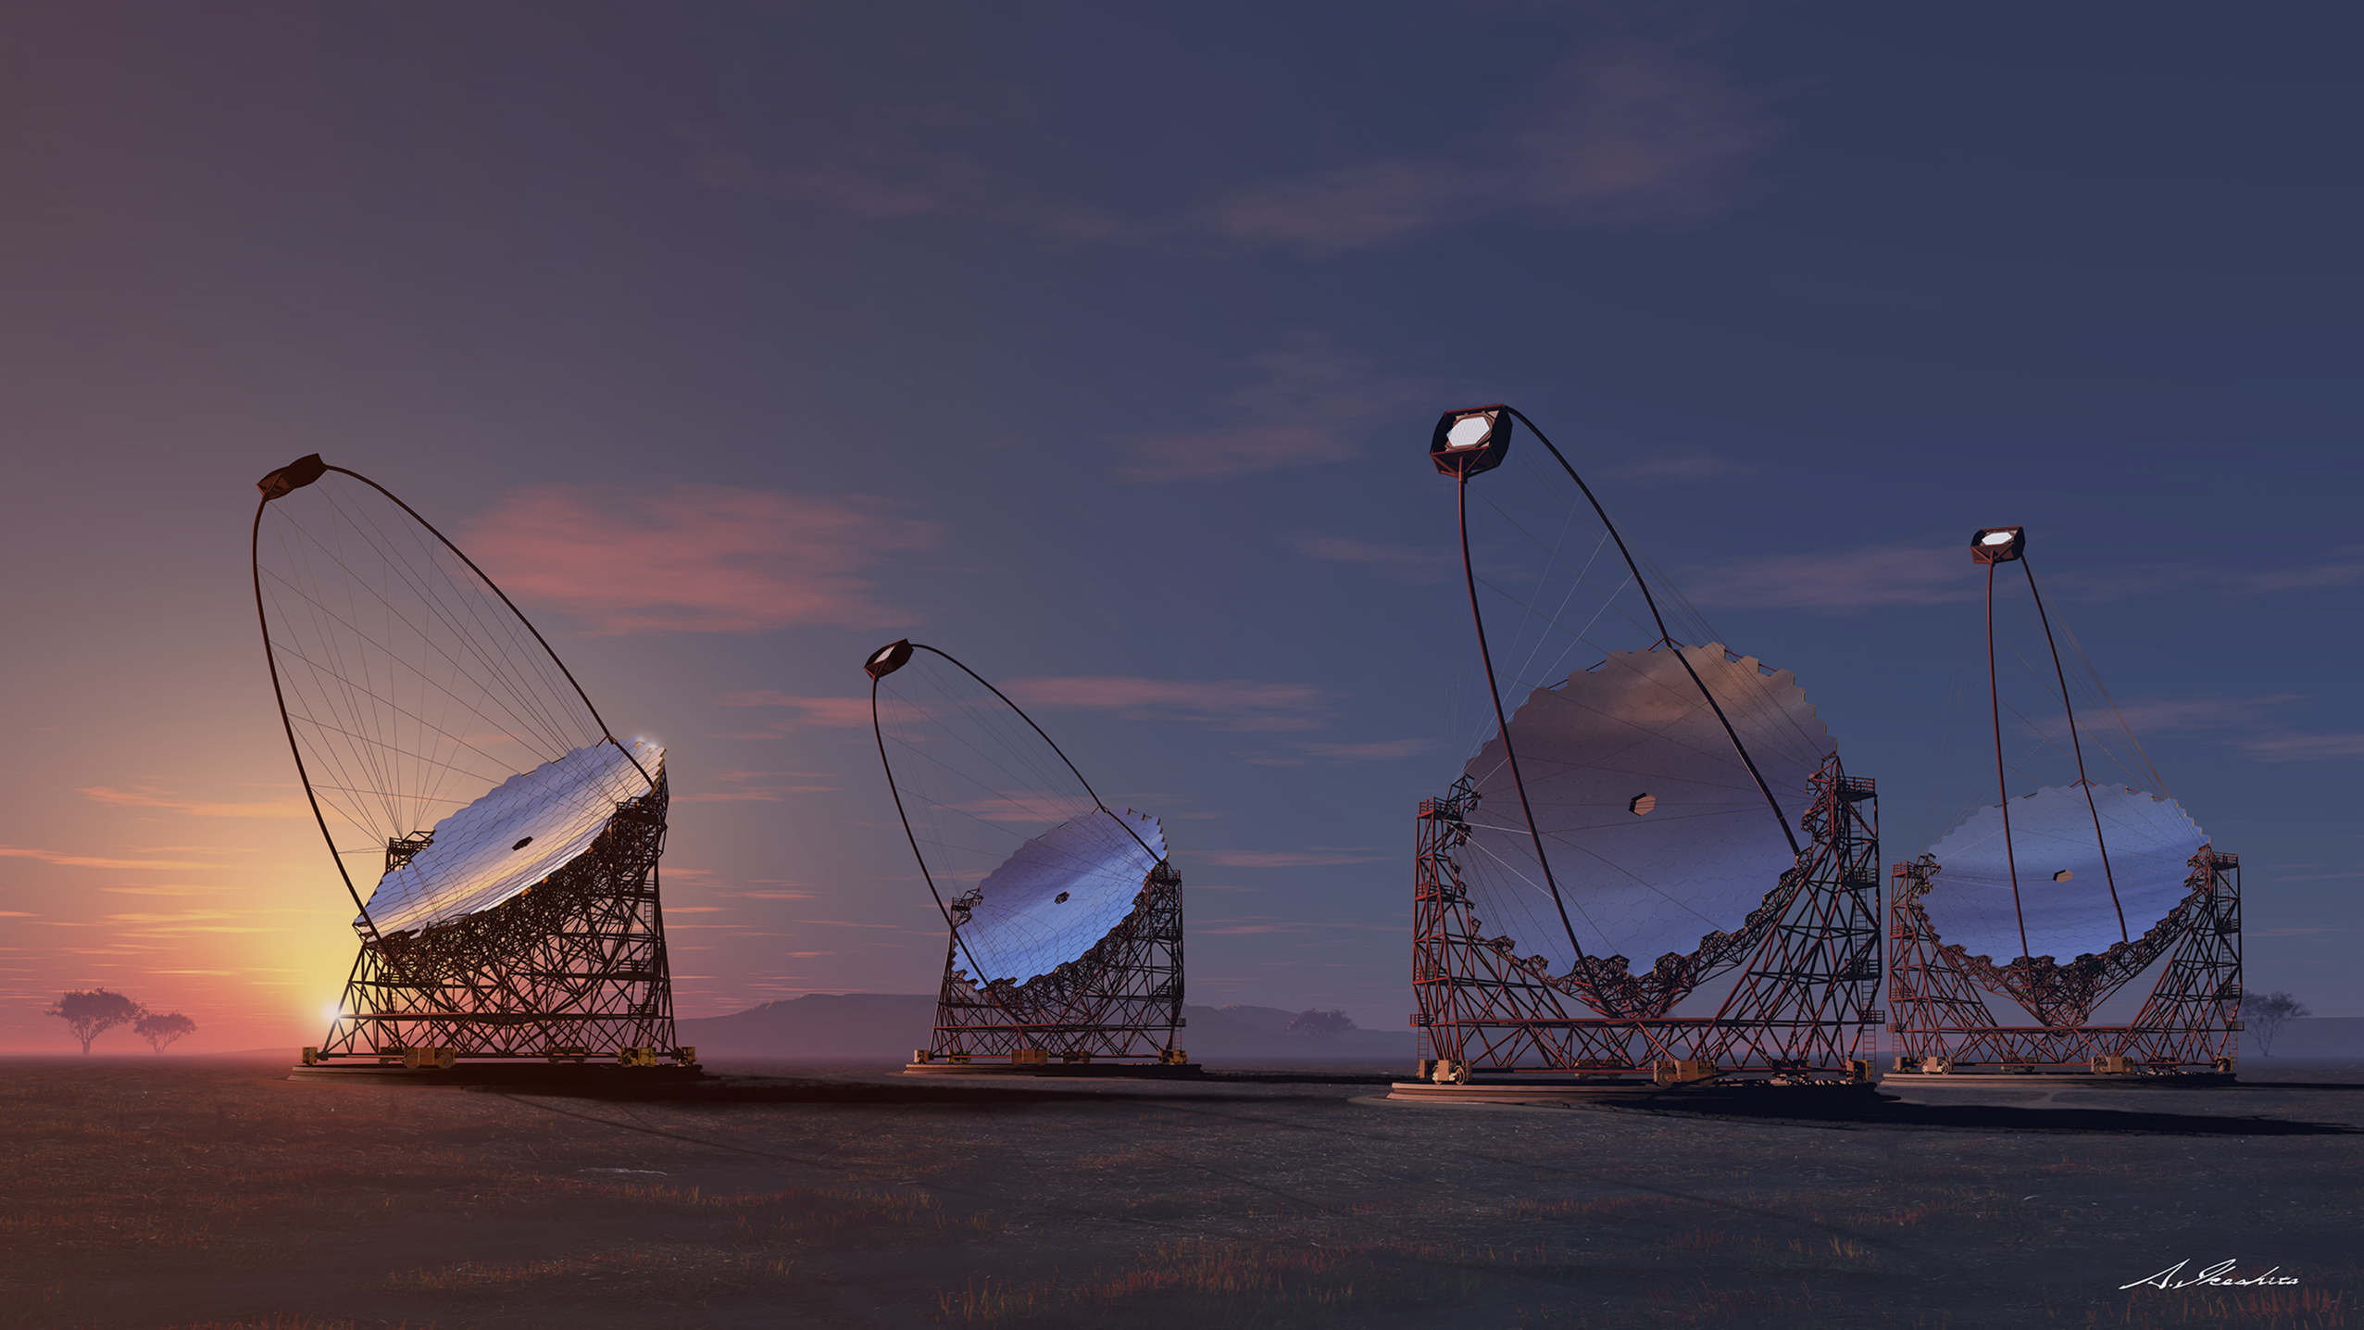
Site Climatology at ORM
What we already know...
Markus Gaug, UAB

Slide 2
Site Climatology at ORM
Molecular profiles
Aerosol profiles
Weather data

Slide 3
Molecular profiles

Slide 4
Molecular profile
Has effects on size of Cherenkov light pool (via shower altitude and Cherenkov angle) and transmission of Cherenkov light
  E_{rec} scales directly with optical transmission, i.e. integrated density from emission point to ground
  E_{rec} scales approximately with ρ_{c} ≈ (h_{med} – h_{obs} ) ⁻²
  because of the modulation of the Cherenkov angle and
  median shower height.
    Bernlöhr, Astrop. Phys. 12 (2000), 255
  A_{eff} more complicated, needs simulations

Slide 5
Molecular profile
Has effects on size of Cherenkov light pool (via shower altitude and Cherenkov angle) and transmission of Cherenkov light
Have excellent Data Assimilation models for La Palma (for free) for temperature and pressure (i.e. density):
Global Data Assimilation System (GDAS) from ground to 25 km a.s.l. ftp://arlftp.arlhq.noaa.gov/pub/archives/gdas1/
The NRLMSIS-00 model for 20 to 100 km a.s.l. http://ccmc.gsfc.nasa.gov/modelweb/atmos/nrlmsise00.html
The ECMWF has been tested by INFN Torino with very encourageing results http://weather.unisys.com/ecmwf/index.php
The IG2 model has been tested as well, but does not agree well at these altitude ranges (at least for temperature).

Slide 6
Molecular profile
Has effects on size of Cherenkov light pool (via shower altitude and Cherenkov angle) and transmission of Cherenkov light
For molecular absorption not so clear...
Only O₃, CO₂ and NO_{X} are (perhaps) relevant for us!
The IG2 model has been used by INFN Torino, claimed to be accurate, but not yet cross-calibrated with our instruments (or other databases).
The effect is small though (at least much, much smaller than the density effects)

Slide 7
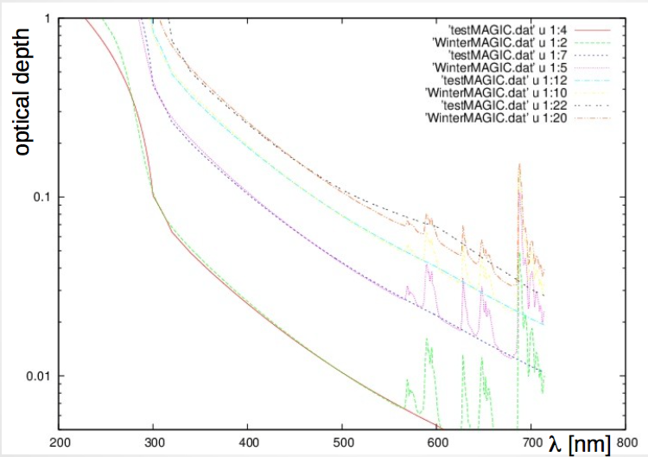
Molecular profile
Has effects on size of Cherenkov light pool (via shower altitude and Cherenkov angle) and transmission of Cherenkov light
For molecular absorption not so clear...
Only O₃, CO₂ and NO_{X} are (perhaps) relevant for us!
The IG2 model has been used by INFN Torino, claimed to be accurate, but not yet cross-calibrated with our instruments (or other databases).
The effect is small though (at least much, much smaller than the density effects)
Credits: Piero Vallania, Bianca Binelli,
C. Bigongiari, F. Di Pierro, E. Papandrea

Slide 8
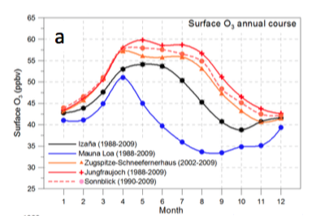
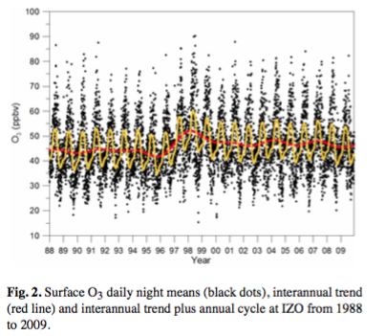
Molecular profile
Ozone has been studied in detail at Izaña (Tenerife), 2400 m a.s.l.
E. Cuevas et al., “Assessment of atmospheric
processes driving ozone variations in the
subtropical North Atlantic free troposphere”,
Atmos. Chem. Phys., 13, 1973–1998, 2013

Slide 9
Molecular profile
Ozone at high troposphere is correlated with a parameter called “Potential vorticitiy” (PV), measured in units of PVU.
Situations with PVU>1.0 indicate stratospheric intrusions into the upper troposphere and hence high O₃ concentrations.
E. Cuevas et al., “Assessment of atmospheric processes driving ozone variations in the subtropical North Atlantic free troposphere”, Atmos. Chem. Phys., 13, 1973–1998, 2013

Slide 10
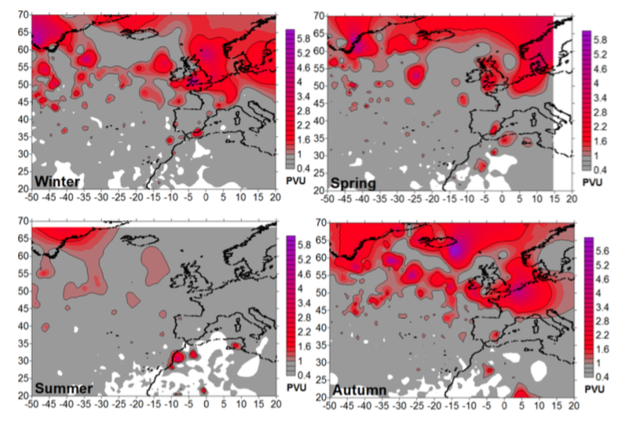
Molecular profile
^{PV}_{max} maps for winter (JFM), spring (AMJ), summer (JAS) and autumn (OND) in the period 1988–2009.
Ozone at high troposphere is correlated with a parameter called “Potential vorticitiy” (PV), measured in units of PVU.
Situations with PVU>1.0 indicate stratospheric intrusions into the upper troposphere and hence high O₃ concentrations.
E. Cuevas et al., “Assessment of atmospheric processes driving ozone variations in the subtropical North Atlantic free troposphere”, Atmos. Chem. Phys., 13, 1973–1998, 2013

Slide 11
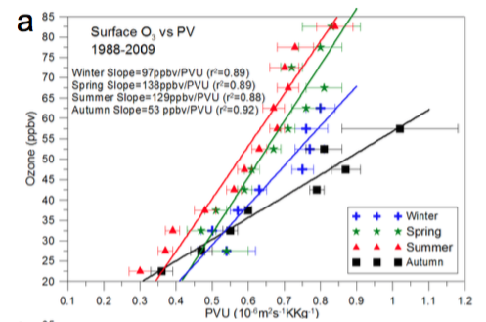
Molecular profile
Stratospheric
intrusions
E. Cuevas et al., “Assessment of atmospheric processes driving ozone variations in the subtropical North Atlantic free troposphere”, Atmos. Chem. Phys., 13, 1973–1998, 2013

Slide 12
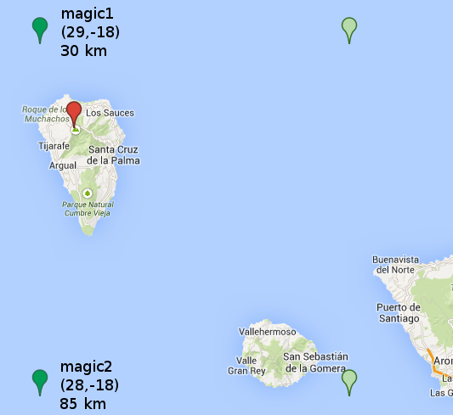
Molecular profile
Cross-correlation with MAGIC weather station
GDAS combined with NRLMSIS-E
Perfect match for pressure comparison
Systematic shift for temperatures can be explained by local ground effects (inverse for day-time data)
Even correlation for humidity is good
(difficult because of very local variation)

Slide 13
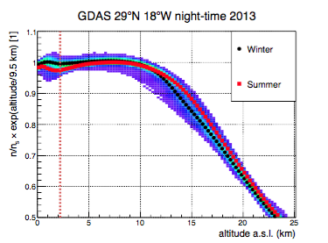
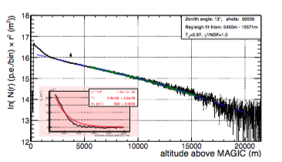
Molecular profile
Cross-correlation with the MAGIC LIDAR
GDAS combined with NRLMSIS-E
The LIDAR is sensitive to the molecular profile during clear nights
We see a significant improvement from linear fits to “GDAS-fits”.
The GDAS fits yield correct χ² distributions!

Slide 14
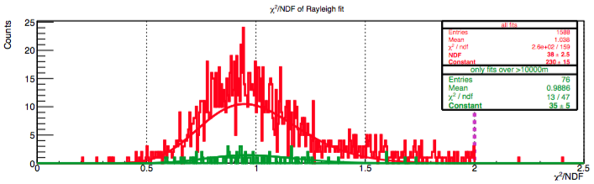
Molecular profile
Cross-correlation with the MAGIC LIDAR
GDAS combined with NRLMSIS-E
The LIDAR is sensitive to the molecular profile during clear nights
We see a significant improvement from linear fits to “GDAS-fits”.
The GDAS fits yield correct χ² distributions!

Slide 15
Molecular profile
Simulation input for the MC studies
Simulation input for the MC studies
GDAS combined with NRLMSIS-E
The LIDAR is sensitive to the molecular profile during clear nights
We see a significant improvement from linear fits to “GDAS-fits”.
The GDAS fits yield correct χ² distributions!

Slide 16
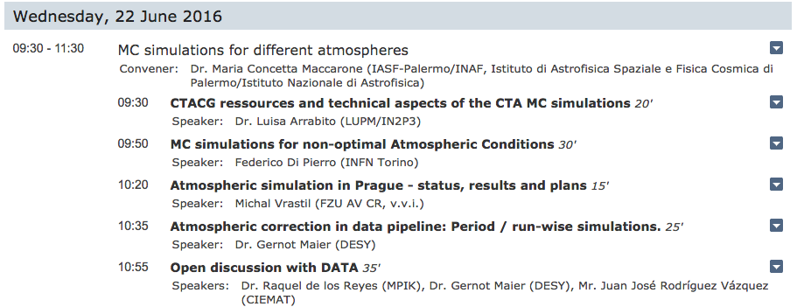
Molecular profile
Simulations and first result are shown on Wednesday morning by Federico di Pierro (INFN Torino)

Slide 17
Aerosol profiles

Slide 18
Aerosol profiles
Has potentially strong effect on extinction of Cherenkov light
Aerosol enhancements of ground layer (“calima”) and clouds (cumulus and cirrus)
Strong dependency on time and altitude
Strong energy dependency in case of clouds
Have analyzed more than 3 years of good quality MAGIC LIDAR data
Taken synchroneously with science data (5 deg. offset)

Slide 19
Aerosol profiles
Are very well studied on La Palma, using:
3 years of continuous MAGIC LIDAR measurements
Almost 10 years of the TNG dust counter
20 years of Sun photometer measurements (Izaña, Tenerife)
Extremely detailed aerosol characterization with state-of-the-art equipment at IARC (Izaña, Tenerife)

Slide 20
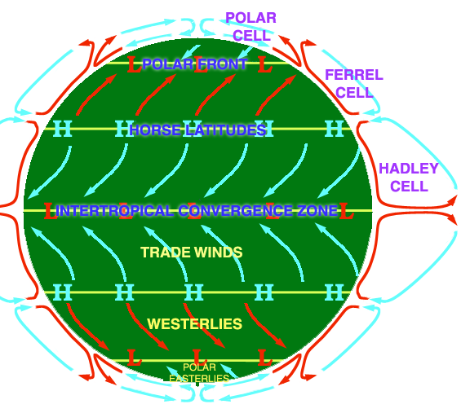
Aerosol profiles
The Island of La Palma is
affected by:
the trade winds
below 1800 m a.s.l.
the descending dry air
transported by the
Hadley cell along the
tropopause above
1800 m a.s.l.
La Palma

Slide 21
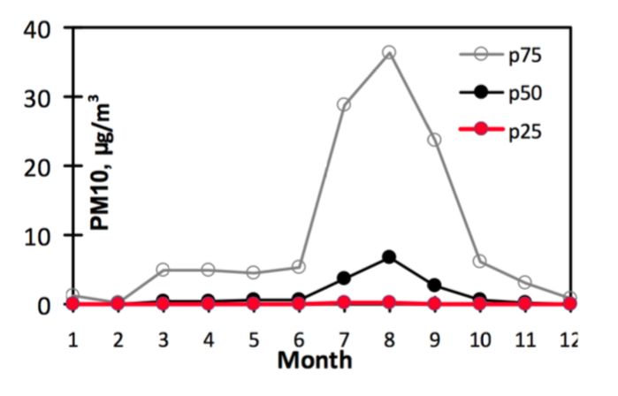
Aerosol profiles
PM₁₀ distributions obtained at Izaña, Tenerife (2400 m a.s.l.)
Threshold
for extremely
clean environments
^{E.Cuevas and J. M.Baldasano,}
“Report on the Incidence of African dust intrusions at the Astronomical Observatories of the Canary Islands:
characterization and temporal analysis”, Izan ̃a Atmospheric Research Centre of AEMET and the Earth Sciences Department, 2009.

Slide 22
Aerosol profiles
Aerosol Transmission over time from MAGIC LIDAR (absolutely calibrated with the Sun photometer data from Izaña)
Aerosol enhancements of ground layer (“calima”) and clouds (cumulus and cirrus)
Strong dependency on time and altitude
Strong energy dependency in case of clouds
Have analyzed more than 3 years of good quality MAGIC LIDAR data
Summer Calima periods

Slide 23
Aerosol profiles
Aerosol Transmission probability map from MAGIC LIDAR
Aerosol enhancements of ground layer (“calima”) and clouds (cumulus and cirrus)
Strong dependency on time and altitude
Strong energy dependency in case of clouds
Have analyzed more than 3 years of good quality MAGIC LIDAR data
Clouds
Calima

Slide 24
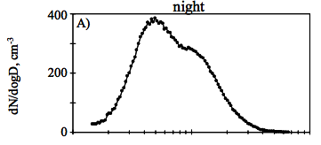
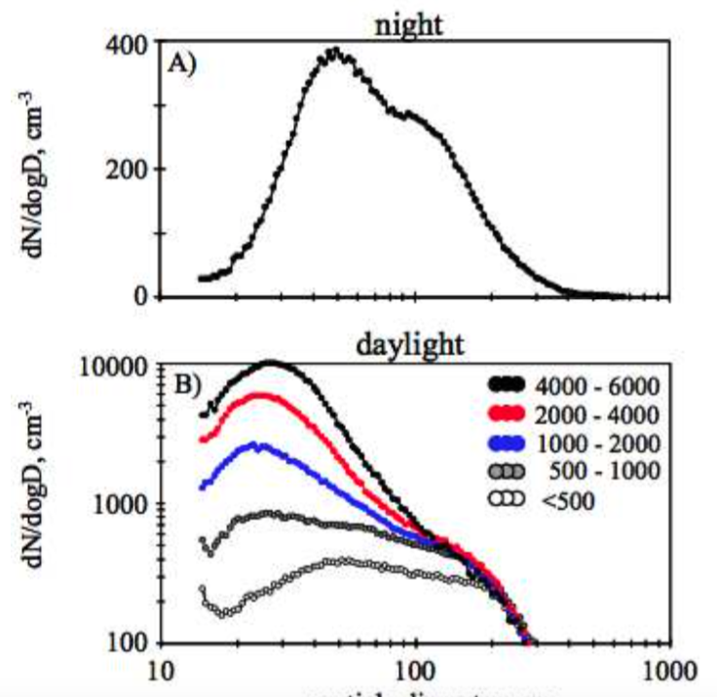
Particle size distributions
Measurements at Izaña
(Tenerife) support idea of
“aged aerosols”
that travel downwards
Rodríguez S. et al., “Atmospheric nanoparticle
observations in the low free troposphere during
upward orographic flows at Izaña Mountain
Observatory”,
Atmospheric Chemistry and Physics 9 (2009) 6319-6335
Scattering
enhanced:
~ 40 cm⁻³
10 nm
100 nm
1 μm

Slide 25
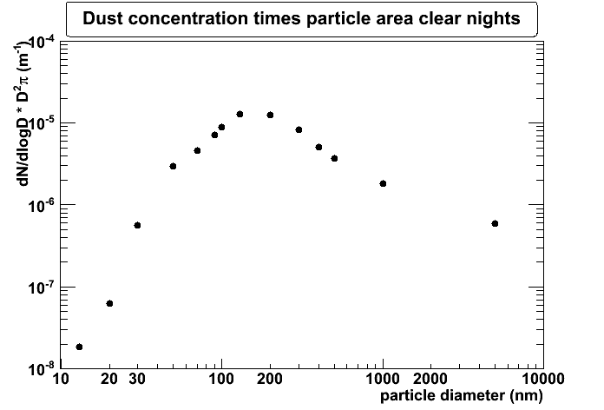
Particle size distributions
Scattering
enhanced:
~ 40 cm⁻³
10 nm
100 nm
1 μm
mode: 50 nm
Simplified (pure “Mie”) extinction coefficient
k(λ,r) =Q_{ext}(n,r,λ) πr² N

Slide 26
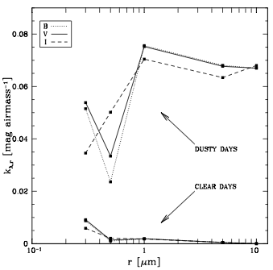
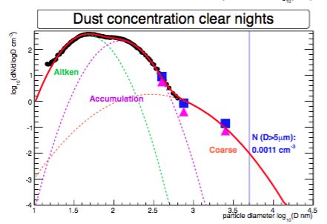
Particle size distributions
CAMT extinction measurements: agree well with Izaña data
Lombardi G. et al.,
“El Roque de los Muchachos Site Characteristics II:
Analysis of atmospheric dust and aerosol extinction”,
A&A (2008) arXiv:0802.3947v2

Slide 27
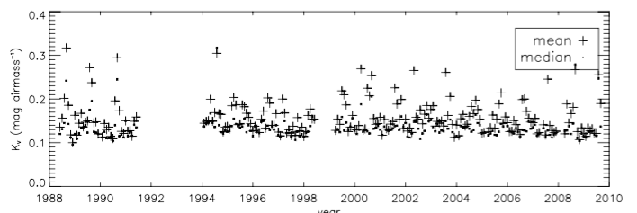
Aerosol Extinction coefficients
20 years data base from the Carlsberg Meridian Telescope
García-Gil A., Muñoz-Tuñón C., Varela A. M. “Atmosphere Extinction at the ORM on La Palma:
A 20 yr Statistical Database Gathered at the Carlsberg Meridian Telescope”, PASP 122 (2010) 1109.

Slide 28
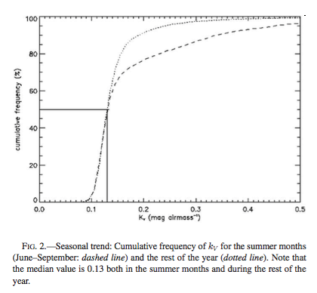
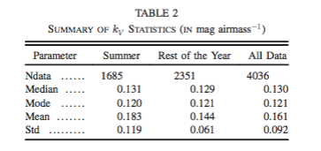
Aerosol optical extinction coefficients
20 years data base from the Carlsberg Meridian Telescope
García-Gil A., Muñoz-Tuñón C., Varela A. M. “Atmosphere Extinction at the ORM on La Palma:
A 20 yr Statistical Database Gathered at the Carlsberg Meridian Telescope”, PASP 122 (2010) 1109.

Slide 29
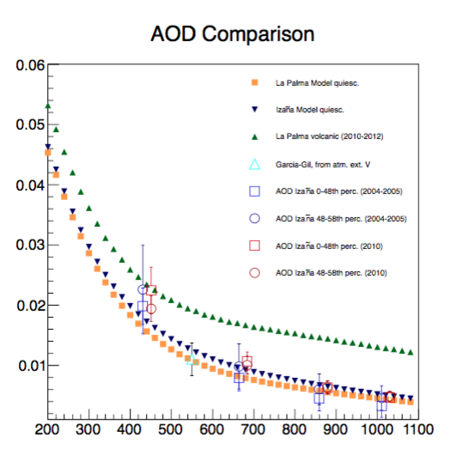
Aerosol AODs
Converting the
particle size distributions
to extinction coefficients
and converting these
into AODs
yields a consistent
picture between the
different data sets available for
the clear night at La Palma

Slide 30
Aerosol profiles
Impact of aerosol intrusions and clouds on IACT data
Has been studied for MAGIC only by Garrido et al. (ICRC 2013, ID 0465 and arXiv:1308.0473) and is part of the CTA Atmospheric Calibration Strategy: COM-CCF/130311 https://portal.cta-observatory.org/recordscentre/Records/COM/COM-CCF/lidar_loi2.pdf
Needs confirmation and extension of energy range for CTA

Slide 31
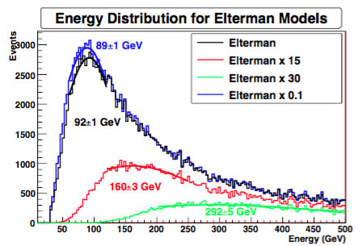
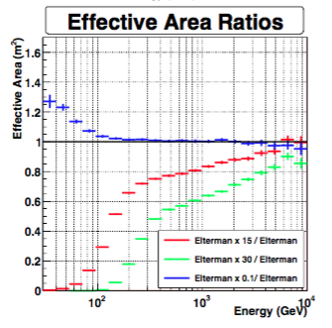
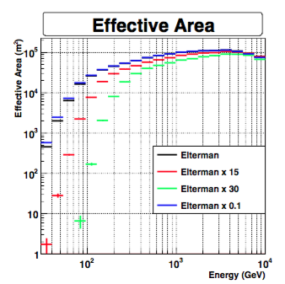
Impact of aerosol intrusions on IACT data
Different simulated cases of “calima”:
OD*15
OD*30
OD*0.1

Slide 32
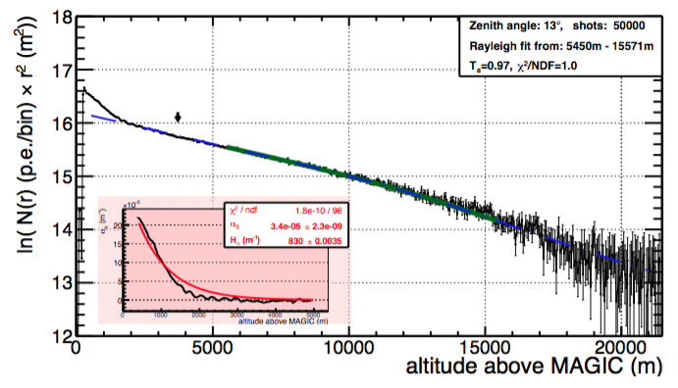
Impact of aerosol intrusions on IACT data
Clear night seen with MAGIC LIDAR

Slide 33
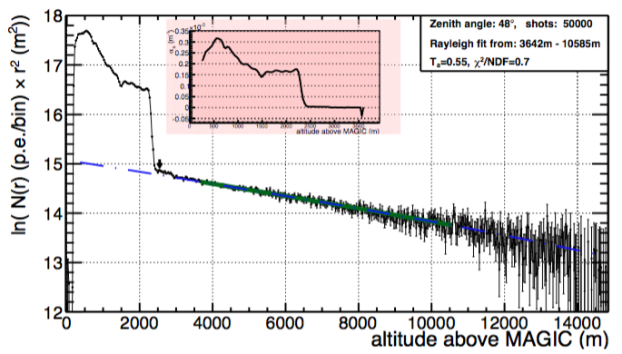
Impact of aerosol intrusions on IACT data
Calima seen with MAGIC LIDAR

Slide 34
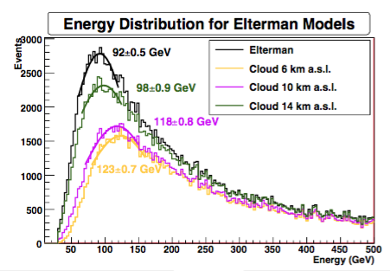
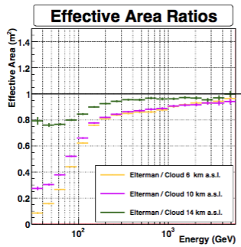
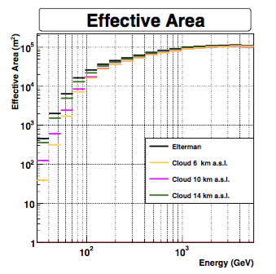
Impact of clouds on IACT data
Simulated “cloud” at 3 different altitudes:
6 km (cumulus)
10 km (cirrus)
14 km (volcanic debris)

Slide 35
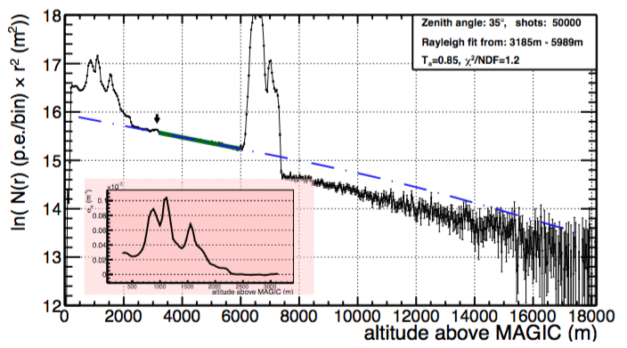
Impact of aerosol intrusions on IACT data
Cloud (and calima!) seen with MAGIC LIDAR

Slide 36
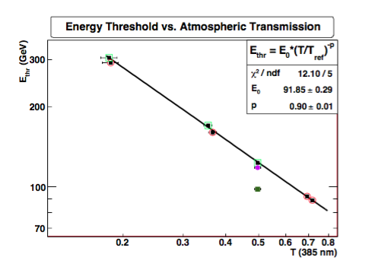
Impact of aerosols (calima and clouds) on IACT energy threshold
Cirrus (10 km)
Volcanic debris
(14 km)

Slide 37
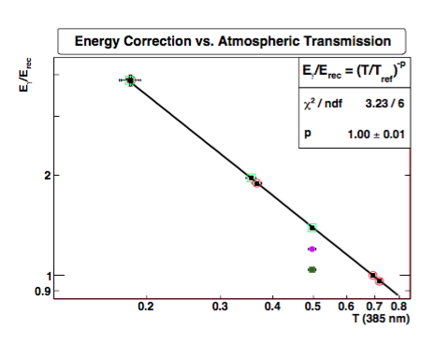
Impact of aerosols (calima and clouds) on IACT on energy scale
Cirrus (10 km)
Volcanic debris
(14 km)

Slide 38
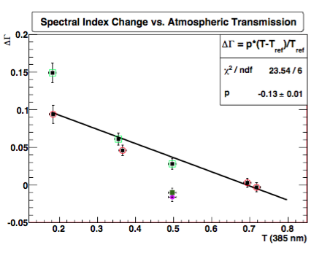
Impact of aerosols (calima and clouds) on IACT reconstructed spectral index

Slide 39
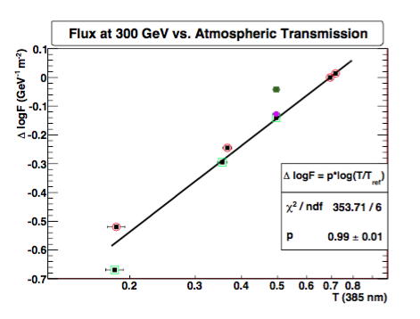
Impact of aerosols (calima and clouds) on IACT reconstructed flux

Slide 40
12 years of MAGIC weather station data

Slide 41
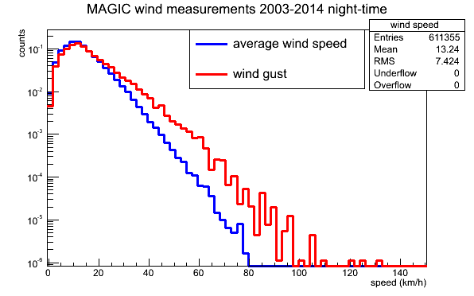
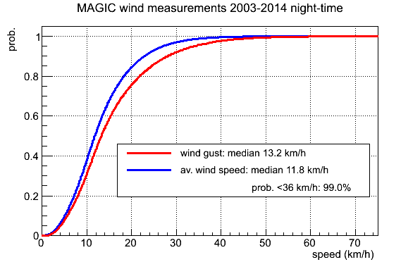
Wind measurements
Large data base of weather data from the roof of the MAGIC control house.
Still need to study the wind at different altitudes (and possibly different points across the CTA area).

Slide 42
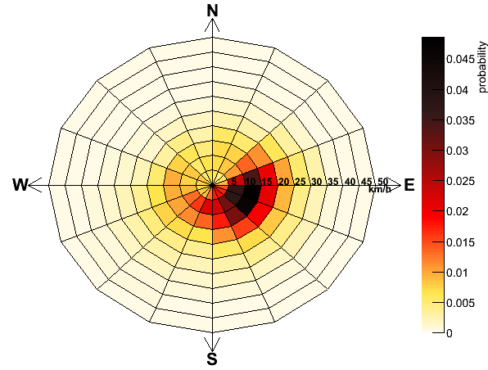
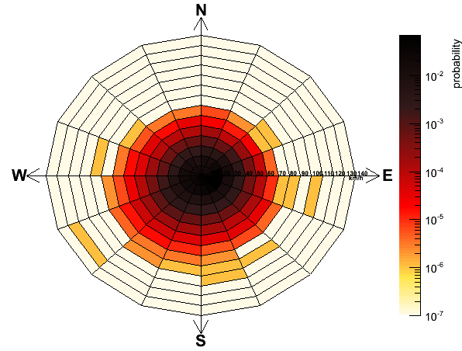
Wind measurements
only v<50 km/h,
linear scale
all data
v<140 km/h,
log scale
Wind comes preferably from ESE
Storms come preferably from a wide range covering E-S-W

Slide 43
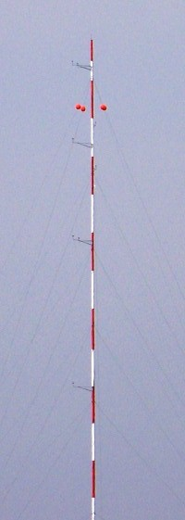
Wind measurements
30 m tower at the LST site would be needed to measure the altitude profile.
Included the tower in the first call to the Spanish FEDER funds (to be released in Autumn this year).
Some conflict with the LST1, but are confident to collect still enough data before the mirrors are mounted.

Slide 44
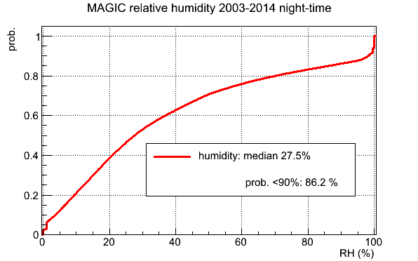
Humidity measurements and rain
Noted some hysteresis in our humidity sensor
Also rain is possible with RH<90% !!
Need additional rain sensors

Slide 45
Rain and humidity sensors
Up to now, rain/humidity is only measured at one point (roof of MAGIC control house)
However, clouds drift sometimes up the mountain, may affect parts of the CTA array without being seen at the MAGIC site. Not much known about statistics of this effect.
Plan to install several rain/humidity sensors across the CTA area and characterize gradients across the terrain.

