Slide 1
Weather monitoring status and plans @ Armazones
Lluís Font and Markus Gaug
UAB & CERES-IEEC
Central Calibration Facilities meeting
Barcelona 20-23 June 2016

Slide 2
Overview
The goals
Provide the site with weather monitoring information to guarantee safety operation of the telescopes. Prevent equipment damage.
Contribute to the site climatology and full atmospheric characterization of the site.
The strategy
Acquire robust WS and weather monitoring instrumentation (24/365 with no failure for 30 years of remote operation)
Redundancy
Final selection and placement of the sensors is site-specific (Classic WS + anemometers + rain sensors + complementary instruments)
Production: all equipment and implementation for methods that are part of the final observatory .
Lluís Font and Markus Gaug
CCF meeting Barcelona 20-23 June 2016
1

Slide 3
The Southern Site: Armazones
Pre-production
3.10.3.4.6 |  |  |  |  | Weather monitoring
3.10.3.4.6.7 |  |  |  |  |  | Complementary Instruments
3.10.3.4.6.7.1 |  |  |  |  |  |  | Electric field mills
3.10.3.4.6.7.1.1 |  |  |  |  |  |  |  | Establish usefulness
3.10.3.4.6.7.2 |  |  |  |  |  |  | Dust counters
3.10.3.4.6.7.2.1 |  |  |  |  |  |  |  | Establish usefulness
3.10.3.4.6.7.3 |  |  |  |  |  |  | Accelerometers
3.10.3.4.6.7.3.1 |  |  |  |  |  |  |  | Establish usefulness
3.10.3.4.6.7.4 |  |  |  |  |  |  | National Rain radars
3.10.3.4.6.7.4.1 |  |  |  |  |  |  |  | Check availability
3.10.3.4.6.7.4.2 |  |  |  |  |  |  |  | Check possibility of integration in ACTL
3.10.3.4.6.7.5 |  |  |  |  |  |  | Weather forecasts
3.10.3.4.6.7.5.1 |  |  |  |  |  |  |  | Check availability
3.10.3.4.6.7.5.2 |  |  |  |  |  |  |  | Check possibility of integration in ACTL
✓
Probably not needed. Still to be studied.
✓
Useful for aerosol modelling and feedback to operators
✓
Useful, although analysis still ongoing
✗
Not available for Armazones
✓
Useful, although no studies performed yet
Coverage: 100% :no equipment cost; only labour (FTEs)
Next actions (to do)
Push for usefulness studies
Lluís Font and Markus Gaug
CCF meeting Barcelona 20-23 June 2016
2

Slide 4
The Southern Site: Armazones
Production
Armazones
Whole CTA
Whole CTA
10 COM | 4.100.030.04.06 | Weather monitoring | € 374.868,00
10 COM | 4.100.030.04.06.01 | Classic weather station | € 55.135,00
10 COM | 4.100.030.04.06.02 | Anemometers | € 98.928,00
10 COM | 4.100.030.04.06.03 | Rain sensors | € 68.051,00
10 COM | 4.100.030.04.06.04 | Complementary Instruments | € 152.754,00
€ 316.339,00
€ 52.484,00
€ 83.226,00
€ 27.876,00
€ 152.754,00
€ 161.347,00
€ 26.242,00
€ 41.613,00
€ 93.492,00
3 classic WS + 2 spares (1 from LSTs weather monitoring)
6 anemometers + 2 spares (3 recycled from LSTs weather monitoring)
9 rain sensors + 2 spares
Coverage
Complementary instruments:
~ 0% !!!
1 Electric field mill: 35.362,00
1 dust counter: 17.900,00
Next steps
Rain radars: Not available
Ask Johannes for EoI data related to Weather monitoring.
Identify Institutes interested in collaborating.
Take advantage of Use cases and ACTL integration from the Northern site.
Weather forecasts: 6.000,00
Accelerometer: 34.230,00
Lluís Font and Markus Gaug
CCF meeting Barcelona 20-23 June 2016
3

Slide 5
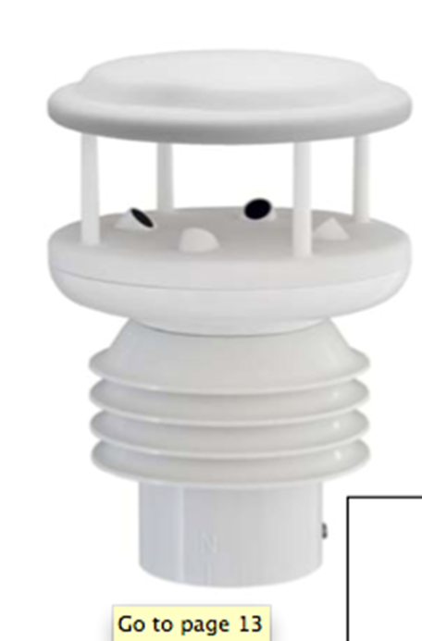
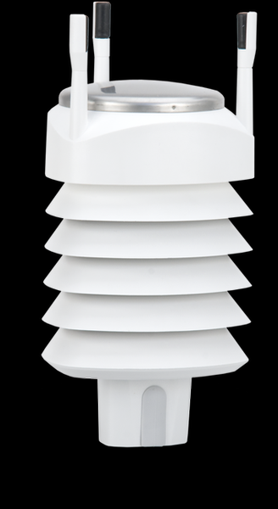
Sensors (almost) decided
Standard Weather Stations

Slide 6
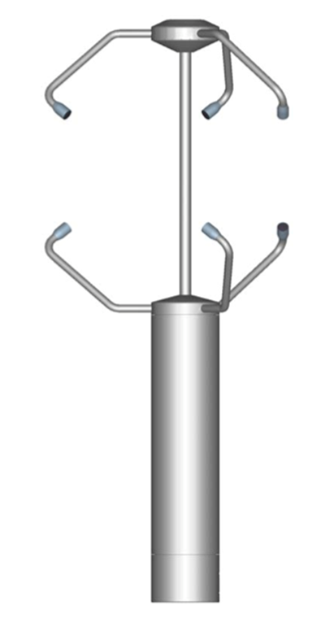
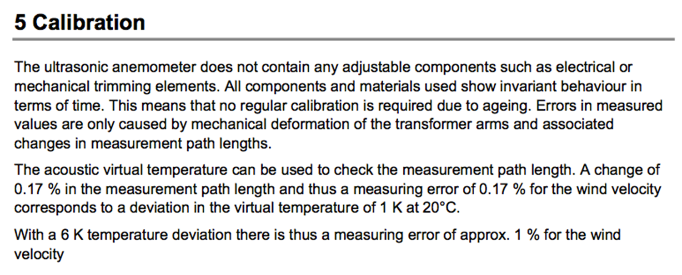
Sensors (almost) decided
Ultrasonic anemometers 3D

Slide 7
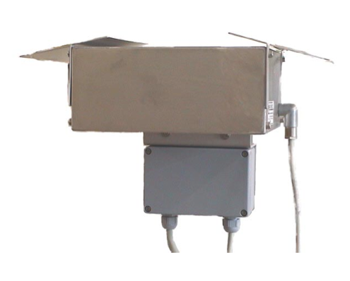
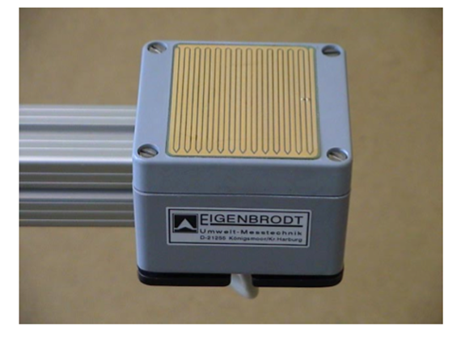
Sensors (almost) decided
Rain sensor: PRECIPITATION SENSOR – IRSS 88 from Eigenbrodt

