Slide 1
Astroclimatic Characterization of the Paranal Site
M. Sarazin (ESO)

Slide 2
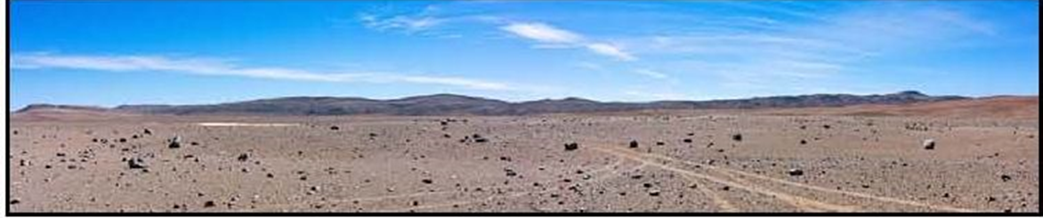
Context
CTA intends to locate the Southern Array near Paranal, operated by ESO
Plans for construction and Operation were discussed between CTA and ESO on 4th February and 28th April 2016 technical meetings
ESO-CTA agreement is expected to go for formal approval by ESO Council in December 2016 after recommendation by ESO Scientific Technical Committee (October) and ESO Finance Committee (November)

Slide 3
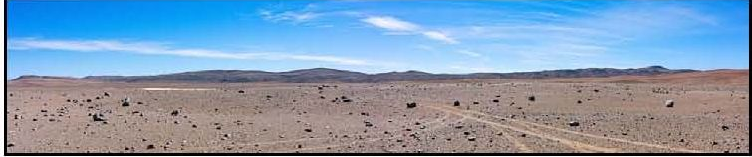
Disclaimer
This presentation was assembled at the request of CTA, it has no precedence in case of discrepancies with official documents currently negotiated

Slide 4
Parameters of interest for CTA
Sky Quality
  molecular profiles
  aerosol profiles
  cloudiness
Climate
  global warming
  El niño
Extreme events
  earthquakes
  precipitation
Lasers
  aircraft avoidance
  Observatory traffic control

Slide 5
Parameters of interest for CTA
Sky Quality
1. What is known about the molecular profiles? Accuracy of methods (especially WRF), nocturnal variations, Seasonal and annual variations, long-term tendencies.
2. What is known about absorbing molecules: Ozone, NOx, SOx ? Their profiles, variations on all time scales: nocturnal, seasonal, annual, long-term tendencies?
3. What is known about aerosol profiles: Accuracy of methods, nocturnal variations, Seasonal and annual variations, long-term tendencies.
4. What is known about cirrus: Typical shape of cirrus, heights, predictability of movement and changes in shape

Slide 6
Sky Quality: Outline
Precipitable water vapour (PWV)
  Water vapour radiometer (LHATPRO)
  Homogeneity of PWV
  Episodes of extremely low PW
  Modeling atmospheric absorption
ESO Classification of sky conditions
  Detrended Fluctuation Analysis
  Cloud detection
  Cloud classification and diagnostic diagram
ECMWF Forecasts

Slide 7
Pecipitable Water Vapour
Median PWV on Paranal 2.4 mm
Low Humidity and Temperature Profiling Radiometer (LHATPRO, Kerber et al. (2012), SPIE 8446, 84463N)
  Radiometer Physics (RPG), http://www.radiometer-physics.de/products/
  Operational since Nov 2011
    Profiles up to 10 km
    Precipitable water vapour (PWV): 183 GHz line
    Temperature: O₂ band 56 GHz
  range 0.1-25 mm validated, saturation at 20 mm
  PWV accuracy: ca 0.1 mm, precision: ca 30 μm
F. Kerber, ESO

Slide 8
LHATPRO - Operational scheme
2-D all-sky scan: step size of 12° azimuth, 12.5° elevation
  duration 6 min, repeated every 6 h;
  1.7% of day
Cone scan at 30° elevation (Hovmöller): step size 6°
  duration 2.5 min, repeated every 15 min;
  16.7% of day
Routine observations set to zenith-staring mode
  81.6% of day
F. Kerber, ESO

Slide 9
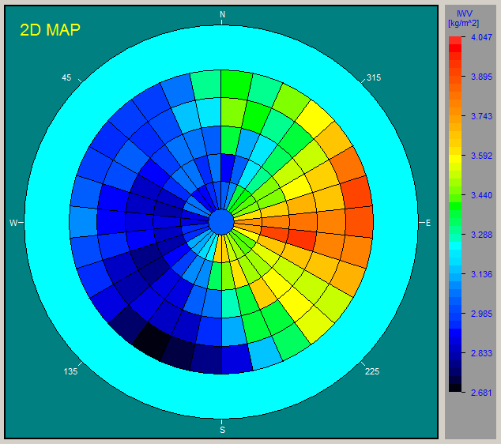
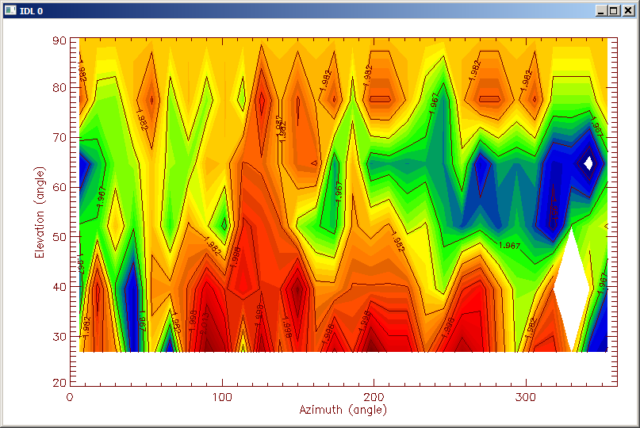
Water vapour monitor
Homogeneity of PWV:
  Dependent on absolute PWV
  Median rms about 3%
  Querel & Kerber (2014), SPIE 9147, 914792
F. Kerber, ESO

Slide 10
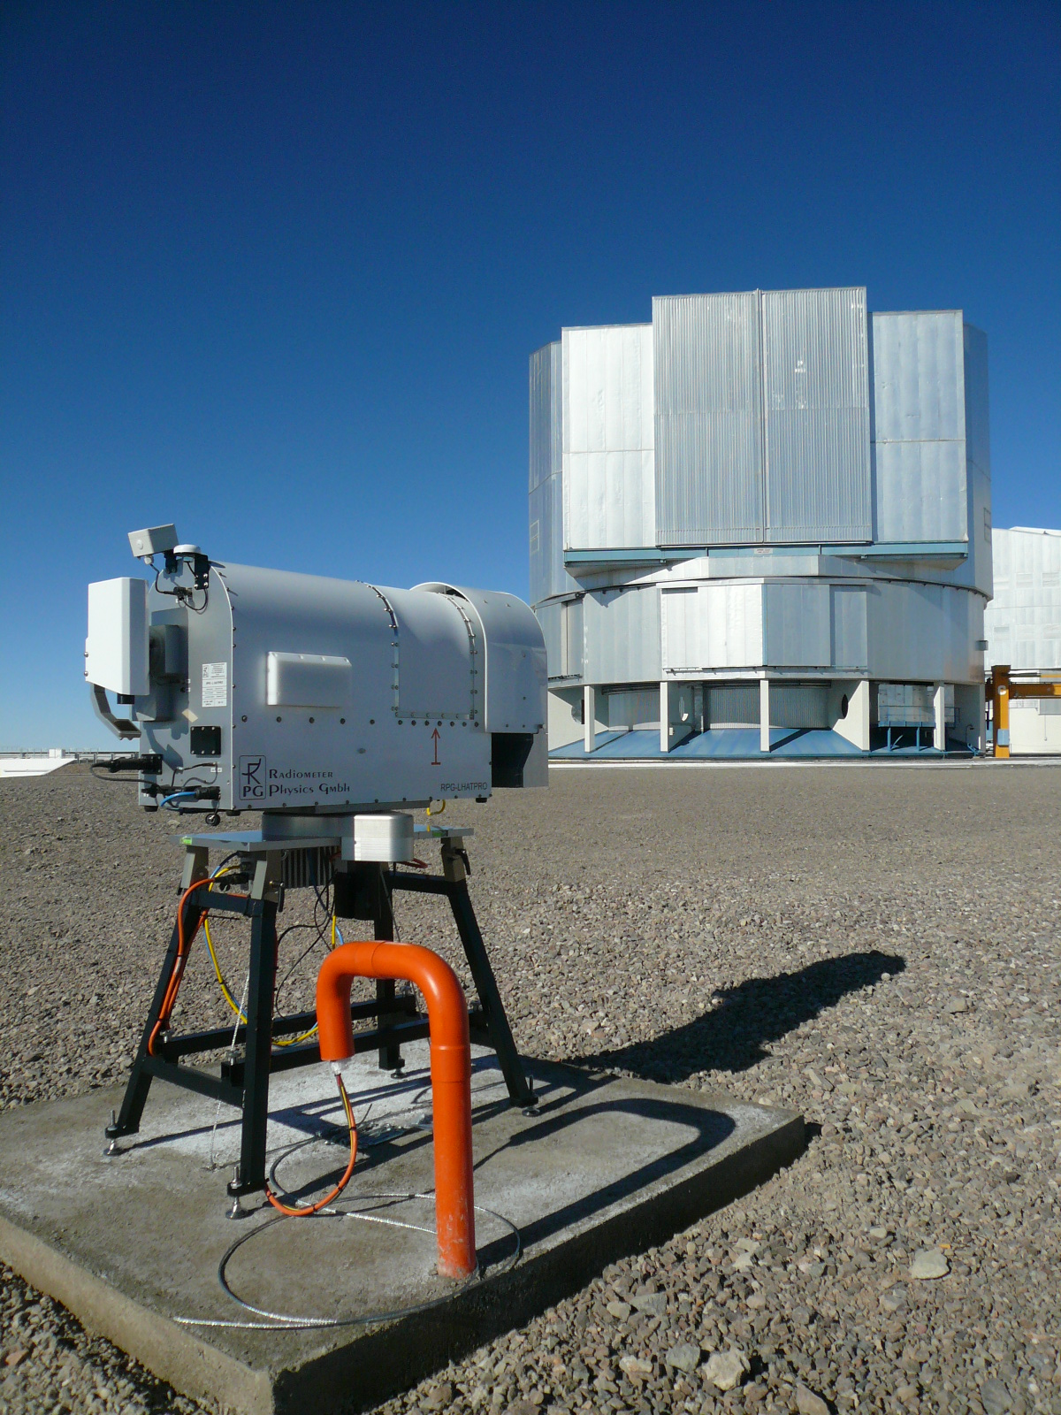

Episodes of extremely low PWV
1st fully documented event: July 5/6th, 2012; Kerber et al. (2014), MNRAS 439, 247
PWV: ≈0.1 mm & very stable
  Dome C, median (winter) ≈0.2 mm
Duration: > 12h
Other ambient conditions: fine
Explanation in terms of meteorological conditions
  Antarctic air plus coastal low
Estimated frequency of occurrence: few nights/year
PWV [mm] | ≤ 0.2 | ≤ 0.5 | ≤ 1.0
UVES (2001-08) | 0.3% | 1.8% | 12%
CRIRES (2007-12) | 0.8% | 2.0% | 15%
F. Kerber, ESO

Slide 11
Episodes of extremely low PWV
F. Kerber, ESO

Slide 12
Atmospheric modeling
Molecfit
  Austrian in-kind contribution (Univ. of Innsbruck) to ESO
  Tool to correct astronomical observations for atmospheric absorption features
  http://www.eso.org/sci/software/pipelines/skytools/molecfit
  Smette et al. (2015), A&A 576, A77
  Kausch et al. (2015), A&A 576, A78
F. Kerber, ESO

Slide 13
LHATPRO – IR channel
IR camera
  Observes in lock-step with PWV
  Sky brightness temperature at 10 μm
  Range: down to -100˚C
  Capability to detect cold, high altitude, thin clouds
Clouds on Paranal
  Cirrus most frequent kind of clouds on Paranal
  Difficult to detect otherwise (moonless nights)
  Ruins photometry
F. Kerber, ESO

Slide 14
ESO Sky quality classification
Photometric (PHOT)
  No visible clouds; transparency variations under 2%.
Clear (CLR)
  Less than 10% of the sky above 2 air masses covered by clouds; transparency variations less than 10%.
Variable, thin cirrus (THN)
  Transparency variations between 10% and 20%.
Variable, thick cirrus (THK)
  Large transparency variations possible, equivalent to no constraint on the transparency conditions.
F. Kerber, ESO

Slide 15
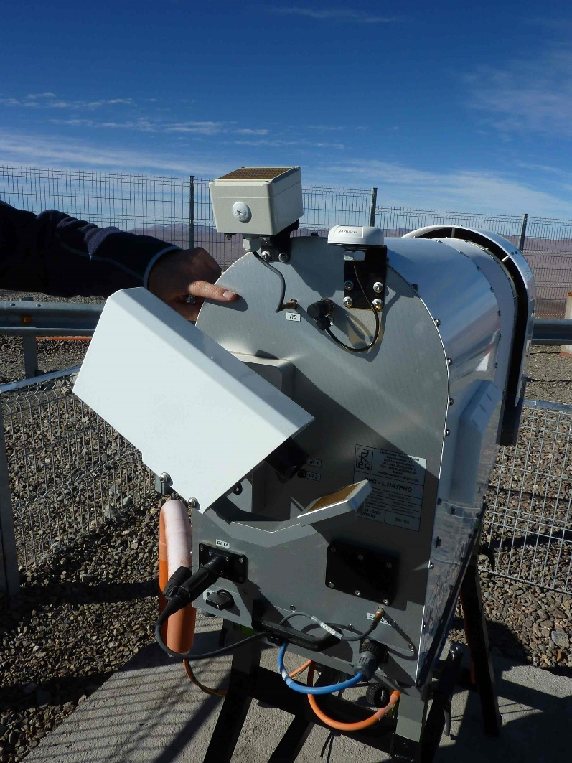
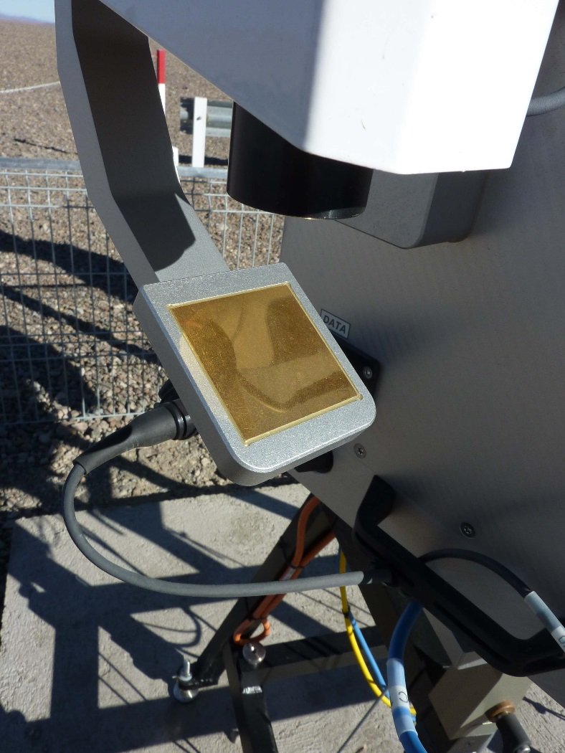
LHATPRO – IR channel
F. Kerber, ESO

Slide 16
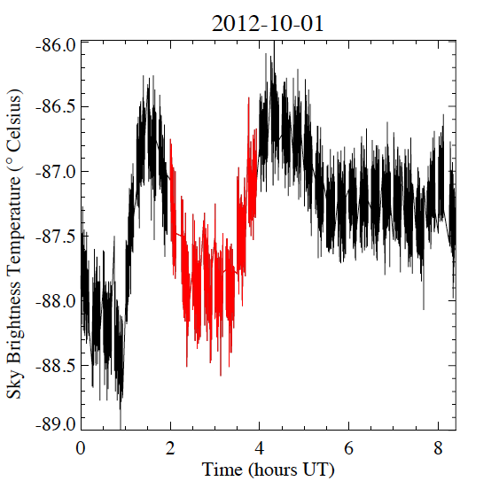
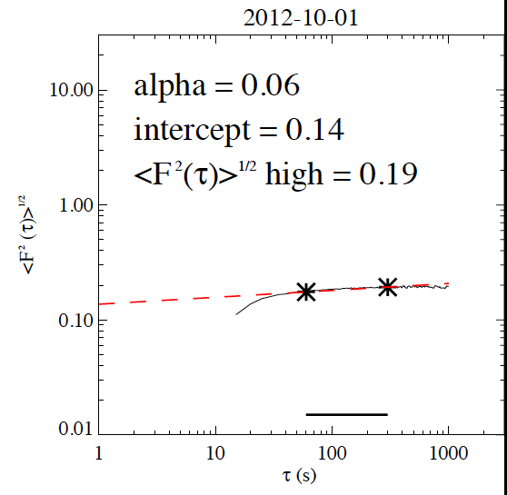
LHATPRO – IR channel
Time series analysis
IR sky brightness temperature
DFA
2 h interval
De-trended Fluctuation Analysis DFA
F. Kerber, ESO

Slide 17
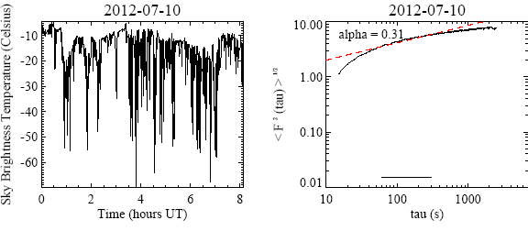
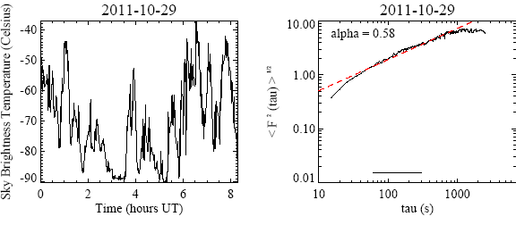
LHATPRO – IR channel
Thick Clouds
F. Kerber, ESO

Slide 18
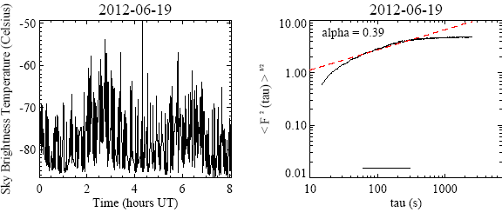
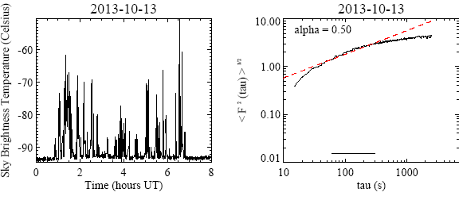
LHATPRO – IR channel
Thin Clouds
F. Kerber, ESO

Slide 19
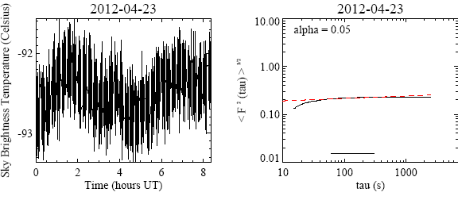
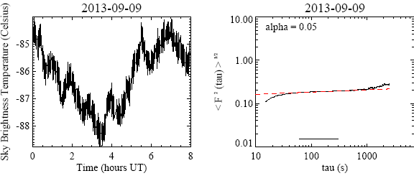
LHATPRO – IR channel
Clear Skies
Robust against variations other than clouds;
Kerber et al. (2014), SPIE 9149, 91490M
F. Kerber, ESO

Slide 20
DFA Diagnostic Diagram
F. Kerber, ESO

Slide 21
Sky quality classification
Classification matrix – probability of detection
Good matches (diagonal): 92.5%
Validated with:
  Night log and FORS 2 extinction measurements
 | Night log
LHATPRO | CLR+PHOT | THN | THK
CLR+PHOT | 72.0 | 1.3 | 0.5
THN | 4.0 | 7.7 | 0.1
THK | 0.8 | 0.8 | 13.0
F. Kerber, ESO

Slide 22
ECMWF Weather Forecasts
Deterministic Forecasts Dissemination to ESO:
Time: 00:00:00, 12:00:00 UTC
Steps: T+0h to T+90h at 1-hour interval, then to T+144h at 3-hour intervals
Domain: 21S to 26.5S,72.5W to 66W, Grid: 0.125 x 0.125 (Lat-Lon)
Pressure levels 25: 1000, 950, 925, 900, 850, 800, 700, 600, 500, 400, 300, 250, 200, 150, 100, 70, 50, 30, 20, 10, 7, 5, 3, 2, 1 hPa
- GH: 156 Geopotential height
- R: 157 Relative humidity
- T: 130 Temperature
- U: 131 U-velocity
- V: 132 V-velocity
Single
- TP: 228 Total precipitation
- HCC: 188 High cloud cover
- LCC: 186 Low cloud cover
- MCC: 187 Medium cloud cover

Slide 23
ECMWF Weather Forecasts
Ensemble Forecasts Dissemination to ESO
Time: 00:00:00, 12:00:00 UTC
Steps: T+0h to T+144h at 3-hour intervals
Domain: 21S to 26.5S,72.5W to 66W, Grid: 0.25 x 0.25 (Lat-Lon)
Model level: 31
CC: 248 Cloud Cover
Single
TP: 228 Total precipitation
HCC: 188 High cloud cover
LCC: 186 Low cloud cover
MCC: 187 Medium cloud cover
SF: 144 Snow fall
http://www.ecmwf.int/en/forecasts/documentation-and-support/dissemination-manual

Slide 24
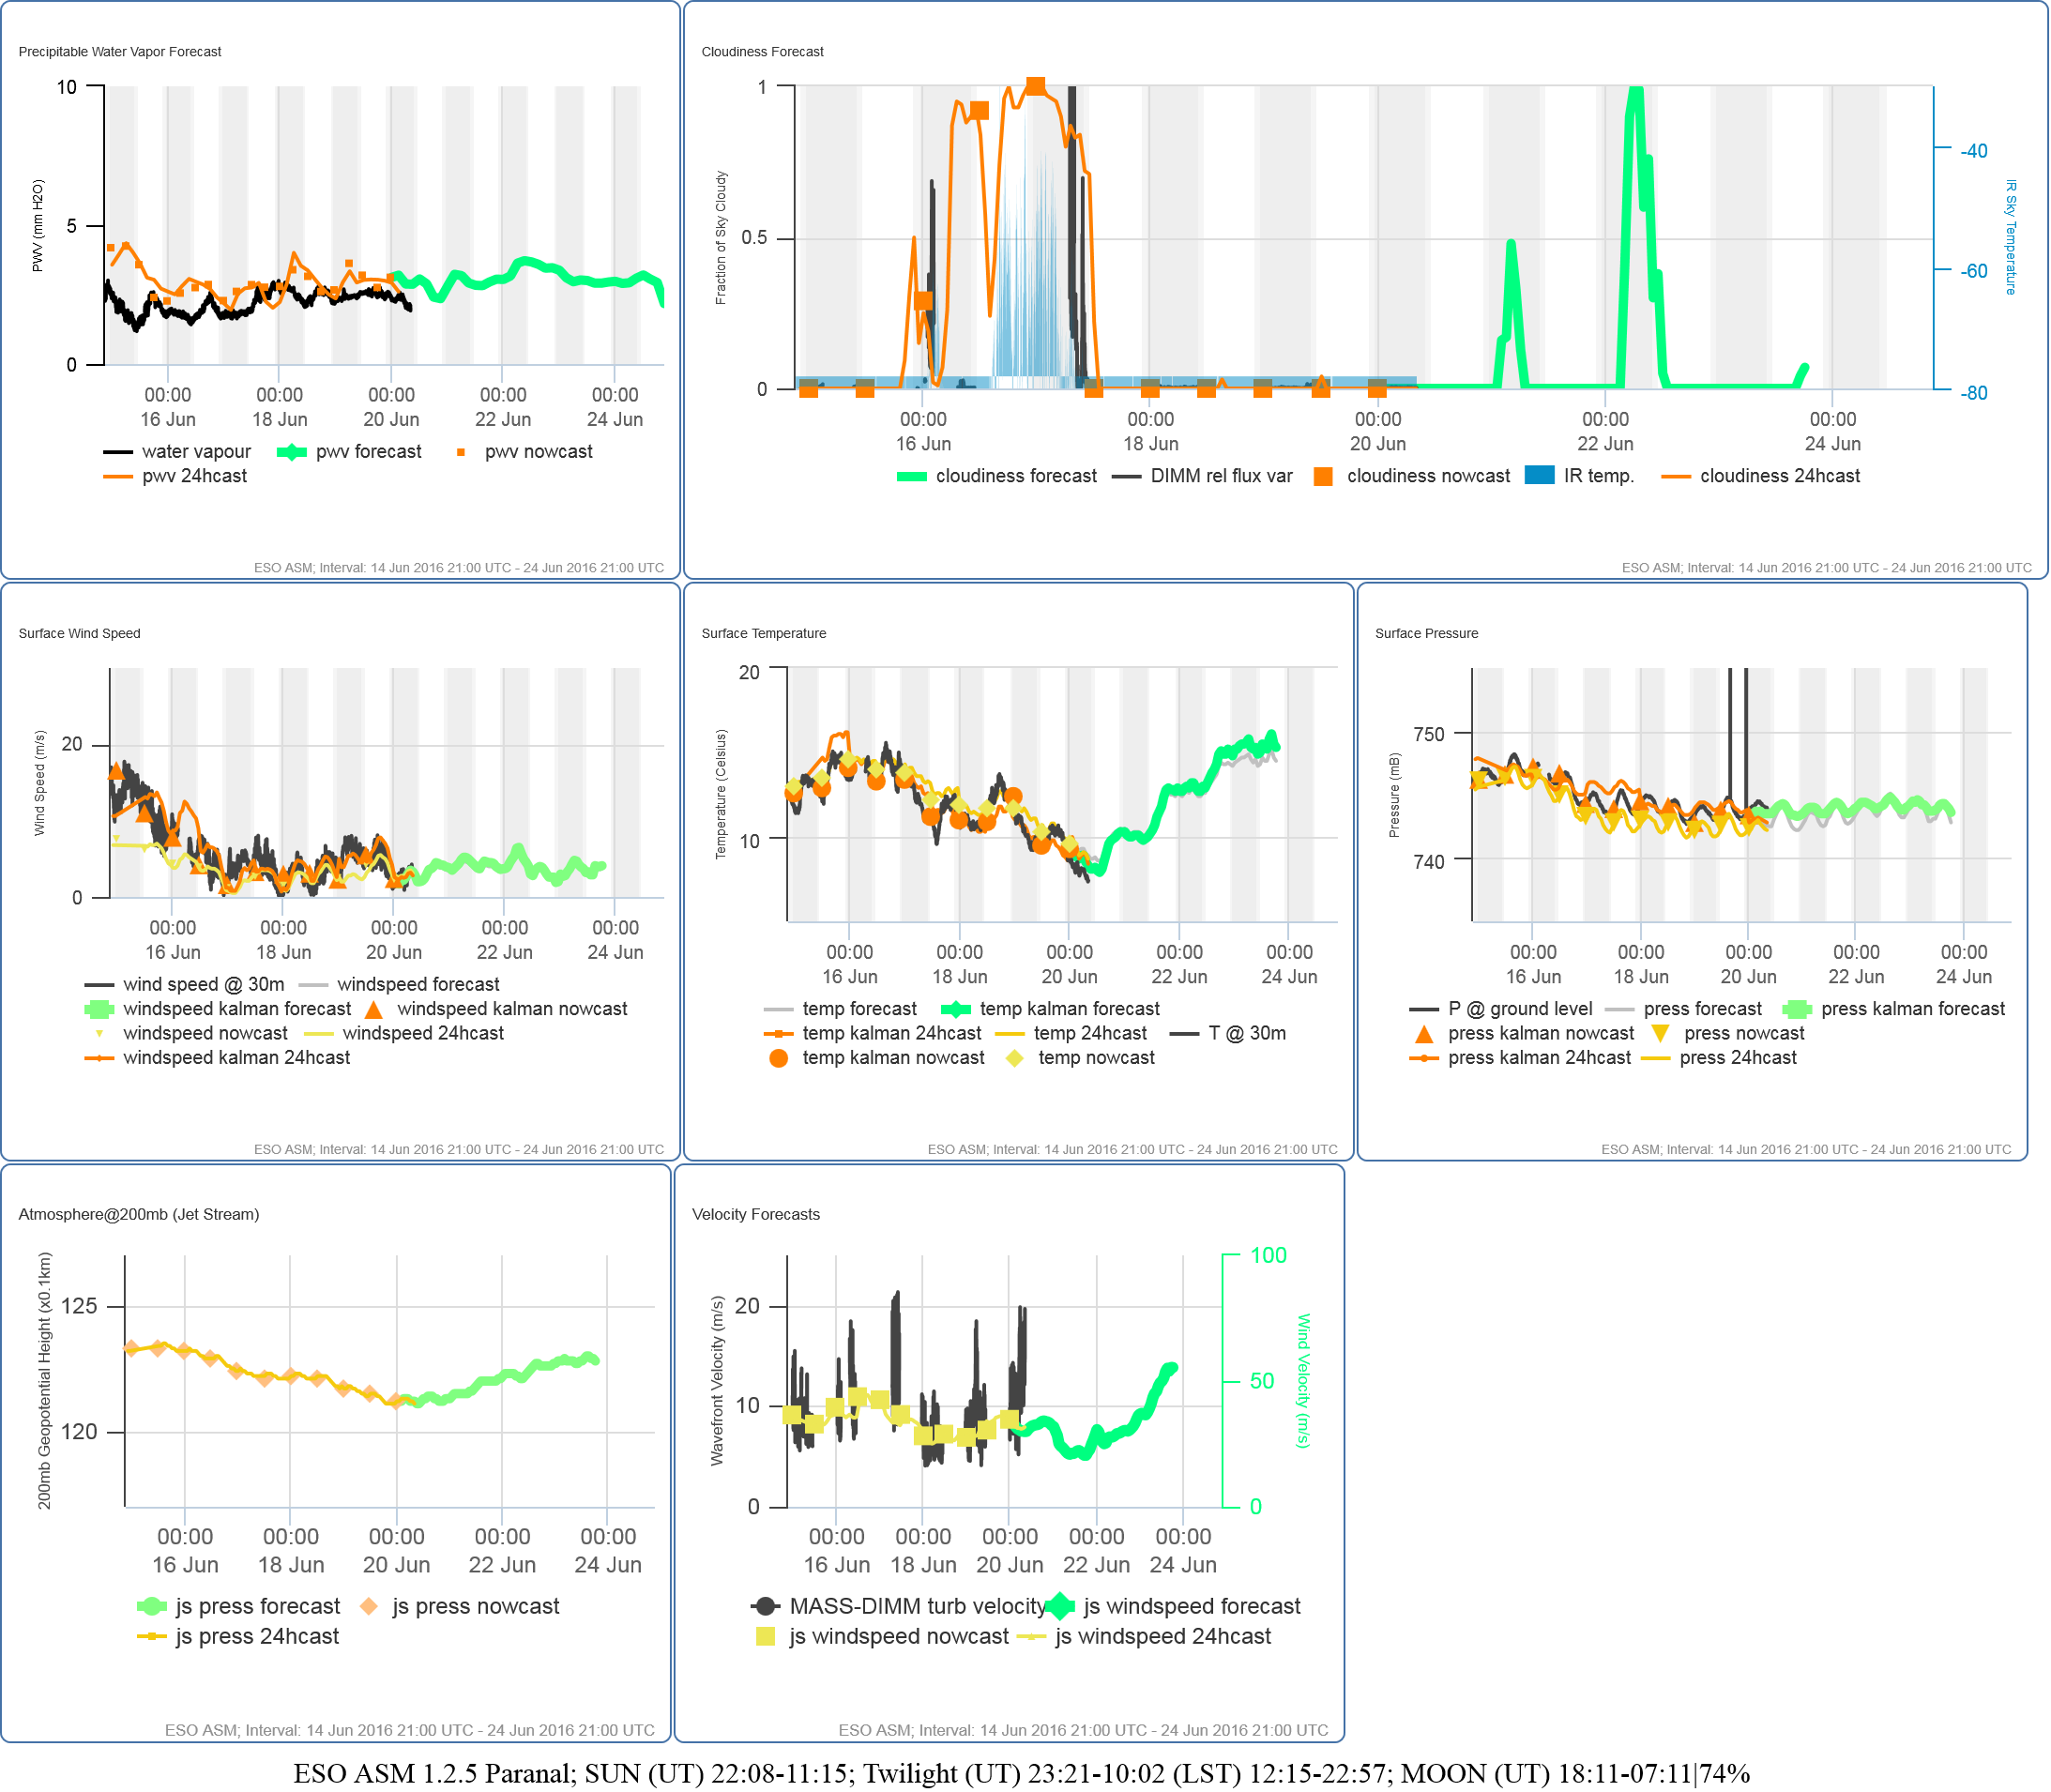
ECMWF Weather Forecasts
VLT Astronomical Site Monitor (ASM) Web Display Tool

Slide 25
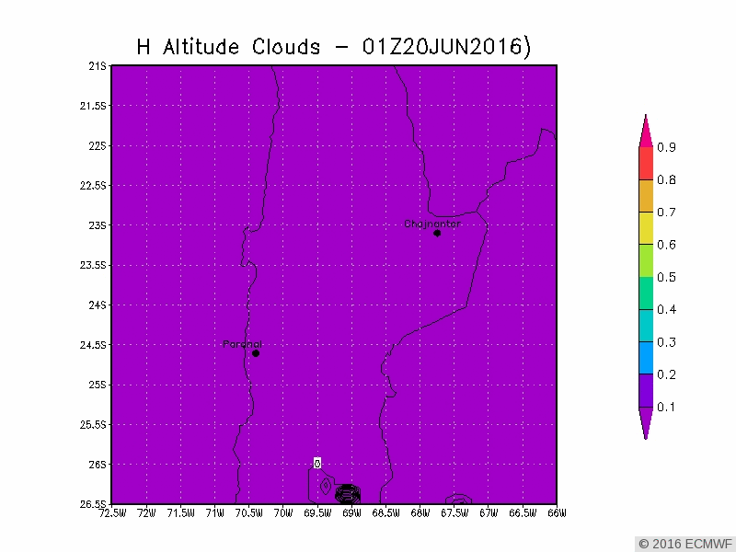
ECMWF Weather Forecasts

Slide 26
Parameters of interest for CTA
Climate Change
5. What exactly happens in an “El Niño” season?
6. What are the effects of “El Niño” events on the above characteristics? Is there a tendency of “El Niño” to
change with time?
9. Has the effect of climate change been assessed for Armazones? What is expected to change?
Extreme Weather
7. What is known about catastrophic events at Armazones? Rainfalls, Snow, Ice, Hail ?

Slide 27
Climate change: El niño
Up to 20% loss in photometric nights during a strong El niño
www.eso.org/sci/publications/messenger/archive/no.90-dec97/messenger-no90-5-7.pdf

Slide 28
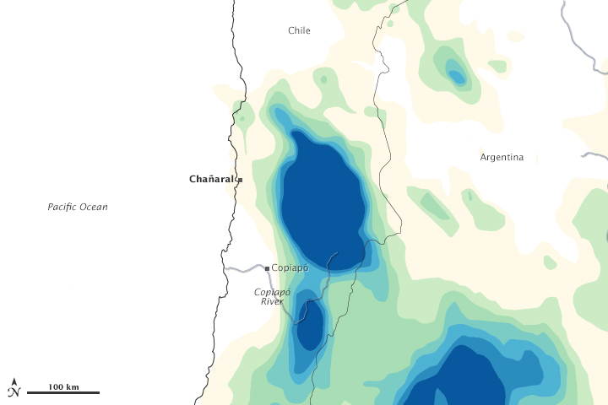
Climate change: severe weather event
March 25 - 27, 2015
the heaviest and most extensive rainfall in the Atacama Desert region in nearly a century. Rain totals barely exceeded 50 millimeters (2 inches), but they came in one of the driest regions of the world. The town of Antofagasta received 24 millimeters (an inch) of rain on March 25-26; with a yearly average of 1.7 millimeters, that was about 14 years worth of rain in a day.

Slide 29
Parameters of interest for CTA
Seismicity
10.Has the risk of volcanic activity been assessed for Armazones? Divided in seismic risk, risk of land slides,
ash fall, ground deformation and pyroclastic flows ?

Slide 30
Seismic Monitor @ Paranal summit
PARANAL STATION CPN
• Sensor: Triaxial Seismic Accelerometer Kinemetrics “EpiSensor”, model FBA ES-T , Bandwith from DC to 200 Hz
• Digitizer: Earthdata 24 bit Model “2400-270-3AAC, GPS Garmin GPS35
• System Acquisition Software: Seislog Data Logger, sample rate 50 Samples/sec.

Slide 31
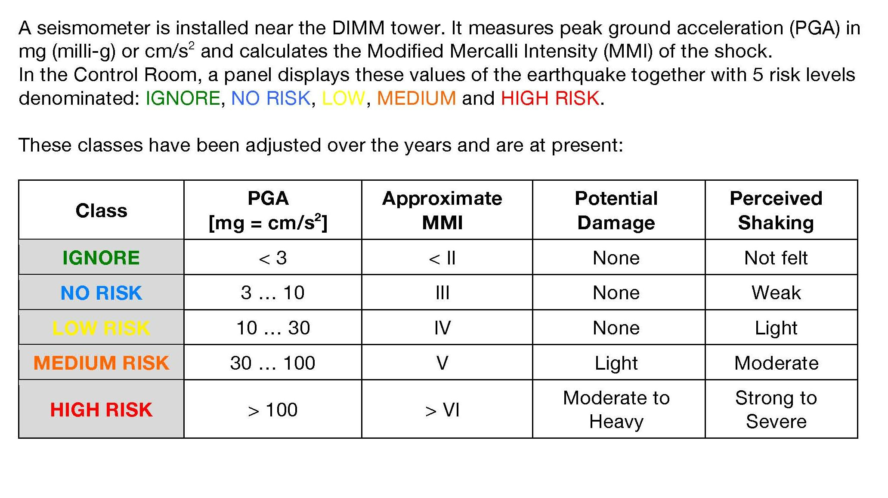
Seismic Monitor:
Classification of Earthquakes
http://safety.pl.eso.org/wiki/images/d/d0/LPO-PRO-ESO-20100-0007-V2-TA-Checklists.pdf

Slide 32
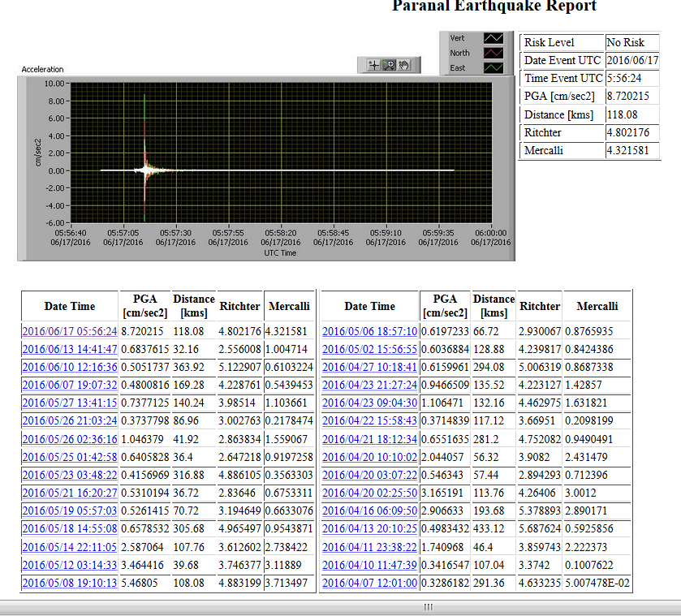
Seismic Monitor: VLT control room display

Slide 33
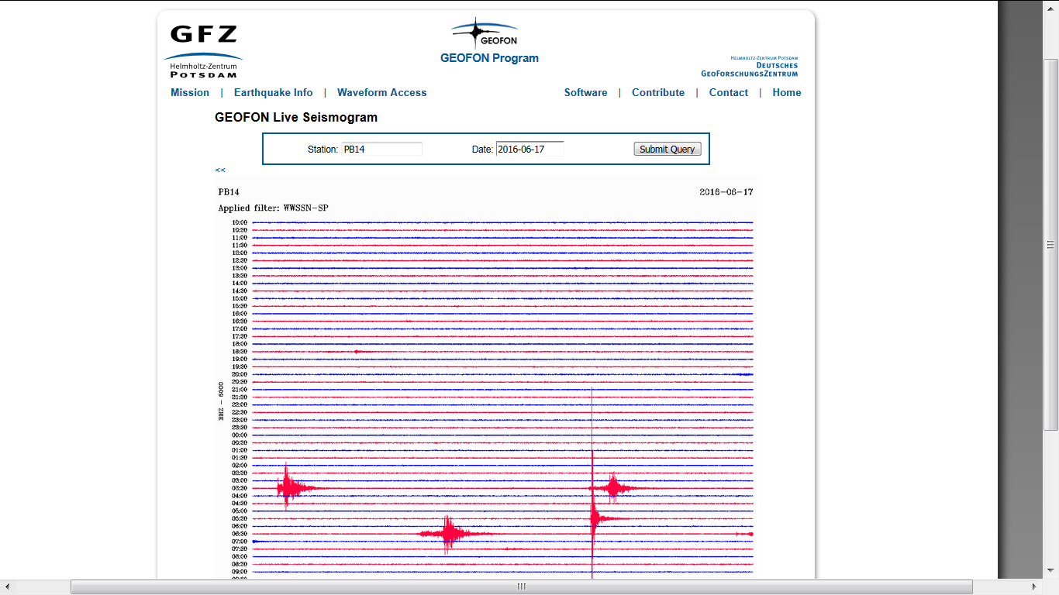
Seismic Monitor Data Archive
http://geofon.gfz-potsdam.de/waveform/liveseis.php?station=PB14

Slide 34
Parameters of interest for CTA
Lasers
11.Will airplanes fly over the CTA area? How many, at which altitude? Will there be problems with the
LIDARs? Has ESO experience with permissions to shoot lasers in the area?
12. Interaction with ESO and the optical telescopes: At which wavelengths do the telescopes operate
exactly? Do 355nm, 532nm, 910nm or 1064nm cause harm? What are the procedure to shoot lasers? Is
there an Laser Traffic Control System installed?

Slide 35
Lasers
Lasers can only be launched under certain conditions:
Any laser system propagating into the atmosphere that operates at ESO observatories has to be included in ESO’s agreement with the national aeronautical authority (DGAC).
Any laser system has to ensure an exposure level allowed by OACI (International Civil Aviation Organisation) in Doc 9815 AN/447 “Manual on laser emission and flight safety” or install safety systems that would interrupt laser emission if an airplane enters the area.
ESO has committed to equip all telescopes with laser systems with such automatic safety systems independent of the actual exposure levels. The core of the safety system are aircraft detection cameras.

Slide 36
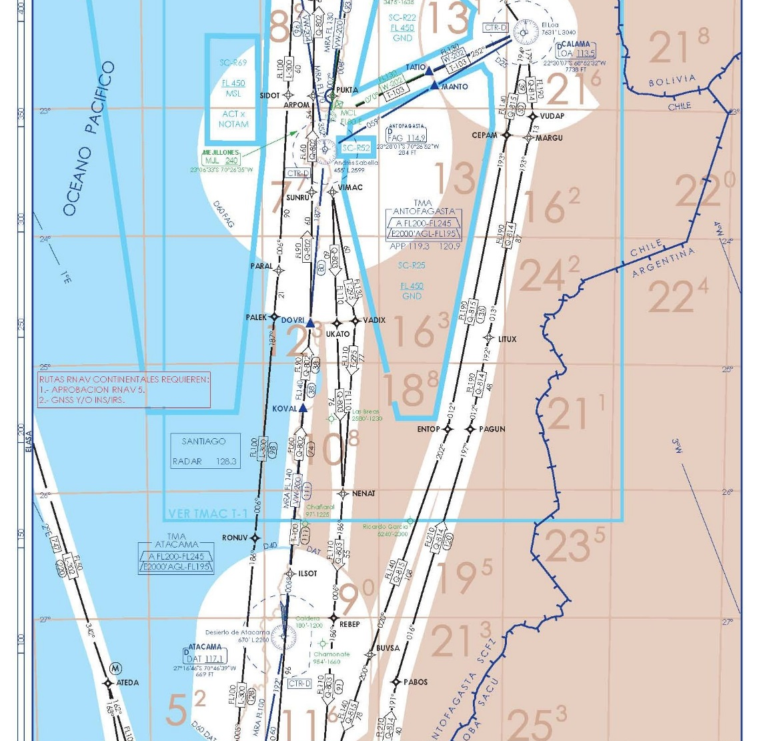
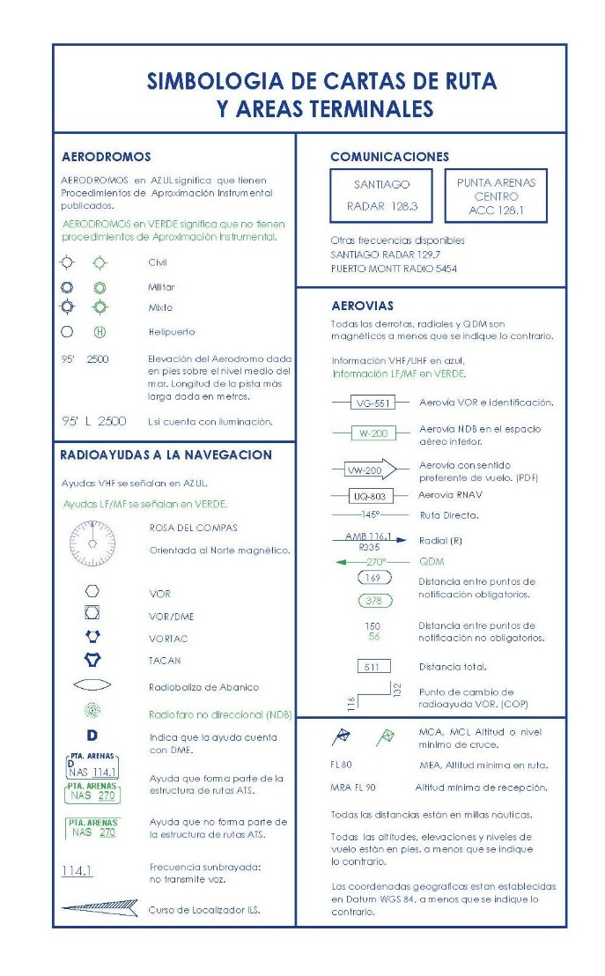
Aircraft Avoidance System
https://www.aipchile.gob.cl/dasa/aip_chile_con_contenido/ais/AMDT%20AIP%20VOL%20II%20(MAP)/AMDT%2079%20del%2003%20MAR%202016/Cartas%20de%20Aerovias.pdf

Slide 37
Lasers: LGSF Aircraft Avoidance System
In case that an airplane is approaching the beam path of any of the 4 LGS beams the Output Shutters of all the LGSU shall close.
The detection of this Hazard requires the use of existing AAS installed in Paranal. Two Aircraft Detection Cameras work in parallel; the Hazard will be detected if at least one of the cameras detects an aircraft.
At Paranal Observatory an automatic aircraft avoidance system has been implemented. The system
consists of two cameras mounted on the top ring of UT4 to create a redundant system for the LGSF.
The cameras have a field of view of 60o and have an onboard computer that performs computations
to recognize the presence of an aircraft in a predefined Region of Interest (ROI). Within the ROI, an
Aircraft Alarm Area (AAA) is defined as centered on the uplink laser beam. If the aircraft enter the
AAA then the alarm is triggered and closes the laser beam shutter in the LTS via the interlock panel
Laser guide star facility at La Silla Paranal Observatory: latest upgrades, operation, and performance
J. L. Alvarez ; J. Beltran ; I. Munoz ; G. Valdes ; F. Gutierrez ; M. Tapia ; C. Ramirez
Proc. SPIE 7736, Adaptive Optics Systems II, 77364X (July 28, 2010);

Slide 38
Lasers: Interaction with ESO and the optical telescopes
At which wavelengths do the telescopes operate exactly?
300 - 20000 nm
Do 355nm, 532nm, 910nm or 1064nm cause harm?
Yes, these wavelength fall in the bandpass of standard imaging filters and spectral ranges of existing instruments. Impact of course depends on the distance between laser and telescope, intensities, relative angles, backscattering properties. CTA has already studied the impact of Paranal lasers on their systems.
Has ESO experience with permissions to shoot lasers in the area?
Yes. ESO is operating two laser systems at Paranal, one single laser, one quadruple laser system.

Slide 39
Lasers: LGSF VLT Policies
http://www.eso.org/sci/facilities/paranal/sciops/LGSF_policies.html:
To avoid beam collisions, the minimum separation between the Rayleigh cone or the laser star and a non-laser observation is 3 arcmin, equivalent to a flux decrease of 3 orders of magnitude
The AOF Laser Traffic Control System (LTCS) entered routine operations on 1 October 2015
P. Amico et al
http://www.eso.org/sci/publications/messenger/archive/no.162-dec15/messenger-no162-19-23.pdf
Example of telescope and laser geometry. Note, that while the laser and the telescope point at
the same science target there would not be a collision for the illustrated situation.
“Operational Concept of the VLT’s Adaptive Optics Facility and its Instruments,”
Proc. SPIE 8448 (2012). H. Kuntschner, P. Amico, J. Kolb, P.Y. Madec, R. Arsenault, M. Sarazin

Slide 40
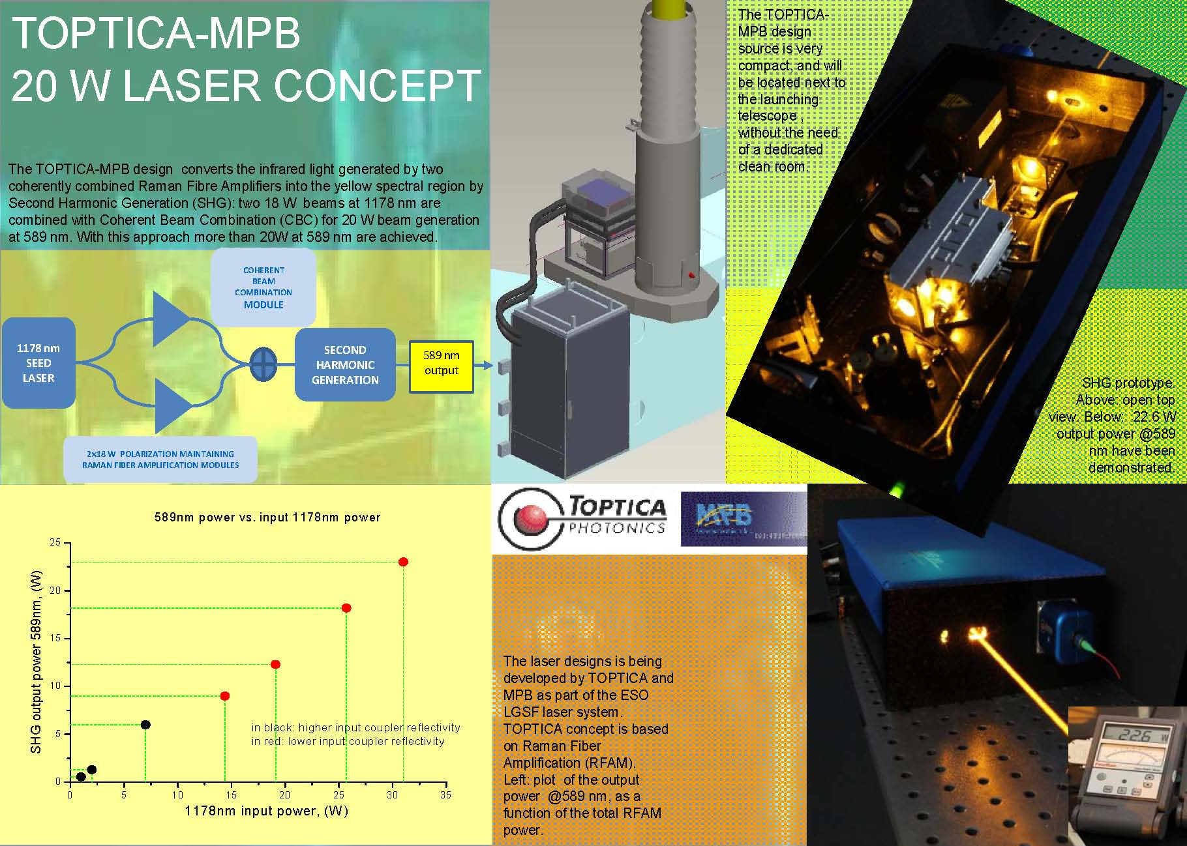
Lasers: VLT- AOF 4LGSF

Slide 41
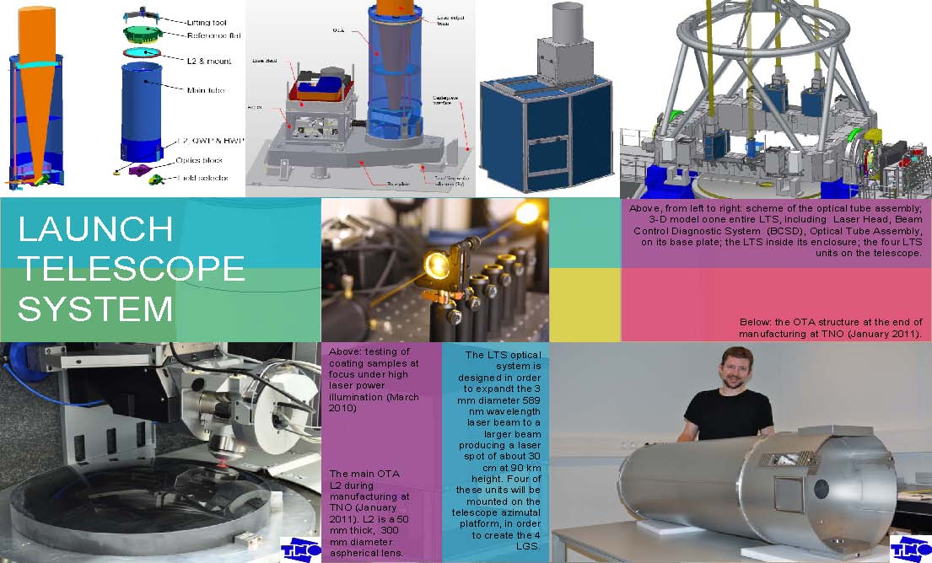
Lasers: VLT- AOF 4LGSF

